Slide 1
VISUAL COMMUNICATION USING ADOBE PHOTOSHOP CREATIVE SUITE 5
Adobe Certified Associate Certification Preparation

Slide 2
Setting Project Requirements
Ability #1

Slide 3
Objectives
Identify the purpose, audience, and audience needs for preparing image(s).
Demonstrate knowledge of standard copyright rules for images and image use.
Demonstrate knowledge of project management tasks and responsibilities.
Communicate with others (such as peers and clients) about design plans.

Slide 4
Vocabulary
Comp
Copyright
Copyrighted
Deliverables
Derivative Work
Design Comp
Fair Use Doctrine
Intellectual Property
Mockup
Project Scope
Scope Creep
Target audience

Slide 5
Objective 1.1 Identify the Purpose, Audience, and Audience Needs for Preparing Image(s)
The first step in any design process is to identify the target audience.
For what type of audience will the final product be directed?
Will the final product be aimed at a specific age group or gender?
Will the final product be geared toward a particular business, customer, or for anyone?
What are the goals of the project?
The target audience will influence the content and style of the design project.

Slide 6
Objective 1.2 Demonstrate Knowledge of Standard Copyright Rules for Images and Image Use
It is important to understand the terminology associated with copyright law.
Intellectual property refers to creations of the mind and may include copyrights, trademarks, patents, industrial design rights, and trade secrets.
Copyright is a category of intellectual property providing protection to the authors of “original works of authorship,” including literary, dramatic, musical, artistic, and certain other intellectual works.

Slide 7
Objective 1.2 Demonstrate Knowledge of Standard Copyright Rules for Images and Image Use
A derivative work is a work that is based on or derived from one or more existing works (and previously published).
Copyright attaches to a work as soon as it is created.
The 1976 Copyright Act defines publication as the distribution of copies of a work to the public by sale or other transfer of ownership, or by rental, lease, or lending.

Slide 8
Objective 1.2 Demonstrate Knowledge of Standard Copyright Rules for Images and Image Use
The use of the notice is the responsibility of the copyright owner.
The notice for visually perceptible copies should contain the following three items which should appear together in close proximity on the copies:
The symbol ©; the word Copyright; or the abbreviation Copr.
The year of first publication.
The name of the copyright owner, an abbreviation by which the name can be recognized, or a generally known alternative designation of owner (e.g., © 2013 Jane Doe).

Slide 9
Objective 1.2 Demonstrate Knowledge of Standard Copyright Rules for Images and Image Use
The fair use doctrine allows copyrighted work to be reproduced for a variety of reasons including news reporting, teaching, parody, and research.
Four factors need to be considered together when determining if the use is fair:
The purpose and character of the use, including whether such use is of a commercial nature or is for nonprofit educational purposes
The nature of the copyrighted work: Is the original primarily factual or fiction published or unpublished?
The amount and substantiality of the portion used in relation to the copyrighted work as a whole
The effect of the use upon the potential market for, or the value of, the copyrighted work

Slide 10
Objective 1.2 Demonstrate Knowledge of Standard Copyright Rules for Images and Image Use
Simply recognizing the source of the copyrighted information is not a substitute for getting permission, and except in cases of fair use, you must obtain permission for all protected material you want to use.
The Chicago Manual of Style is commonly used with all subjects, as well as in books, magazines, newspapers, and other non-scholarly publications.
The Modern Library Association (MLA) style guide is typically used by language arts and humanities.
The American Psychological Association (APA) style, is used for psychology, education, and other social sciences.

Slide 11
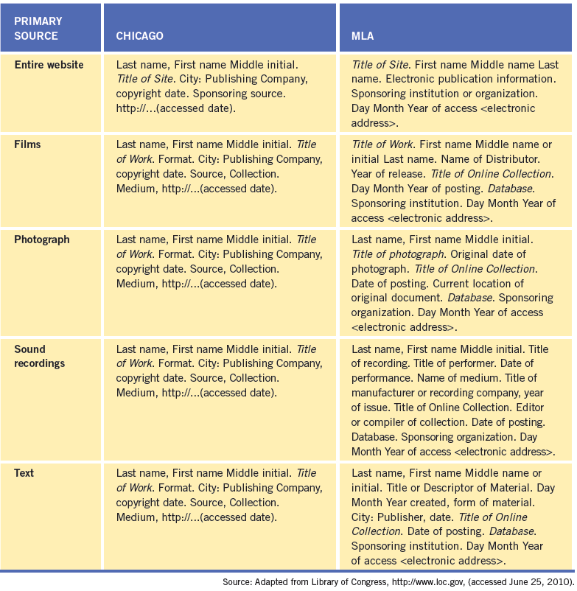
Objective 1.2 Demonstrate Knowledge of Standard Copyright Rules for Images and Image Use
Citing electronic sources

Slide 12
Objective 1.3 Demonstrate Knowledge of Project Management Tasks and Responsibilities
The design process when working the Photoshop to create a graphic design is similar to the process used when designing a web site or interactive media.
Knowing the type of project will help you write an outline for the scope of the job and the job requirements.
The outline will help you determine the project scope, how long it should take, and provide a way to verify that you have met the job specifications.

Slide 13
Objective 1.3 Demonstrate Knowledge of Project Management Tasks and Responsibilities
Once you know who you are designing for and the type of project you are designing, it is time to get inspired.
Brainstorm, research the topic, doodle, or flip through magazines to get your creativity flowing.
On a piece of paper, sketch different layout possibilities to help identify where various elements will be located.
The client may wish to view your sketches before designing anything in an electronic format.

Slide 14
Objective 1.3 Demonstrate Knowledge of Project Management Tasks and Responsibilities
You will want to create a comp, or mockup, of the design in electronic format.
A comp is a prototype or design of the layout.
A comp is presented to the client for feedback before designing the final project.
Explain to the client that it is possible to mix and match the different designs.

Slide 15
Objective 1.3 Demonstrate Knowledge of Project Management Tasks and Responsibilities
Executing a successful project is in the planning.
Stage 1—Planning and analysis: Identify the elements of the project. The items identified in this stage are called deliverables.
Stage 2—Scheduling: You need to create a schedule with due dates based on the deliverables identified in the previous step.
Stage 3—Building: You need to develop a sketch of the layout either on paper or in a graphics-editing application to show to the client. The sketch, or design comp, should meet the initial needs that were identified in stage 1 and be approved by the client before moving forward.
Stage 4—Review and evaluation: The project needs to be reviewed for accuracy to ensure the design meets the requirements set forth in the project outline.
Stage 5—Implementing or publishing: Once the final product meets the client’s satisfaction, it is time to publish the final project to the medium for which it was designed.

Slide 16
Objective 1.4 Communicate with Others (Such as Peers and Clients) About Design Plans
Your project should have a project manager to oversee the communication process and to help keep individuals on task and on time.
Scope creep refers to changes in the requirements of the project as the project is being constructed.

Slide 17
Summary
1.1 Identify the purpose, audience, and audience needs for preparing image(s).
1.2 Demonstrate knowledge of standard copyright rules for images and image use.
1.3 Demonstrate knowledge of project management tasks and responsibilities.
1.4 Communicate with others (such as peers and clients) about design plans.

