Slide 1
VISUAL COMMUNICATION USING ADOBE PHOTOSHOP CREATIVE SUITE 5
Adobe Certified Associate Certification Preparation

Slide 2
Identifying Design Elements When Preparing Images
Ability #2

Slide 3
Objectives
Demonstrate knowledge of image resolution, image size, and image file format for web, video, and print
Demonstrate knowledge of design principles, elements, and image composition
Demonstrate knowledge of typography
Demonstrate knowledge of color correction using Photoshop
Demonstrate knowledge of image-generating devices, their resulting image types, and how to access resulting images in Photoshop
Understand key terminology of digital images.

Slide 4
Vocabulary
Aspect ratio
Background
Bitmap
Camera Raw
CMYK
Cropping
Document size
Downsampled
Dpi
Field of view
Foreground
Gamut
High Dynamic Range (HDR)
Image composition
Interpolation
Line screen frequency
Lpi
Pixel
Raster Image
Readability
Resolution
RGB
Screen frequency
Screen ruling
Typography
Upsampling
Vector
Visual hierarchy

Slide 5
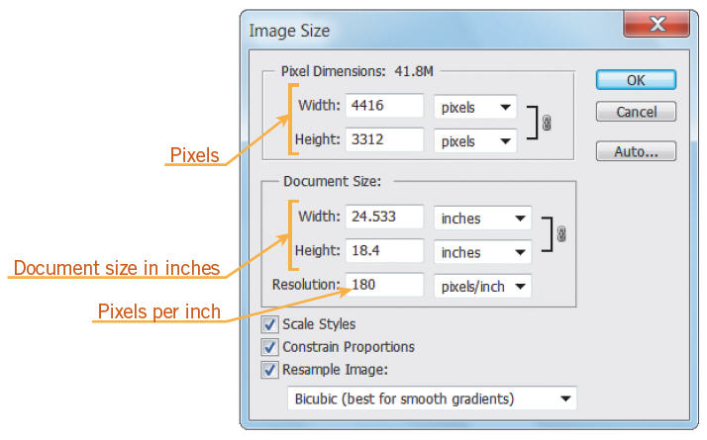
Objective 2.1 Demonstrate Knowledge of Image Resolution, Image Size, and Image File Format for Web, Video, and Print
Resizing an Image
The Image Size dialog box displays the image data, which includes the number of pixels in an image, the size of the image in inches, and the resolution.

Slide 6
Objective 2.1 Demonstrate Knowledge of Image Resolution, Image Size, and Image File Format for Web, Video, and Print
Resizing an Image
To change the image data, which affects the resolution and file size, you must resample the image, which increases or decreases the number of pixels contained in the image.
Photoshop uses a method called interpolation to resample an image, using existing pixel colors to create new color values.
You can crop an image to resize it. Cropping allows you to remove the outside portion of an image to correct its focus.

Slide 7
Objective 2.1 Demonstrate Knowledge of Image Resolution, Image Size, and Image File Format for Web, Video, and Print
Printer Resolution
The resolution on a printer is measured in ink dots per inch (dpi). The more dots per inch, the higher the image quality.
This actual number of printer dots is referred to as screen frequency, screen ruling, or line screen frequency and is measured in lines per inch (lpi).
When preparing your image for print, it is often easier to specify your image in the printed dimensions, often referred to in inches, as well as the image resolution; this is referred to as the document size.

Slide 8
Objective 2.1 Demonstrate Knowledge of Image Resolution, Image Size, and Image File Format for Web, Video, and Print
File Formats
There are many different file formats available for graphics. It is important to choose the correct file format for how and where the image will be used.
Image Optimization
The Save for Web & Devices command on the File menu provides a method to optimize images for publishing on the web and mobile devices.

Slide 9
Objective 2.2 Demonstrate Knowledge of Design Principles, Elements, and Image Composition
Graphic design includes design elements, design principles, and image composition. It is important to understand some concepts to be able to create an attractive layout.
Graphic Design Elements
Line are a long narrow straight or curved stroke.
Color is the visual perceptual property derived from the spectrum of light.
Hue is another word for color
Chroma is the intensity or purity of color
Tint is a color mixed with white
Tone is a color mixed with gray
Shade is a color mixed with black

Slide 10
Objective 2.2 Demonstrate Knowledge of Design Principles, Elements, and Image Composition
Graphic Design Elements
Color and Contrast
Using color can enhance or detract from composition
Color wheels help determine which color are in greatest contrast
Analogous colors are adjacent to each other on the color wheel
Complementary colors are opposite each other on the color wheel
Color in Design
Use color to label or show hierarchy
Use color to represent or imitate reality
Use color to unify, separate, or emphasize
Use color to decorate
Use color consistently

Slide 11
Objective 2.2 Demonstrate Knowledge of Design Principles, Elements, and Image Composition
Graphic Design Elements
Shape are enclosed objects that can be created by line or created by color and value changes that define their edges.
Texture is the surface look of an object created by varying dark and light areas.
Roughness
Smoothness
Depth

Slide 12
Objective 2.2 Demonstrate Knowledge of Design Principles, Elements, and Image Composition
Graphic Design Principles
Movement is the use of lines, color & repetition to create the illusion of motion.
Curved forms or lines
Repetition of geometric forms
Fuzzy lines or outlines
Emphasis is to express with particular stress or force.
Unity is the correct balance of composition or color that produces a harmonious effects.

Slide 13
Objective 2.2 Demonstrate Knowledge of Design Principles, Elements, and Image Composition
Graphic Design Principles
Balance is the act of comparing or estimating two things, one agains the other, and the contrast between:
empty/white space – filled space,
text – images,
color – no colors – different colors,
texture –flat colors.
Types of balance when using color, shape and position:
Symmetry
Asymmetry
Radial Symmetry
Ussually lines of symmetry can be identified as Horizontal, Vertical or Diagonal

Slide 14
Objective 2.2 Demonstrate Knowledge of Design Principles, Elements, and Image Composition
Image Composition and Principles
An image composition is the arrangement of the visual elements of your image to create a visually compelling design.
When composing or laying out your design, there are some basic concepts you should consider for your graphic design project, such as aspect ratio, framing, field of view, foreground, and background.

Slide 15
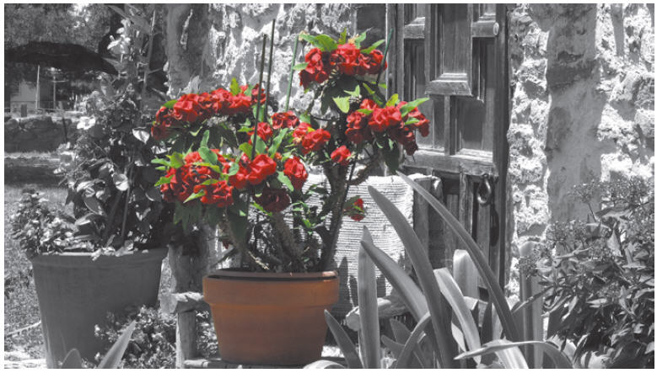
Objective 2.2 Demonstrate Knowledge of Design Principles, Elements, and Image Composition
Image Composition and Principles
Visual hierarchy is used in graphic design to emphasize important elements and organize content in a logical manner.

Slide 16
Objective 2.3 Demonstrate Knowledge of Typography
When adding text to a digital image it is important to consider the font, style, color, and spacing.
The selections made to design the text and the placement of the words are called typography.
Readability is the feeling that is conveyed to make the typeface comfortable and easy to read.

Slide 17
Objective 2.4 Demonstrate Knowledge of Color Correction Using Photoshop CS5
RGB color mode uses red (R), green (G), and blue (B) in various combinations to create the colors you see on a computer display, a television screen, or a movie in a theatre.
CMYK color mode uses cyan (C), magenta (M), yellow (Y), and black (K) to create various colors in print.
Colors that are in a range that can be displayed or printed are referred to as a gamut.

Slide 18
Objective 2.4 Demonstrate Knowledge of Color Correction Using Photoshop CS5
You can use the Histogram panel to interpret colors in an image.
High dynamic range (HDR) images allow a photographer to record a much larger range of tonal detail than can be captured in one photo.

Slide 19
Objective 2.5 Demonstrate Knowledge of Image-Generating Devices, Their Resulting Image Types, and How to Access Resulting Images in Photoshop
You can create an image with a digital or film camera and from scanning an image.
The Open command opens each image into its own Photoshop document.
The Place command allows you to place multiple images into a single document.
You can scan images directly into Photoshop by clicking File on the Application bar (Win), pointing to Import, and then clicking WIA Support.

Slide 20
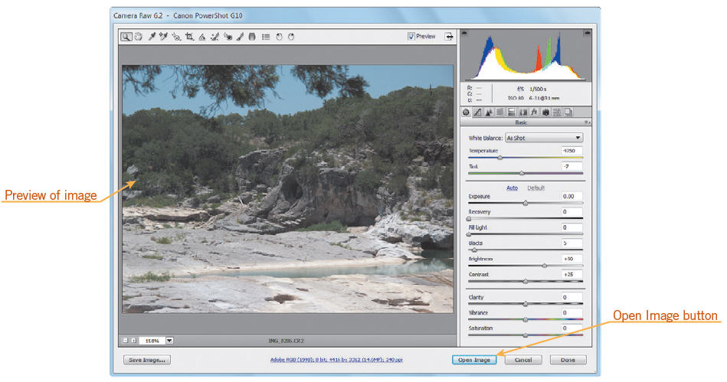
Objective 2.5 Demonstrate Knowledge of Image-Generating Devices, Their Resulting Image Types, and How to Access Resulting Images in Photoshop
The Camera Raw format contains minimally processed data that is not ready to be used and still needs to be processed.

Slide 21
Objective 2.6 Understand Key Terminology of Digital Images
Bitmap vs. Vector Graphics
A bitmap image, technically known as a raster image, is represented by pixels in a grid layout; each pixel contains color information for the image.
A vector image is created with mathematical calculations and can be enlarged without a loss of quality.

Slide 22
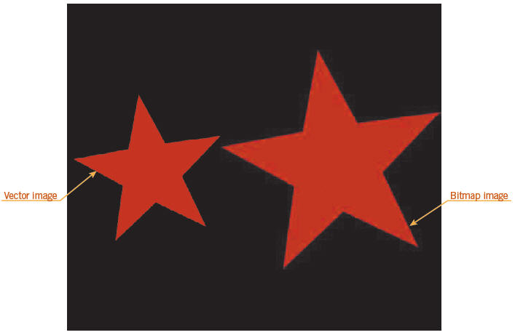
Objective 2.6 Understand Key Terminology of Digital Images
Bitmap vs. Vector Graphics

Slide 23
Summary
2.1 Demonstrate knowledge of image resolution, image size, and image file format for web, video, and print
2.2 Demonstrate knowledge of design principles, elements, and image composition
2.3 Demonstrate knowledge of typography
2.4 Demonstrate knowledge of color correction using Photoshop CS5.
2.5 Demonstrate knowledge of image-generating devices, their resulting image types, and how to access resulting images in Photoshop
2.6 Understand key terminology of digital images.

