Slide 1
VISUAL COMMUNICATION USING ADOBE PHOTOSHOP CREATIVE SUITE 5
Adobe Certified Associate Certification Preparation

Slide 2
Manipulating Images Using Adobe Photoshop CS5
Ability #4

Slide 3
Objectives
Demonstrate knowledge of working with selections and measurement.
Use Photoshop guides and rulers.
Transform images.
Adjust or correct the tonal range, color, or distortions of an image.
Demonstrate knowledge of retouching and blending images.
Demonstrate knowledge of drawing and painting.
Demonstrate knowledge of type.
Demonstrate knowledge of filters.

Slide 4
Vocabulary
Anti-aliasing
Channel compositing
Droplet
Edge halo
Feathering
Marching ants
Refine edge

Slide 5
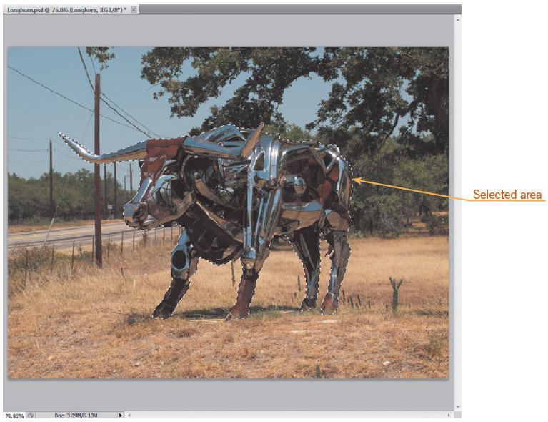
Objective 4.1 Demonstrate Knowledge of Working with Selections and Measurement
Marching ants is the term used for an active selection.

Slide 6
Objective 4.1 Demonstrate Knowledge of Working with Selections and Measurement
Selection Commands
All—Selects everything on the active layer
Deselect—Removes the selection
Reselect—Reactivates the previous selection
Inverse—Reverses the selection to the opposite of what is currently selected
Copying and Cutting a Selection
You can cut, copy, or paste a selection, as in other applications.
Working with Selections
In the Save Selection dialog box, you can name the selection, save the selection in the current document or in a new document, and add the current selection to a previously saved selection, known as a channel.
The refine edge option uses truer edge technology to improve selections.

Slide 7
Objective 4.1 Demonstrate Knowledge of Working with Selections and Measurement
Modifying Selections
An edge halo, also called fringing or matting, are the fringe pixels in the background that are difficult to isolate and remove.
Touch-Up Brushes
The retouching tools include a set of brushes that remove imperfections in images.
Undoing a Selection
The History panel allows you to view the exact commands that you have executed and step back several steps at one time.
Taking Measurements
To measure areas of an image, you can use tools and commands available on the Analysis menu.

Slide 8
Objective 4.1 Demonstrate Knowledge of Working with Selections and Measurement
Compositing Images
Compositing an image combines multiple images into a single image.
Use feathering to blur the edge of the selection and use anti-aliasing to smooth the edges between multiple images.
Batch Processing
If you have many images to which you would like to apply the same techniques, you can use batch processing to repeat repetitive actions automatically.
If you want to repeat certain actions using multiple images, you can turn an action into a droplet.

Slide 9
Objective 4.2 Use Photoshop Guides and Rulers
Guides and grids are useful when you need to align elements such as text in the document.

Slide 10
Objective 4.3 Transform Images
Photoshop allows you to transform entire images, individual layers, or specific selections.
You can alter the appearance of an object by scaling, rotating, skewing, distorting, changing the perspective, and flipping it horizontally or vertically.

Slide 11
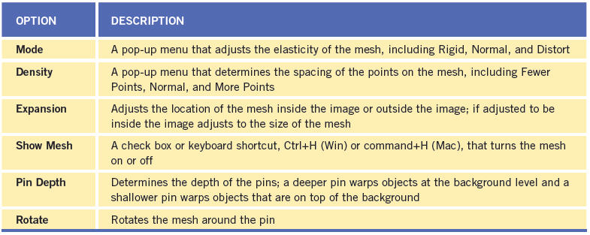
Objective 4.3 Transform Images
Puppet Warp options

Slide 12
Objective 4.3 Transform Images
Opacity and Fill Options
You can adjust a layer’s opacity and fill in the Layers panel.

Slide 13
Objective 4.4 Adjust or Correct the Tonal Range, Color, or Distortions of an Image
You can adjust the tonal range of an image, such as auto contrast, auto levels, and auto color, using commands on the Image menu.

Slide 14
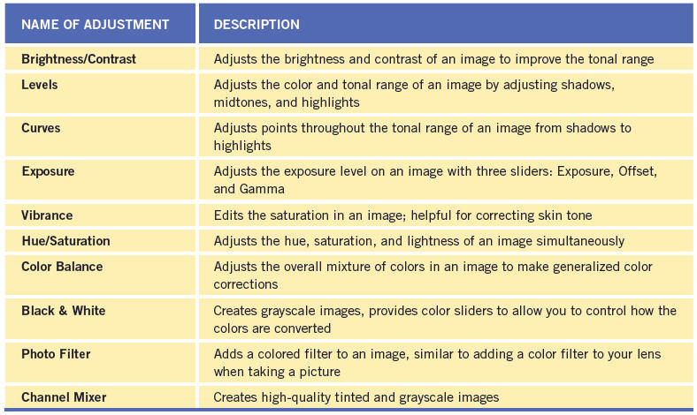
Objective 4.4 Adjust or Correct the Tonal Range, Color, or Distortions of an Image
Adjustment options

Slide 15
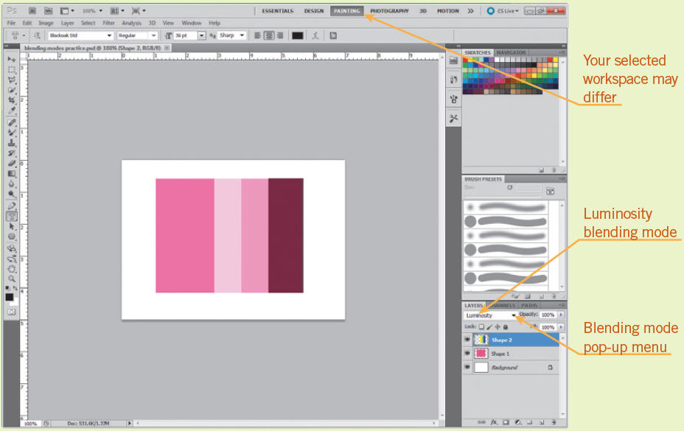
Objective 4.5 Demonstrate Knowledge of Retouching and Blending Image
Blending modes change how the selected layer blends with the layer just below it.

Slide 16
Objective 4.6 Demonstrate Knowledge of Drawing and Painting
Drawing Tools
You can choose three modes before starting to draw a shape with a shape tool or a path with a Pen tool—shape layers, paths, or fill pixels.
Brush Options
Brush tool options can be customized using the Brush panel.

Slide 17
Objective 4.7 Demonstrate Knowledge of Type
The options bar provides basic options such as font, style, size, alignment, and color. Additional formatting options are available in the Character and Paragraph panels, which you can open on the Windows menu.

Slide 18
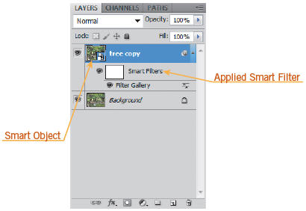
Objective 4.8 Demonstrate Knowledge of Filters
To open the Filters Gallery, click Filter Gallery on the Filter menu. You can preview filters, apply multiple filters, rearrange their order, and adjust individual filters.

Slide 19
Summary
4.1 Demonstrate Knowledge of Working with Selections and Measurement
4.2 Use Photoshop Guides and Rulers
4.3 Transform Images
4.4 Adjust or Correct the Tonal Range, Color, or Distortions of an Image
4.5 Demonstrate Knowledge of Retouching and Blending Image
4.6 Demonstrate Knowledge of Drawing and Painting
4.7 Demonstrate Knowledge of Type
4.8 Demonstrate Knowledge of Filters

