Slide 1



SAP S/4HANA Configuration
Phase 0 - Introduction

Slide 2
4.3 (August 2025)
SAP S/4HANA 2023
Fiori 3.0
Global Bike
none

Slide 3
Stefan Weidner
Beginner

Slide 4
You are able to
Understand the structure of the ERP configuration curriculum, especially phase 0,
Identify relevant aspects of the Global Bike story,
analyze scenarios, identify problems and find solutions.

Slide 5
Agenda
Introduction to ERP Configuration Curriculum
Introduction to Global Bike
Scenario Analysis
Problem Identification
Problem Analysis / Solution Finding
[OPTIONAL] Project Planning

Slide 6
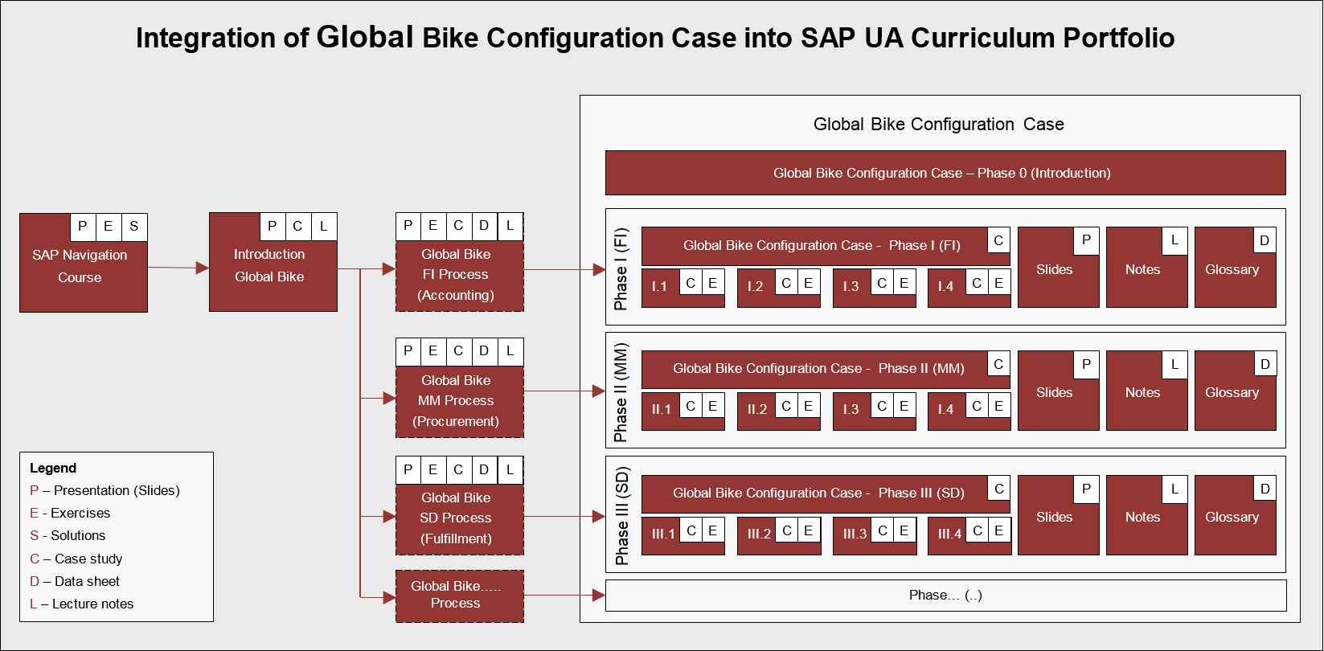
ERP Configuration Case Using Global Bike

Slide 7
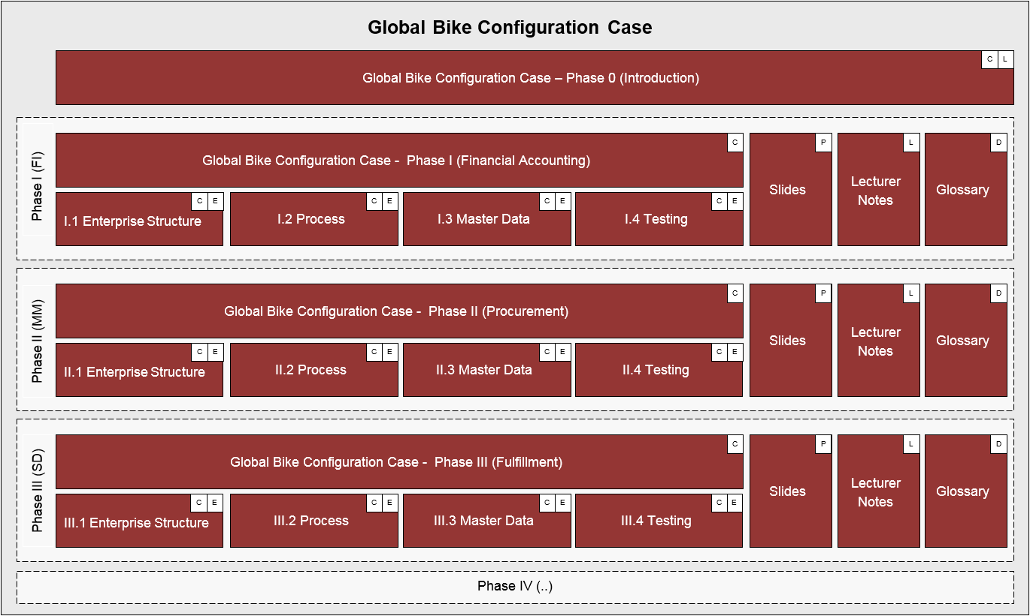
ERP Configuration Case Using Global Bike

Slide 8
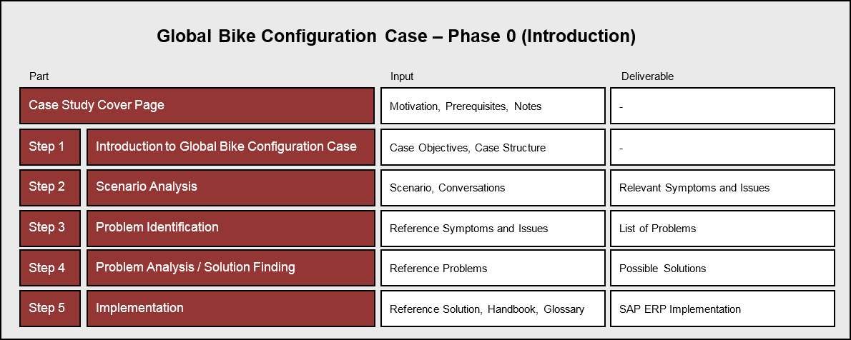
ERP Configuration Case – Phase 0

Slide 9
Agenda
Introduction to ERP Configuration Curriculum
Introduction to Global Bike
Scenario Analysis
Problem Identification
Problem Analysis / Solution Finding
[OPTIONAL] Project Planning

Slide 10

Introduction to Global Bike
GBI story document with
  Company history
  Corporate overview
  Product strategy
  Manufacturing strategy
  Distribution network
  Partner network
  IT strategy

Slide 11
Agenda
Introduction to ERP Configuration Curriculum
Introduction to Global Bike
Scenario Analysis
Problem Identification
Problem Analysis / Solution Finding
[OPTIONAL] Project Planning

Slide 12
Scenario
Task Read the scenario and highlight the most important and relevant information.
Short Description Read through the scenario and critically analyze the challenges employees are facing in this company. Focus particularly on the core statements during the conversations.
Name (Position) Jermain Kumins (Shop Floor Worker 1)
Jun Lee (Production Supervisor)
Ricardo Robles (Warehouse Supervisor)
Juriko Hamada (Shipping Clerk)
Silvia Cassano (Accountant Payable Specialist GBI US)

Slide 13
Agenda
Introduction to ERP Configuration Curriculum
Introduction to Global Bike
Scenario Analysis
Problem Identification
Problem Analysis / Solution Finding
[OPTIONAL] Project Planning

Slide 14
Problem Identification
Task Revisit the reference symptoms/issues and condense them into the problems specific to this case.
Short Description You (in the role of Mona Falco – System Design and Dev Manager) need to come to a clear understanding of the most relevant symptoms in the respective organizational units in order to identify the causes and underlying problems.
Name (Position) Bianca Cavarini (Chief Information Officer)
Mona Falco (System Design and Development Manager)

Slide 15
Agenda
Introduction to ERP Configuration Curriculum
Introduction to Global Bike
Scenario Analysis
Problem Identification
Problem Analysis / Solution Finding
[OPTIONAL] Project Planning

Slide 16
Problem Analysis / Solution Finding
Task Revisit the reference problems and identify possible solutions for Global Bike.
Short Description In the role of Mona Falco (System Design and Dev Manager) and Rick Sanchez (Business Analyst 1), establish an effective baseline to spot the key problems quickly and come up with a solution to optimize performance.
Name (Position) Mona Falco (System Design and Development Manager)
Rick Sanchez (Business Analyst 1)

Slide 17
Agenda
Introduction to ERP Configuration Curriculum
Introduction to Global Bike
Scenario Analysis
Problem Identification
Problem Analysis / Solution Finding
[OPTIONAL] Project Planning

Slide 18
Project Planning
Task Revisit the reference solution and develop a project proposal.
Short Description In order for Mona Falco and Rick Sanchez to prepare for a corporate executive board presentation they need to evaluate the reference solution and fill in the Global Bike project proposal template.
Name (Position) Bianca Cavarini (Chief Information Officer)
Mona Falco (System Design and Development Manager)
Rick Sanchez (Business Analyst 1)

