Slide 1
SAP S/4HANA Configuration
Phase I – Financial Accounting

Slide 2
4.2 (March 2024)
SAP S/4HANA 2020
GUI 7.70
Global Bike
None

Slide 3
Simha Magal
Stefan Weidner
Advanced

Slide 4
You are able to:
Understand the structure of the ERP configuration curriculum, especially phase I
Define the central organizational structures for financial accounting
Analyze scenarios
Do the necessary steps for financial accounting configuration
Explain the common processes in financial accounting
Identify integration points between financial accounting and controlling.

Slide 5
Agenda
Introduction
Scenario
Enterprise structure
Process configuration
Master data
Process execution

Slide 6
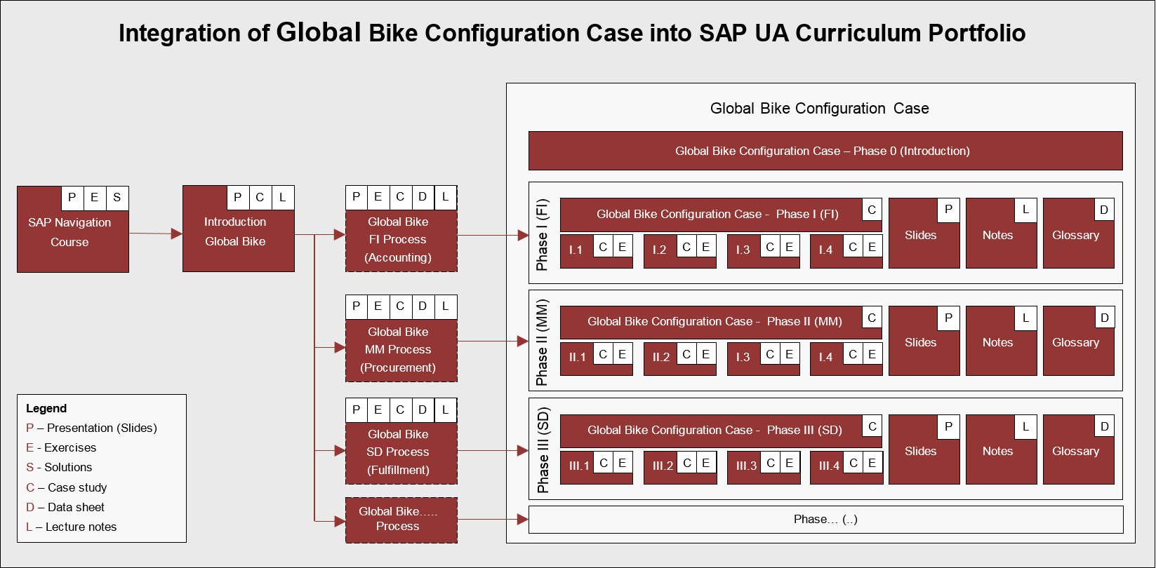
ERP Configuration Case Using Global Bike

Slide 7
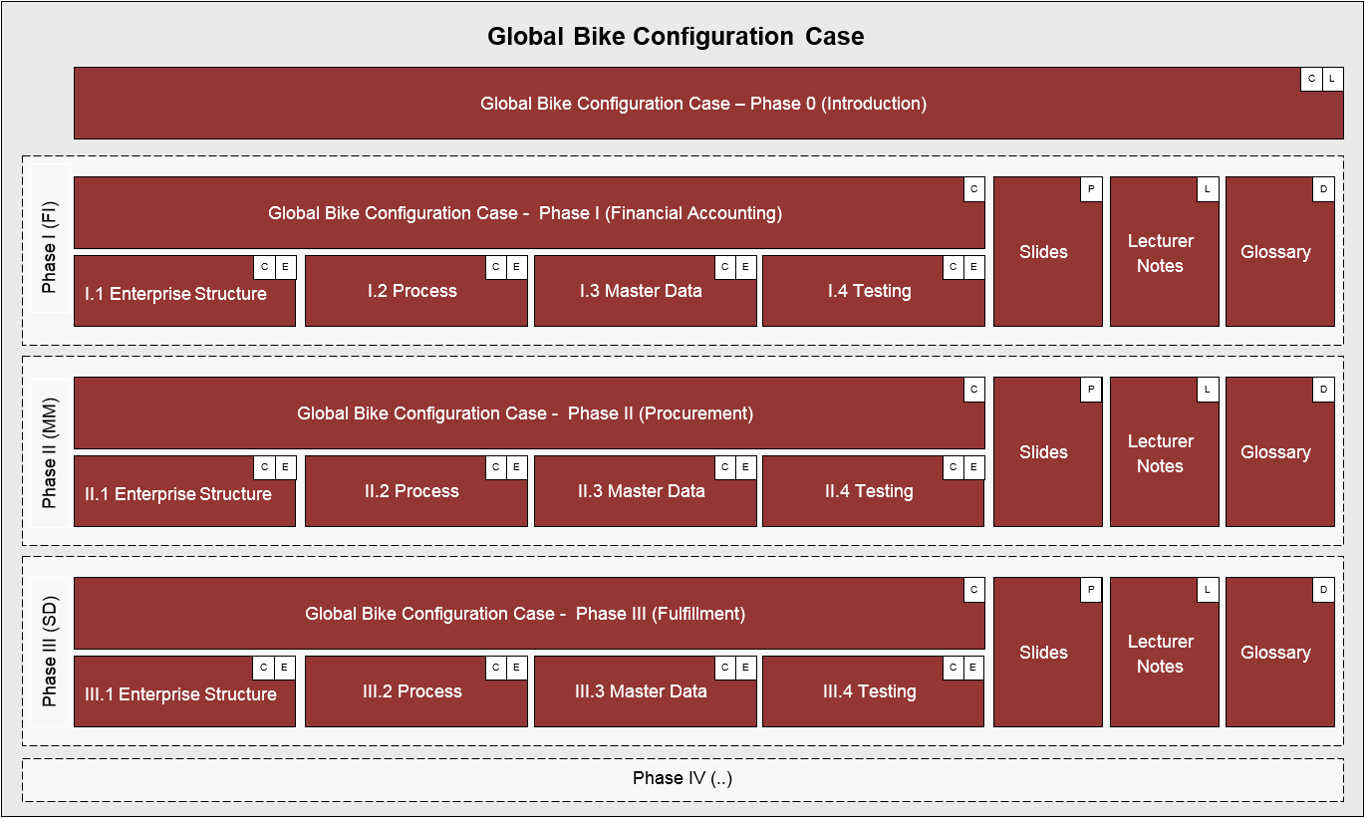
ERP Configuration Case Using Global Bike

Slide 8
ERP Configuration Case – Phase I

Slide 9
Agenda
Introduction
Scenario
Enterprise structure
Process configuration
Master data
Process execution

Slide 10
Scenario
In 2008, Global Bike Inc. starts implementing SAP S/4HANA.
In a preparation project (phase 0), the scope of the implementation project was defined.
In project phase I, Bianca Cavarini (Chief Information Officer) and her team are now tasked with the setup of basic Financial Accounting processes in the S/4HANA system.
In order to do so they are observing the work of the following GBI employees in the Financial Accounting department:
Silvia Cassano (Accountant Payable Specialist GBI US)
Stephanie Bernard (Billing Clerk Accounts Receivable GBI US)
Shuyuan Chen (Chief Accountant GBI US)
Task Read the scenario and highlight the most important and relevant information.

Slide 11
Problem Analysis and Solution Finding
Task Revisit the reference symptoms/issues and condense them into the problems specific to this case.
Short Description You (in the role Mona Falco; System Design and Dev Manager) need to come to a clear understanding of the most relevant symptoms in Financial Accounting in order to identify the causes and underlying problems including the issue of duplicate invoice numbers that was just reported by Shuyuan Chen.
Task Revisit the reference problems and identify possible solutions for Global Bike.
Short Description In the role of Mona Falco and Sarah Garcia (Business Analyst 2), analyze all relevant problems in Financial Accounting and find possible solutions.

Slide 12
Agenda
Enterprise Structure
Process Configuration
Master Data
Process
Execution
Introduction
Scenario
Enterprise structure
Process configuration
Master data
Process execution

Slide 13
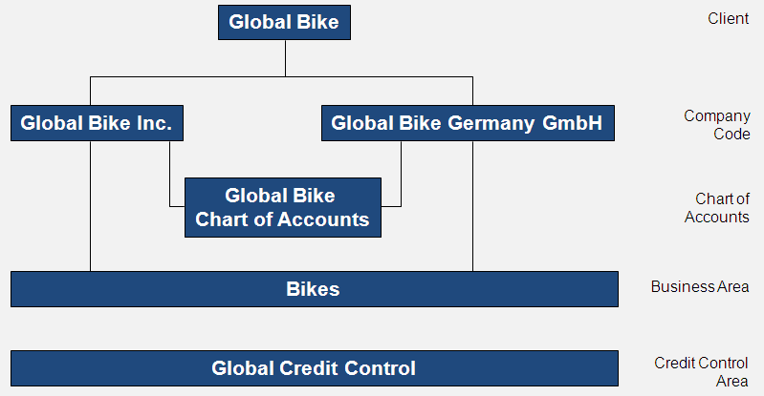
Enterprise Structure – Financial Accounting

Slide 14
Client
In commercial, organizational, and technical terms, a self-contained unit in an SAP system with separate master records and its own set of tables.
Represents the largest organizational unit implemented within an SAP system, e.g.:
Global Enterprises
Consolidated concern
Corporation
Holding
In this context: Global Bike Group.
Identified by a three-digit number, e.g. 200.
Client Global Bike Group

Slide 15
Company Code
The smallest organizational unit of Financial Accounting for which a complete self-contained set of accounts can be drawn up for purposes of external reporting.
This includes recording of all relevant transactions and generating all supporting documents required for financial statements.
Key organizational level for Financial Accounting:
Books are maintained at company code level
Financial statements (Balance sheet, profit and loss statement) are generated for company codes
In this context: Global Bike Inc. (US), Global Bike Germany GmbH (DE).
Identified by a four-digit alphanumeric ID, e.g. US00.
CC US##
CC DE##
Client Global Bike Group

Slide 16
Chart of Accounts
A classification scheme consisting of a group of general ledger (G/L) accounts.
A chart of accounts provides a framework for the recording of values to ensure an orderly rendering of accounting data.
The G/L accounts it contains are used by one or more company codes. A chart of accounts must be assigned to each company code. This chart of accounts is the operative chart of accounts and is used in both financial accounting and cost accounting.
In this context: one global chart of accounts for Global Bike.
Identified by a four-digit alphanumeric ID, e.g. GL00.
CC US##
CC DE##
Chart of Accounts (global) GL##
Client Global Bike Group

Slide 17
Credit Control Area
An organizational unit that represents an area responsible for granting and monitoring credit.
This organizational unit handles either one single company code or, if credit control is performed across several companies. Multi company codes.
Credit information can be made available per customer within a credit control area.
Centralized or decentralized
For global enterprises or subsidiaries (e.g. North America, Europe, Asia)
In this context: global credit management.
Identified by a four-digit alphanumeric ID, e.g. GL00.
CC US##
CC DE##
Chart of Accounts (global) GL##
Credit Control Area (global) GL##
Client Global Bike Group

Slide 18
Business Area
An organizational unit of Financial Accounting that represents a separate area of operations or responsibilities within an organization and to which value changes recorded in Financial Accounting can be allocated.
You can create financial statements for business areas and use them for various internal reporting purposes (segmentation).
In this context: Bikes.
Identified by a four-digit alphanumeric ID, e.g. BI00.
Business Area Bikes BI##
CC US##
CC DE##
Chart of Accounts (global) GL##
Credit Control Area (global) GL##
Client Global Bike Group

Slide 19
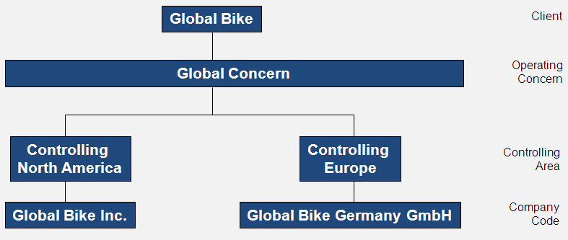
Enterprise Structure – Controlling (basics)

Slide 20
Controlling Area
An organizational unit within a company, used to represent a closed system for cost accounting purposes.
A controlling area may include single or multiple company codes that may use different currencies. These company codes must use the same operative chart of accounts.
All internal allocations refer exclusively to objects in the same controlling area.
In this context: North America, Europe.
Identified by a four-digit alphanumeric ID, e.g. NA00.
Business Area Bikes BI##
CC US##
CC DE##
Chart of Accounts (global) GL##
Credit Control Area (global) GL##
CA North Am. NA##
CA Europe EU##
Client Global Bike Group

Slide 21
Operating Concern
A representation of a part of an organization for which the sales market is structured in a uniform manner.
By setting off the costs against the revenues, an operating profit can be calculated for the individual market segments that are defined by a combination of classifying characteristics (such as product group, customer group, country, or distribution channel). The market segments are called profitability segments.
Relevant and used for profitability analysis.
Several controlling areas can be assigned to an operating concern.
In this context: global operating concern.
Identified by a four-digit alphanumeric ID, e.g. GL00
Business Area Bikes BI##
CC US##
CC DE##
Chart of Accounts (global) GL##
Credit Control Area (global) GL##
CA North Am. NA##
CA Europe EU##
Operating Concern (global) GL00
Client Global Bike Group

Slide 22
Enterprise Structure SAP S/4HANA
Business Area Bikes BI##
CC US##
CC DE##
Company Code
Chart of Accounts (global) GL##
Credit Control Area (global) GL##
CA North Am. NA##
CA Europe EU##
Controlling Area
Operating Concern (global) GL00
Client Global Bike Group

Slide 23
[OPTIONAL] Handbook Tasks
Operating concern (Global: GL00)
Technical reason for not using GL##
Operating concern is a cross-client (SAP system-wide) change
Company code (US company: US##)
Business area (Bikes: BI##)
Chart of accounts (Global: GL##)
Controlling area (North America: NA##)
Credit control area (Global: GL##)

Slide 24
[OPTIONAL] Handbook Tasks
Variant for posting periods.
Field status variant and field status groups.
Company code parameters:
Chart of accounts
Credit control area
Fiscal year variant:
Define accounting fiscal year
Create normal posting periods
Create special periods for adjustments

Slide 25
[OPTIONAL] Handbook Tasks
Assign company code to controlling area.
Assign controlling area to operating concern.
Parameters for controlling area.
Assign credit control area to company code.
Initialize posting period.

Slide 26
Agenda
Enterprise Structure
Process Configuration
Master Data
Process
Execution
Introduction
Scenario
Enterprise structure
Process configuration
Master data
Process execution

Slide 27
[OPTIONAL] Handbook Tasks
Set up company code for payment transactions.
Account groups:
Groups accounts with similar characteristics
Define number ranges
Define field status
Number ranges for financial accounting.
Number ranges for controlling.
Tolerance groups.

Slide 28
Agenda
Enterprise Structure
Process Configuration
Master Data
Process
Execution
Introduction
Scenario
Enterprise structure
Process configuration
Master data
Process execution

Slide 29
General Ledger Accounts
Used to record all accounting impact of business transactions.
Data in general ledger accounts are segmented by organizational level:
Chart of Accounts (CoA) segment
Company code segment
General ledger = CoA data + company code data

Slide 30
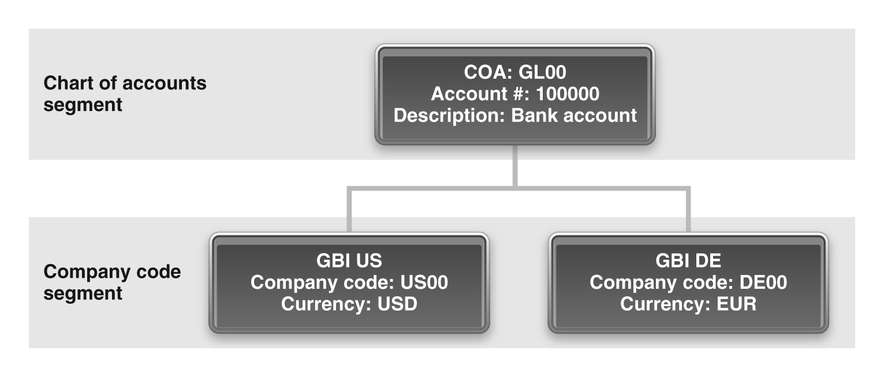
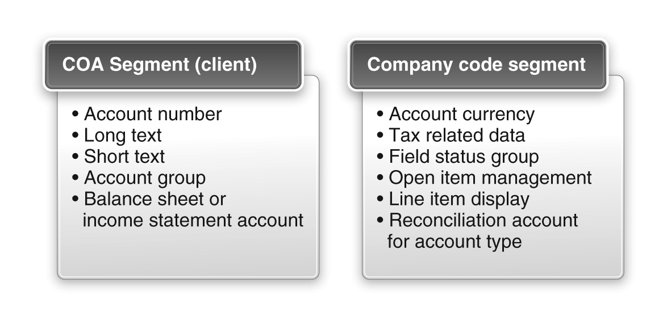
General Ledger Accounts

Slide 31
Sub-ledger and Reconciliation Accounts
Subsidiary Ledgers
Are not part of the general ledger.
Used to separate accounting for customers, vendors, and assets
Reconciliation Accounts
Are general ledger accounts
Cannot be posted to directly
Maintain the sum of the postings in sub-ledgers
Are specified in the definition of the sub-ledger
Sub ledger account | Reconciliation account
Customer | Accounts Receivable
Vendor | Accounts Payable
Asset (specific) | Assets

Slide 32
Cost Center
Location where costs are incurred:
Department, individuals, special projects
Examples
Copy center
Security department
IT Help desk
Cost bucket used to accumulate costs:
Typically Overhead costs
Payroll
Rent
Utilities
Responsible for cost containment
Accumulated costs are then “charged” to other cost centers
Many processes have “orders”:
Purchase orders, Production orders, Sales orders
Expenses can be charged to these orders
Collectively objects that can absorb costs are called controlling objects

Slide 33
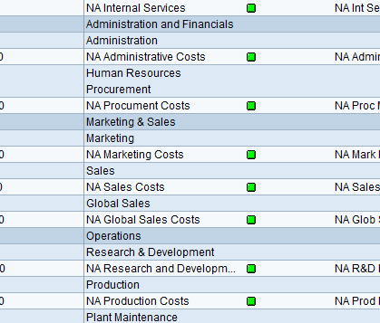
Standard (Cost Center) Hierarchy

Slide 34
Cost Elements
Since SAP S/4HANA primary and secondary cost types are mapped via G/L accounts.
The G/L accounts are therefore used for postings in Financial Accounting (FI) and Controlling (CO) at the same time.
The postings to the G/L accounts of the cost elements can be used both in the context of business transactions in FI and for the purposes of internal cost allocation in CO.
The distinction between primary and secondary costs is made on the basis of the cost type:
Primary cost types
e.g. material costs, personnel costs, rental costs, energy costs
Secondary cost types
Costs for internal cost allocation
Imputed depreciation
Imputed interest
Allocation of administrative costs

Slide 35
Real-time integration between FI and CO
FI
CO
Supplies Expense
Bank Account
Primary
Cost Element
Debit
Credit
Debit
Credit
500
500
500
NAAD1000: Administrative
Costs

Slide 36
[OPTIONAL] Handbook Tasks
General ledger accounts:
Balance sheet accounts
Income statement accounts
Reconciliation accounts
Standard (cost center) hierarchy.
Cost elements:
Primary cost elements
Secondary cost elements
Cost center groups.
Open posting period.

Slide 37
Agenda
Enterprise Structure
Process Configuration
Master Data
Process
Execution
Introduction
Scenario
Enterprise structure
Process configuration
Master data
Process execution

Slide 38
Business Processes in Financial Accounting
Recording of value flows ($$) as a result of other processes and transactions:
General Ledger Accounting (FI-GL)
G/L postings for rent, utilities, wages, etc.
Accounts Payable Accounting (FI-AP)
Part of the procurement process
Accounts Receivable Accounting (FI-AR)
Part of the fulfillment process
Asset Accounting (FI-AA)
Acquisition, depreciation, retirement

Slide 39
General Ledger Accounting
Concerned with recording the financial impact of all process steps performed within the organization.
Double-entry accounting is used for every transaction.

Slide 40
Accounts Payable Accounting
Concerned with vendors.
Involve sub-ledgers to track money owed to individual vendors: vendor master.
Involve reconciliation accounts: Accounts payable-reconciliation.
Note A non-reconciliation AP account (payables-miscellaneous) also exists in GBI.
Involves the GR/IR account (discussed in Phase III – Procurement).

Slide 41
Accounts Payable Accounting

Slide 42
Accounts Receivable Accounting
Concerned with customers.
Involve sub-ledgers to track money owed by individual customers: customer master.
Involves reconciliations accounts: Accounts receivable-reconciliation.
Note A non-reconciliation AR account (Misc AR) also exists in GBI.

Slide 43
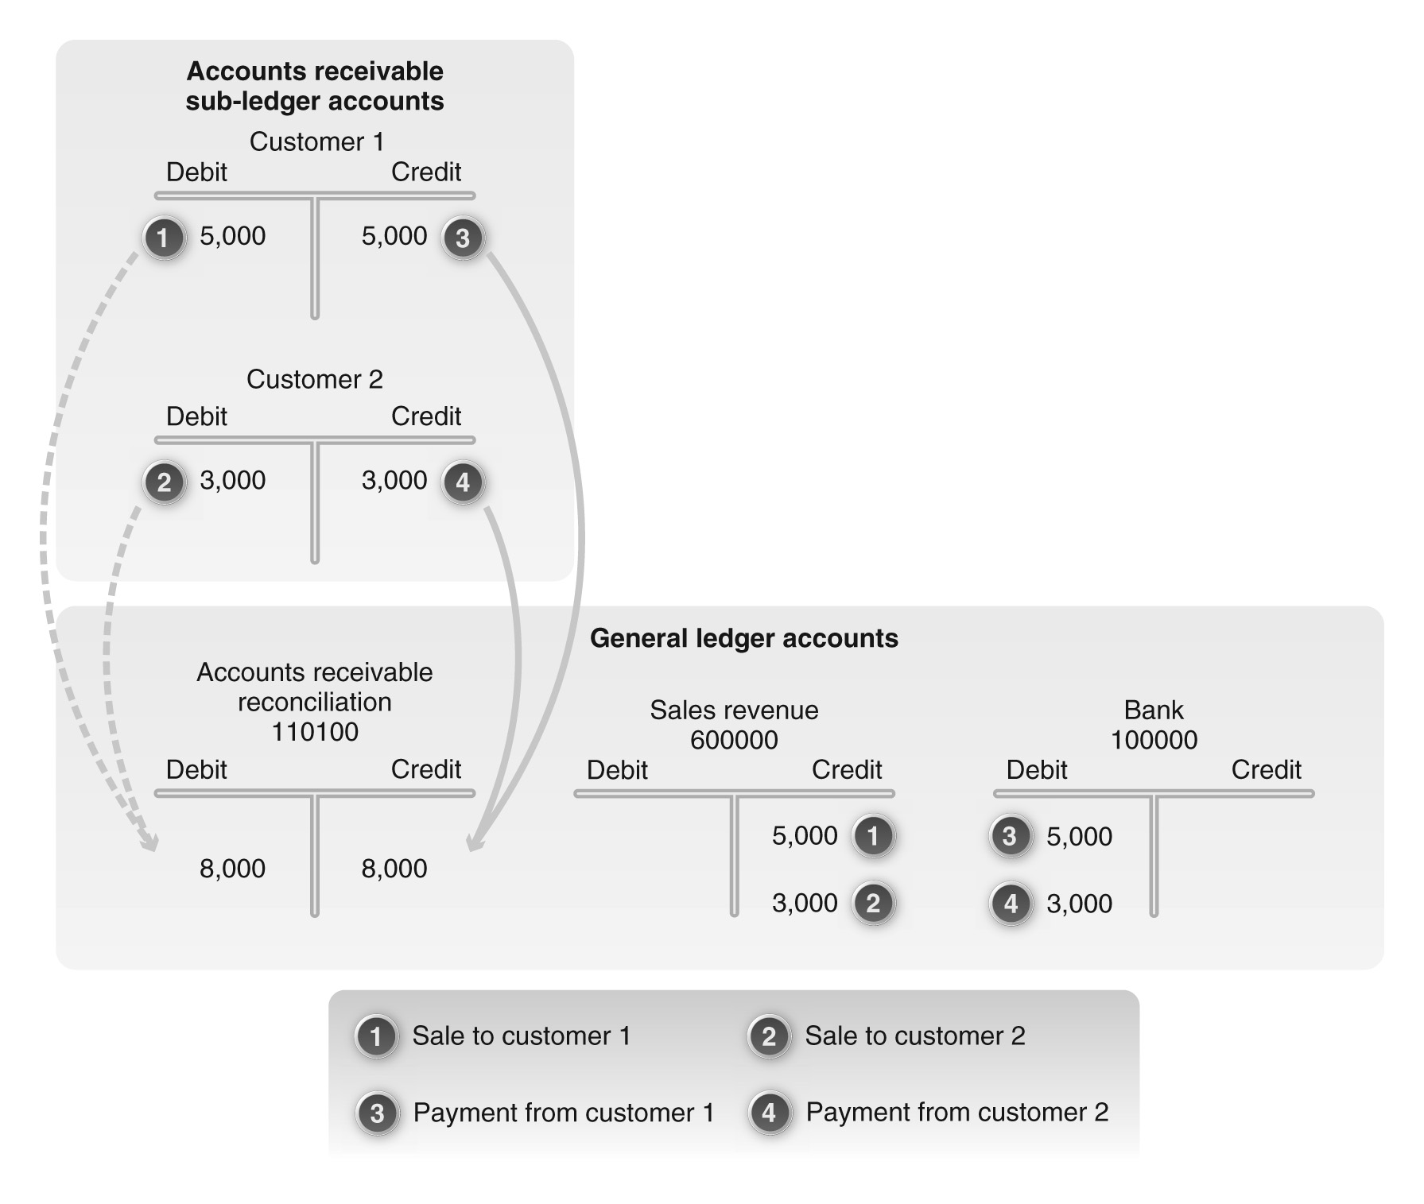
Accounts Receivable Accounting

Slide 44
[OPTIONAL] Handbook Tasks
Display General Ledger Accounts
Display Balance I
Enter General Ledger Account Posting
Display Balance II

