Slide 1
SAP S/4HANA Configuration
Phase II - Procurement

Slide 2
4.2 (March 2024)
SAP S/4HANA 2020
GUI 7.70
Global Bike
None

Slide 3
Simha Magal
Stefan Weidner
Advanced

Slide 4
You are able to:
Understand the structure of the ERP configuration curriculum, especially phase II.
Define the central organizational structures for material management.
Analyze scenarios.
Do the necessary steps for materials management configuration.
Explain common processes in materials management.

Slide 5
Agenda
Introduction
Scenario
Enterprise structure
Process configuration
Master data
Process execution

Slide 6
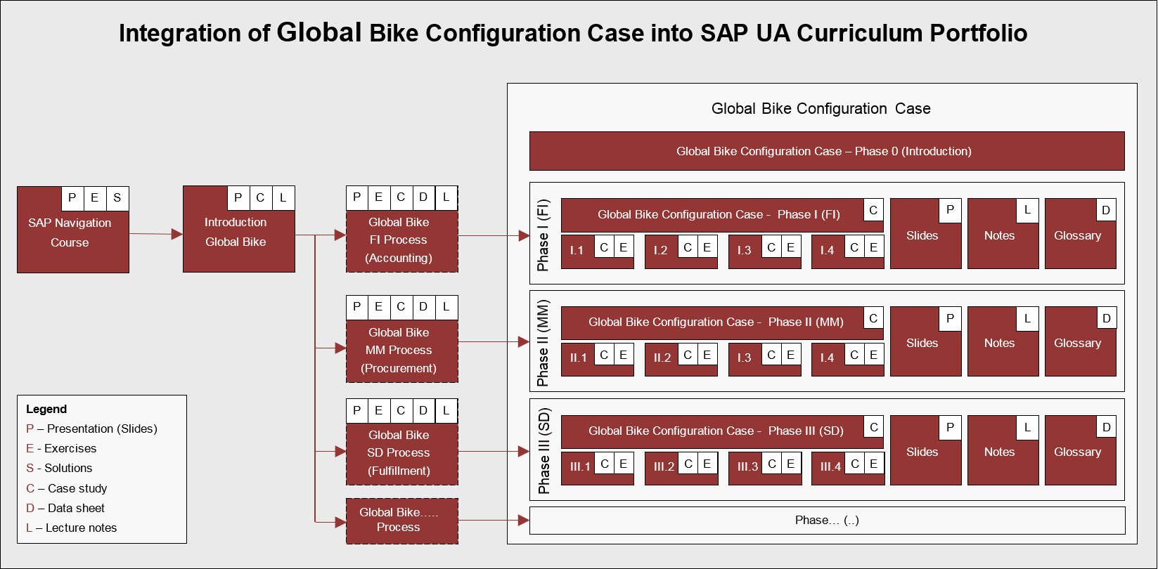
ERP Configuration Case Using Global Bike

Slide 7
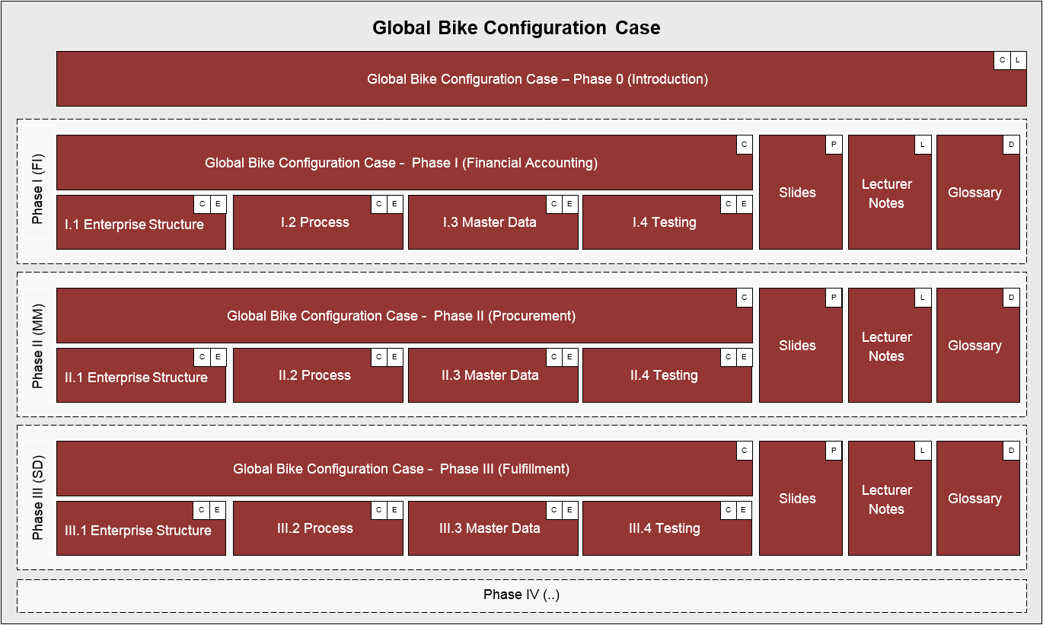
ERP Configuration Case Using Global Bike

Slide 8
ERP Configuration Case – Phase II

Slide 9
Agenda
Introduction
Scenario
Enterprise structure
Process configuration
Master data
Process execution

Slide 10
Scenario
In 2008, Global Bike Inc. starts implementing SAP S/4HANA.
In a preparation project (phase 0), the scope of the implementation project was defined.
In project phase I, Bianca Cavarini (Chief Information Officer) and her team successfully configured basic Financial Accounting processes in the S/4HANA system.
In phase II, before starting to configure the procurement process, they are observing the work of the following GBI employees:
Silvia Cassano (Accountant Payable Specialist GBI US)
Stephanie Bernard (Billing Clerk Accounts Receivable GBI US)
Shuyuan Chen (Chief Accountant GBI US)
Task Read the scenario and highlight the most important and relevant information.

Slide 11
Problem Analysis and Solution Finding
Task Revisit the reference symptoms/issues and condense them into problems specific to this case.
Short Description You (in the role Mona Falco) need to come to a clear understanding of the most relevant symptoms in Purchasing in order to identify the causes and underlying problems including the issue of invoice discrepancy.
Task Revisit the reference problems and identify possible solutions for Global Bike.
Short Description In the role of Mona Falco (System Design and Dev Manager) and Sarah Garcia (Business Analyst 2), analyze all relevant problems in Purchasing and Accounting and find possible solutions.

Slide 12
Agenda
Enterprise Structure
Process Configuration
Master Data
Process
Execution
Introduction
Scenario
Enterprise structure
Process configuration
Master data
Process execution

Slide 13
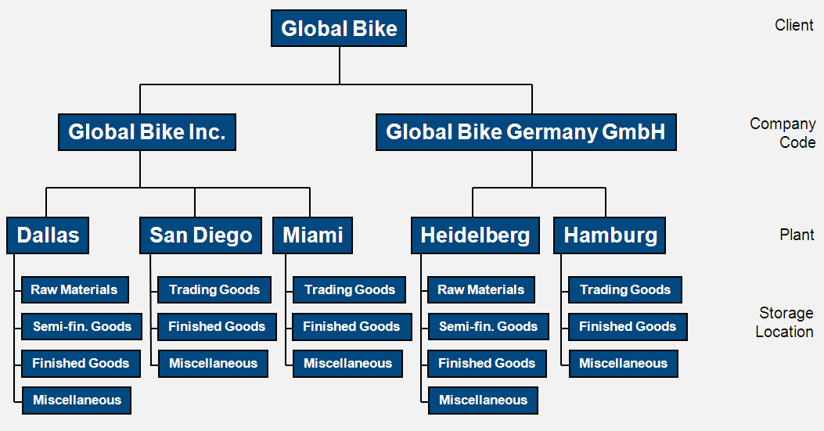
Enterprise Structure – Materials Management

Slide 14
Client
In commercial, organizational, and technical terms, a self-contained unit in an SAP system with separate master records and its own set of tables.
Represents the largest organizational unit implemented within an SAP system e.g.
Global enterprises
Consolidated concern
Corporation
Holding
In this context: Global Bike Group
Identified by a three-digit number, e.g. 200
Client Global Bike Group

Slide 15
Company Code
The smallest organizational unit of Financial Accounting for which a complete self-contained set of accounts can be drawn up for purposes of external reporting.
This includes recording of all relevant transactions and generating all supporting documents required for financial statements.
Key organizational level for Financial Accounting
Books are maintained at company code level
Financial statements (Balance sheet, profit and loss statement) are generated for company codes
In this context: Global Bike Inc. (US), Global Bike Germany GmbH (DE)
Identified by a four-digit alphanumeric ID, e.g. US00
CC US##
CC DE##
Client Global Bike Group

Slide 16
Plant
Many definitions or uses. A location
That holds valuated stock (for distribution)
Where production planning is carried out
Where products and services are created
That contains service or maintenance facilities
Where work is performed
Office, store, factory, warehouse, distribution center
Can be assigned to one company code only
A company can have many plants
In this context: five plants at Global Bike
Identified by a four-digit alphanumeric ID, e.g. DL00
Dallas
DL##
Miami
MI##
Hamburg
HH##
S. Diego
SD##
Heidelb.
HD##
CC US##
CC DE##
Client Global Bike Group

Slide 17
Storage Location
RM##
TG##
TG##
RM##
TG##
SF##
FG##
FG##
SF##
FG##
A place in a plant where materials are stored
Areas designated for different types of material (raw material, work-in-process, finished goods)
Does not have to be physical, can be logical
More sophisticated divisions including storage bins, cabinets, trays is part of warehouse management
A plant must have at least one storage location
A storage location is assigned to a single plant
Storage locations in different plants can have the same name
Finished Goods FG00 in MI00, FG00 in DL00
In this context: various storage location types at Global Bike
Identified by a four-digit alphanumeric ID, e.g. FG00
FG##
MI##
MI##
FG##
MI##
MI##
MI##
Dallas
DL##
Miami
MI##
Hamburg
HH##
S. Diego
SD##
Heidelb.
HD##
CC US##
CC DE##
Client Global Bike Group

Slide 18
Purchasing Organization
RM##
TG##
TG##
RM##
TG##
SF##
FG##
FG##
SF##
FG##
Identify and select vendors
Negotiate general conditions of purchase and contracts for one or more plants or companies.
Determine pricing conditions
Typically three models for Purchasing Organization
Enterprise-Level (assigned to plant)
Company-Level (assigned to plant and one company code) ← used in Global Bike
Plant-Level (assigned to plant and its company code)
Hybrid
In this context: three purchasing organizations at Global Bike
Identified by a four-digit alphanumeric ID, e.g. US00
FG##
MI##
MI##
FG##
MI##
MI##
MI##
Central Purchasing Organization (global) GL##
Purchasing Org. US##
P.Org. DE##
Dallas
DL##
Miami
MI##
Hamburg
HH##
S. Diego
SD##
Heidelb.
HD##
CC US##
CC DE##
Client Global Bike Group

Slide 19
Purchasing Group
RM##
TG##
TG##
RM##
TG##
SF##
FG##
FG##
SF##
FG##
A buyer or group of buyers responsible for certain materials or groups of materials
Can be internal to the company or external
Decide to purchase land, but use a realtor (external purchasing group) to execute the purchase
Not assigned to or related to purchasing organization
In this context: two groups: North America and Europe
Identified by a three-digit alphanumeric ID, e.g. N00
FG##
MI##
MI##
FG##
MI##
MI##
MI##
Central Purchasing Organization (global) GL##
Purchasing Org. US##
P.Org. DE##
P. Group N. America N##
P.Gr. Europe E##
Dallas
DL##
Miami
MI##
Hamburg
HH##
S. Diego
SD##
Heidelb.
HD##
CC US##
CC DE##
Client Global Bike Group

Slide 20
Enterprise Structure SAP S/4HANA
RM##
TG##
TG##
RM##
TG##
Storage
Location
SF##
FG##
FG##
SF##
FG##
FG##
MI##
MI##
FG##
MI##
MI##
MI##
Central Purchasing Organization (global) GL##
Purchasing Org. US##
Purch. Org. DE##
Purchasing Group North America
N##
Purch. Group Europe
E##
Dallas
DL##
Miami
MI##
San Diego
SD##
Heidelberg
HD##
Hamburg
HH##
Plant
CC US##
CC DE##
Company Code
Client Global Bike Group

Slide 21
[OPTIONAL] Handbook Tasks
Maintain Purchasing organization (US: US##)
Define Plants
Dallas: DL##
Miami: MI##
San Diego: SD##
Maintain Storage Locations
Finished Goods: FG##
Miscellaneous Goods: MI##
Raw Materials: RM##
Semi-Finished Goods: SF##
Trading Goods: TG##
Create Purchasing Group (North America: N##)

Slide 22
[OPTIONAL] Handbook Tasks
Maintain Purchasing Organization
Define Plants
Maintain Storage Location
Create Purchasing Group
Assign Purchasing Organization to Company Code
Assign Plants to Company Code
Assign Purchasing Organization to Plants
Group Together Valuation Areas

Slide 23
Agenda
Enterprise Structure
Process Configuration
Master Data
Process
Execution
Introduction
Scenario
Enterprise structure
Process configuration
Master data
Process execution

Slide 24
[OPTIONAL] Handbook Tasks
Assign Material Ledger Types to Valuation Area
Activate Material Ledger Types for Valuation Areas
Set Valuation Areas as Productive
Determine Tax Version
Define Tax Accounts
Configure Automatic Postings
Maintain Default Values for Tax Codes
Set Tolerance Limits for Purchase Orders
Set Tolerance Limits for Goods Receipts
Set Tolerance Limits for Invoices
Set Tolerance Limits for Outgoing Payments
Define Default Values for Inventory
Define Default Values for Plants
Define Attributes of Material Types

Slide 25
Agenda
Enterprise Structure
Process Configuration
Master Data
Process
Execution
Introduction
Scenario
Enterprise structure
Process configuration
Master data
Process execution

Slide 26
Material Master Data
Data needed to execute transactions related to materials
Data are grouped by different user / functional areas (views)
Basic data
Purchasing
Accounting
Forecasting
Sales
Plant / Storage
Work Scheduling
MRP
Classification
Warehouse Management

Slide 27
Material Master Data
Material master data are defined for specific organizational levels
Can have different data for different combinations of Org data
Purchasing: Plant, storage location
Sales: Sales Area (Sales Org, Distribution Channel)
Warehouse: Warehouse #, storage type
Example:
SHRT1000 + MI00+ TG00
SHRT1000 + SD00+ TG00
SHRT1000 + US00 + Wholesale channel
SHRT1000 + US00 + Internet channel

Slide 28
Vendor Master Data
Data needed to do business with vendors
Data needed to execute transactions related to vendors
Data are specific to (defined for) different organizational levels.
The three segments are:
Client level data (General)
Company code level data (Accounting)
Purchasing organization level data (Purchasing)

Slide 29
Purchasing Info Records
Relates vendors and materials
One info record per combination of vendor and material (or material group)
General data
Conditions: pricing, discounts, free goods (current and future)
Vendor data
Texts (notes)

Slide 30
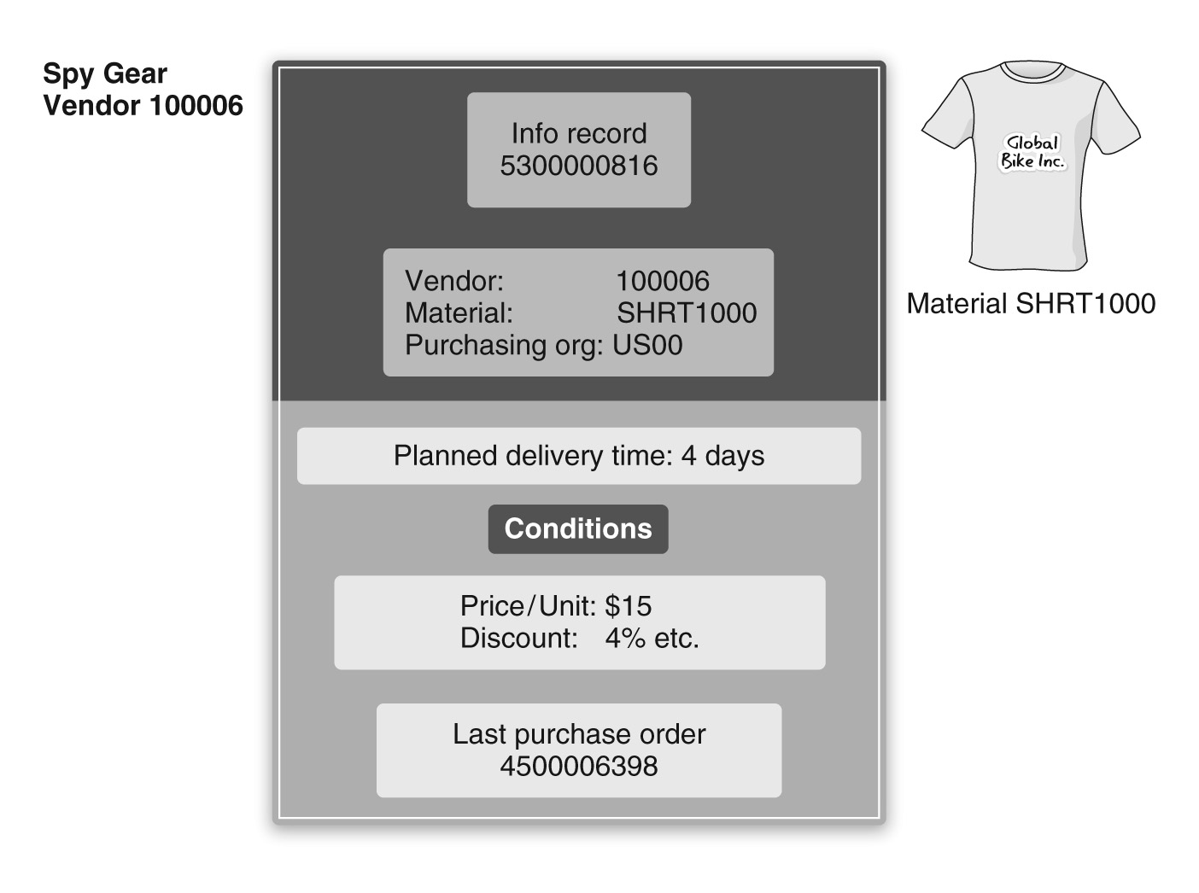
Purchasing Info Records

Slide 31
Conditions
Pricing conditions
Gross price
Discounts and surcharges
Freight / shipping
Pricing data in a purchase order is obtained from
Condition records
Purchasing info records
Contracts and agreements
Other sources

Slide 32
[OPTIONAL] Handbook Tasks
Create Trading Goods
Material master records from Appendix D
Create Vendor
Vendor – Olympic Protective Gear

Slide 33
Agenda
Enterprise Structure
Process Configuration
Master Data
Process
Execution
Introduction
Scenario
Enterprise structure
Process configuration
Master data
Process execution

Slide 34
Process

Slide 35
Process: Purchase Requisition

Slide 36
Process: Purchase Order

Slide 37
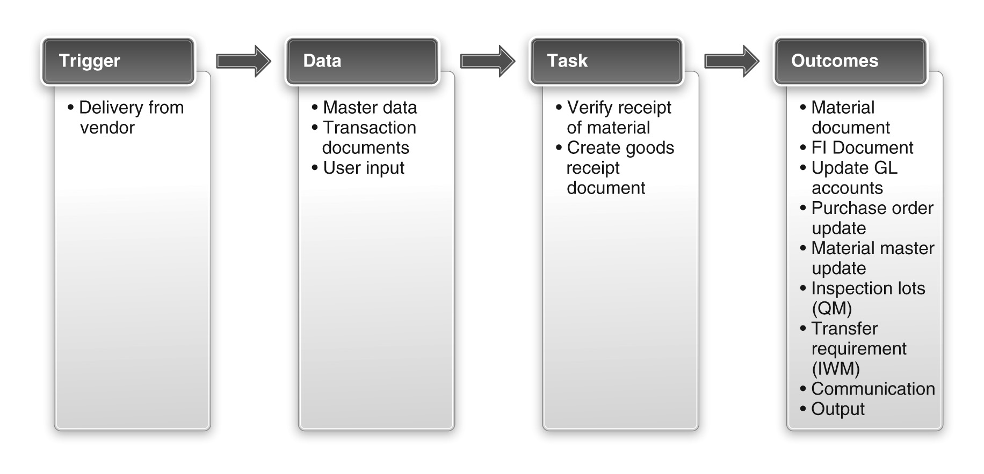
Process: Goods Receipt

Slide 38
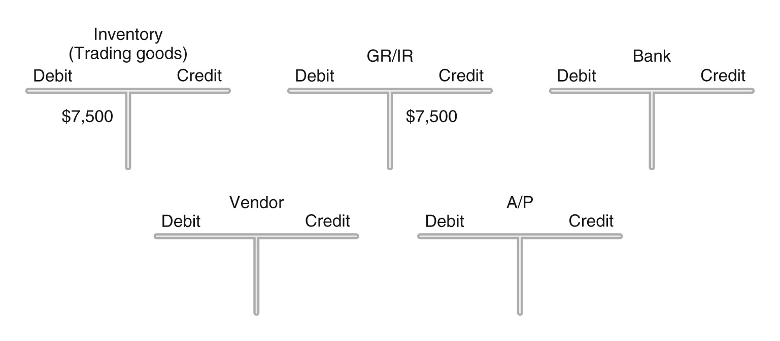
Process: Goods Receipt

Slide 39
Process: Invoice Receipt / Verification

Slide 40
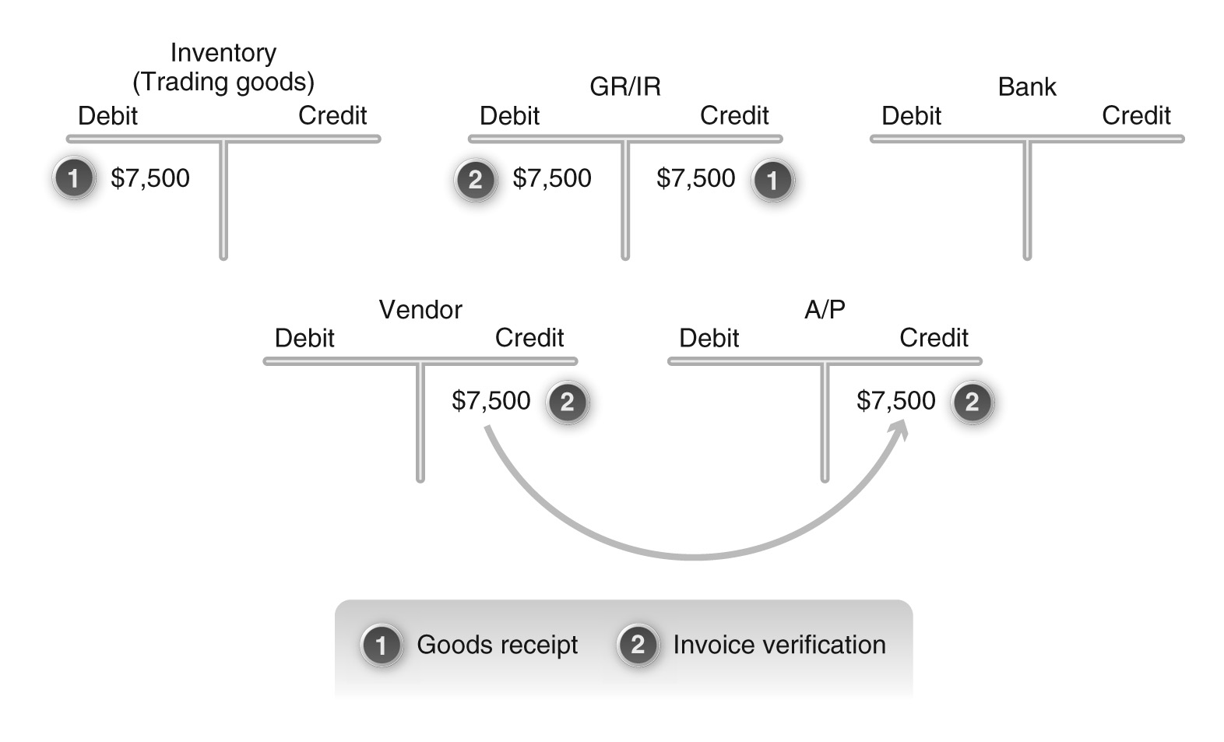
Process: Invoice Receipt / Verification

Slide 41
Process: Vendor Payment

Slide 42
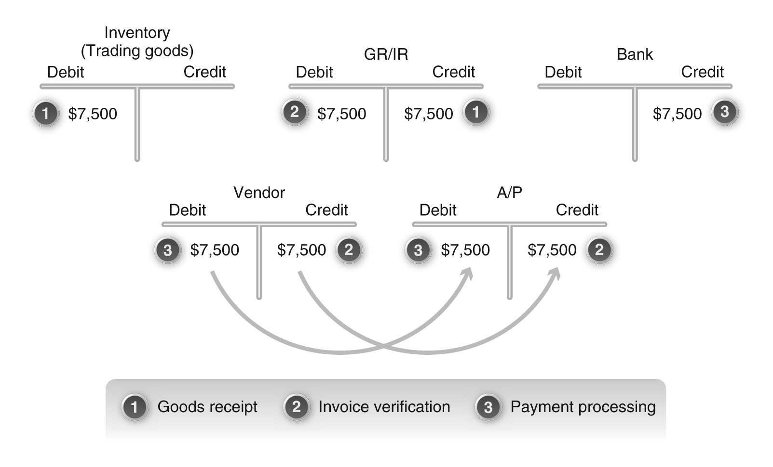
Process: Vendor Payment

