Slide 1
SAP S/4HANA Configuration
Phase III - Fulfillment

Slide 2
4.2 (March 2024)
SAP S/4HANA 2020
GUI 7.70
Global Bike
None

Slide 3
Simha Magal
Stefan Weidner
Advanced

Slide 4
You are able to:
Understand the structure of the ERP configuration curriculum, especially phase III.
Define the central organizational structures for sales and distribution.
Analyze scenarios.
Do the necessary steps for sales and distribution configuration.
Explain common processes in sales and distribution.

Slide 5
Agenda
Introduction
Scenario
Enterprise structure
Process configuration
Master data
Process execution

Slide 6
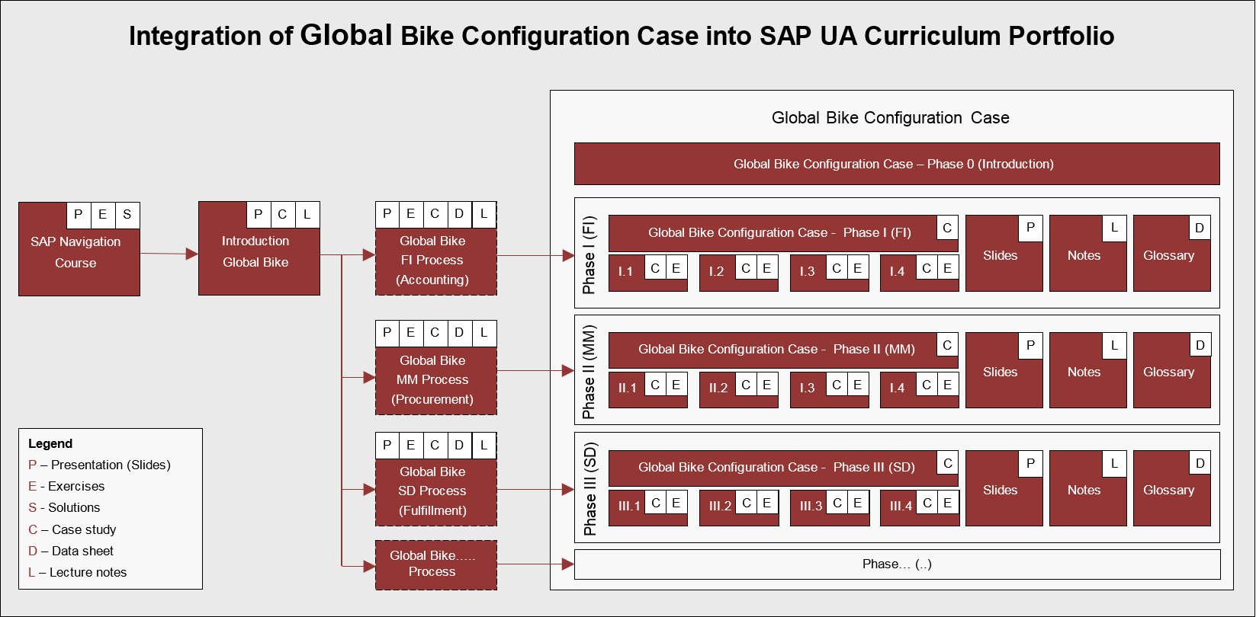
ERP Configuration Case Using Global Bike

Slide 7
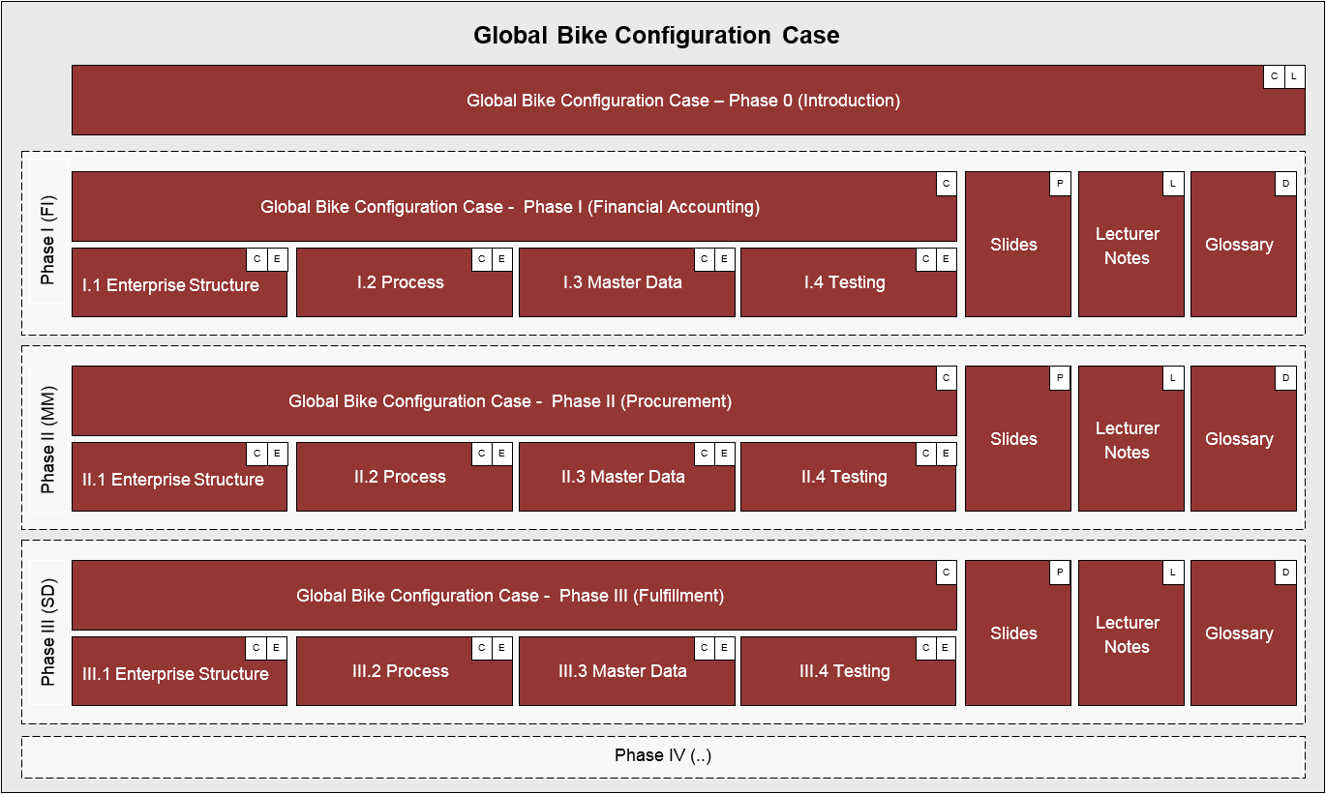
ERP Configuration Case Using Global Bike

Slide 8
ERP Configuration Case – Phase III

Slide 9
Agenda
Introduction
Scenario
Enterprise structure
Process configuration
Master data
Process execution

Slide 10
Scenario
In 2008, Global Bike Inc. starts implementing SAP S/4HANA.
In a preparation project (phase 0), the scope of the implementation project was defined.
In project phases I and II, Bianca Cavarini (Chief Information Officer) and her team successfully configured basic Financial Accounting and Procurement processes in the ERP system.
In phase III, before starting to configure the fulfillment process, they are observing the work of the following GBI employees:
David Lopez (US East Sales Representative)
Juriko Hamada (Dallas WH Shipping Clerk)
Jun Lee (Production Supervisor)
Task Read the scenario and highlight the most important and relevant information.

Slide 11
Problem Analysis and Solution Finding
Task Revisit the reference symptoms/issues and condense them into problems specific to this case.
Short Description You (in the role Mona Falco) need to come to a clear understanding of the most relevant symptoms in Sales in order to identify the causes and underlying problems including the issue of delayed delivery to customer.
Task Revisit the reference problems and identify possible solutions for Global Bike.
Short Description In the role of Mona Falco (System Design and Dev Manager) and Sarah Garcia (Business Analyst 2), analyze all relevant problems in Sales and Accounting and find possible solutions.

Slide 12
Agenda
Enterprise Structure
Process Configuration
Master Data
Process
Execution
Introduction
Scenario
Enterprise structure
Process configuration
Master data
Process execution

Slide 13
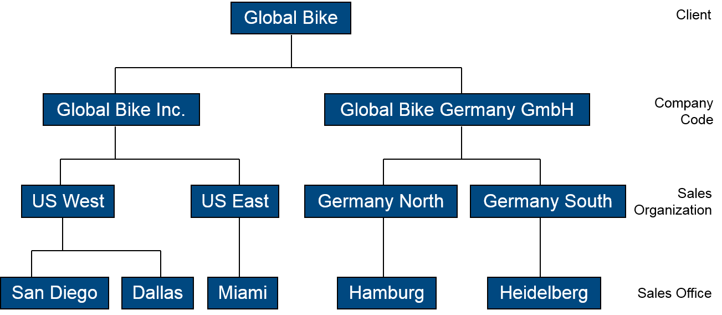
Enterprise Structure – Sales and Distribution

Slide 14
Client
In commercial, organizational, and technical terms, a self-contained unit in an SAP
system with separate master records and its own set of tables.
Represents the largest organizational unit implemented within an SAP system e.g.
Global enterprises
Consolidated concern
Corporation
Holding
In this context: Global Bike Group
Identified by a three-digit number, e.g. 200
Client Global Bike Group
Client Global Bike Group

Slide 15
Credit Control Area
An organizational unit that represents an area responsible for granting and monitoring
credit.
This organizational unit handles either one single company code or, if credit control is
performed across several companies, - multi company codes.
Credit information can be made available per customer within a credit control area.
Centralized or decentralized
For global enterprises or subsidiaries (e.g. North America, Europe, Asia)
In this context: Global Credit Management.
Identified by a four-digit alphanumeric ID, e.g. GL00.
Credit Control Area (Global) GL00
Client Global Bike Group

Slide 16
Company Code
The smallest organizational unit of Financial Accounting for which a complete
self-contained set of accounts can be drawn up for purposes of external reporting.
This includes recording of all relevant transactions and generating all supporting documents
required for financial statements.
Key organizational level for Financial Accounting
Books are maintained at company code level
Financial statements (Balance sheet, profit and loss statement) are generated for company codes
In this context: Global Bike Inc. (US), Global Bike Germany GmbH (DE)
Identified by a four-digit alphanumeric ID, e.g. US00
CC US00
CC CA00
CC DE00
CC GB00
CC AU00
Credit Control Area (Global) GL00
Client Global Bike Group

Slide 17
Sales Organization
An organizational unit responsible for the sale of certain products or services.
This organizational unit structures the company according to its sales requirements.
The responsibilities of a sales organization may include legal liability for products as well as customer claims.
The sales organization is the highest level of aggregation in sales-related reporting.
In this context: US Sales Organization.
Identified by a four-digit alphanumeric ID, e.g. US00.
US West
UW00
CA West
CW00
DE North
DN00
GB North
GN00
AU North
AN00
US East
UE00
CA East
CE00
DE South
DS00
GB South
GS00
AU South
AS00
CC US00
CC CA00
CC DE00
CC GB00
CC AU00
Credit Control Area (Global) GL00
Client Global Bike Group

Slide 18
Distribution Channel
Distribution Channel Wholesale WH
Distribution Channel Internet IN
This organizational unit determines the way in which products or services reach the
customer.
Typical examples of distribution channels are wholesale, retail, or direct sales.
One sales organization can have many distribution channels and a single distribution channel can be valid for several sales organizations.
In this context: Wholesale and Internet sales.
Identified by a two-letter ID, e.g. WH.
US West
UW00
CA West
CW00
DE North
DN00
GB North
GN00
AU North
AN00
US East
UE00
CA East
CE00
DE South
DS00
GB South
GS00
AU South
AS00
CC US00
CC CA00
CC DE00
CC GB00
CC AU00
Credit Control Area (Global) GL00
Client Global Bike Group

Slide 19
Division
Distribution Channel Wholesale WH
Division Accessories AS
Division Bicycles BI
Distribution Channel Internet IN
Cross-Division 00
Used to consolidate materials with similar characteristics
Different sales strategies, pricing agreements
Statistics and reporting
Associated with product lines
A sales organization must have at least one division
In this context, there are two Divisions i.e. Bicycles and Accessories
Identified by a two-letter ID, e.g. BI.
For the US Sales Organization, we will focus on only the BI sales division
US West
UW00
CA West
CW00
DE North
DN00
GB North
GN00
AU North
AN00
US East
UE00
CA East
CE00
DE South
DS00
GB South
GS00
AU South
AS00
CC US00
CC CA00
CC DE00
CC GB00
CC AU00
Credit Control Area (Global) GL00
Client Global Bike Group

Slide 20
Other SD organization units
Sales Area – A combination of sales organization, distribution channel and division.
Plant (Delivering Plant) - Plant from which the goods should be delivered to the customer.
Shipping Point - Organizational unit within which processing and monitoring of the deliveries as well as goods issue is carried out.
Loading Point - The exact physical location where the loading of a delivery item takes place (e.g. the number of a specific loading bay).
Sales Office - An organizational unit in a geographical area of a sales organization. A sales office establishes contact between the firm and the regional market.
Sales Group - An organizational unit that performs and is responsible for sales transactions.

Slide 21
Enterprise Structure SAP S/4HANA
Distribution Channel Wholesale WH
Division Accessories AS
Division Bicycles BI
Cross-Division 00
Distribution Channel Internet IN
US West
UW00
CA West
CW00
DE North
DN00
GB North
GN00
AU North
AN00
US East
UE00
CA East
CE00
DE South
DS00
GB South
GS00
AU South
AS00
Sales
Organization
CC US00
CC CA00
CC DE00
CC GB00
CC AU00
Company Code
Credit Control Area (Global) GL00
Client GBI

Slide 22
[OPTIONAL] Handbook Tasks
Define Sales Organization (US: US##)
Define Shipping Points
Dallas - DL##
Miami - MI##
San Diego - SD##
Assign Sales Organization to Company Code
Assign Distribution Channel to Sales Organization
US## - Internet
US## - Wholesale
Assign Division to Sales Organization

Slide 23
[OPTIONAL] Handbook Tasks
Set up Sales Area
US## - Wholesale (WH) - Bicycles (BI)
US## - Internet (IN) - Bicycles (BI)
Assign SO - Distribution Channel - Plant
Assign Sales Area to Credit Control Area
Assign Business Area to Plant and Div.
Assign Shipping Point to Plant
DL## - ## Dallas
MI## - ## Miami
SD## - ## San Diego

Slide 24
Agenda
Enterprise Structure
Process Configuration
Master Data
Process
Execution
Introduction
Scenario
Enterprise structure
Process configuration
Master data
Process execution

Slide 25
[OPTIONAL] Handbook Tasks
Configure Automatic Postings
Maintain Automatic Account Assignment of Revenue Elements
Assign Shipping Points with Loading Groups
Assign G/L Revenue Accounts
Define Pricing Procedure Determination
Define Rules by Sales Area

Slide 26
Agenda
Enterprise Structure
Process Configuration
Master Data
Process
Execution
Introduction
Scenario
Enterprise structure
Process configuration
Master data
Process execution

Slide 27
Material Master Data
Data needed to execute transactions related to materials
Data are grouped by different user / functional areas (views)
Basic data
Purchasing
Accounting
Forecasting
Sales
Plant / Storage
Work Scheduling
MRP
Classification
Warehouse Management

Slide 28
Material Master Data
Material master data are defined for specific organizational levels
Can have different data for different combinations of Org. data
Purchasing: Plant, storage location
Sales: Sales Area (Sales Org, Distribution Channel, Division)
Warehouse: Warehouse #, storage type
Example:
SHRT1000 + MI00+ TG00
SHRT1000 + SD00+ TG00
SHRT1000 + US00 + Wholesale channel
SHRT1000 + US00 + Internet channel

Slide 29
Customer Master Data
Data needed to do business with customers.
Data needed to process orders, deliveries, invoices and customer payments.
Data are specific to (defined for) Sales Area.
The three segments are:
Client data (General)
Company Code data (Accounting)
Sales Area data (Sales)

Slide 30
Condition Master Data (Pricing)
Condition master data includes:
Pricing
Surcharges
Discounts
Freight
Taxes
Condition data can be defined to be dependent on various date:
Material specific
Customer specific

Slide 31
[OPTIONAL] Handbook Tasks
Extend Material Master
Extend sales view for Trading goods
Create Customer
## DC Bike
Create Pricing Conditions
Assign selling prices to all your trading goods

Slide 32
Agenda
Enterprise Structure
Process Configuration
Master Data
Process
Execution
Introduction
Scenario
Enterprise structure
Process configuration
Master data
Process execution

Slide 33
Process

Slide 34
Process: Create Sales Quotation

Slide 35
Process: Create Sales Order

Slide 36
Process: Goods Issue

Slide 37
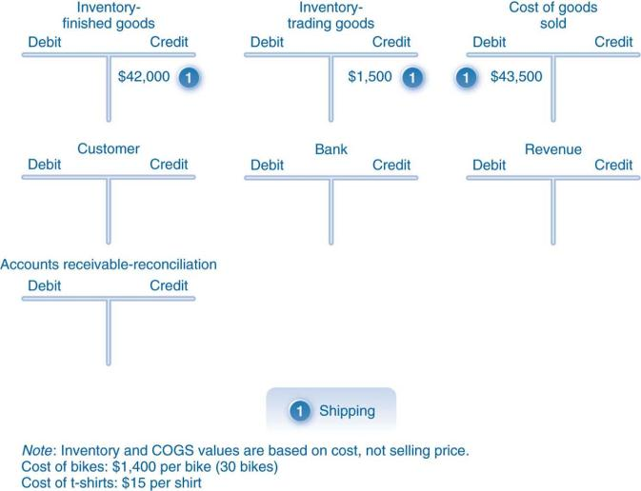
Process: Goods Issue

Slide 38
Process: Billing

Slide 39
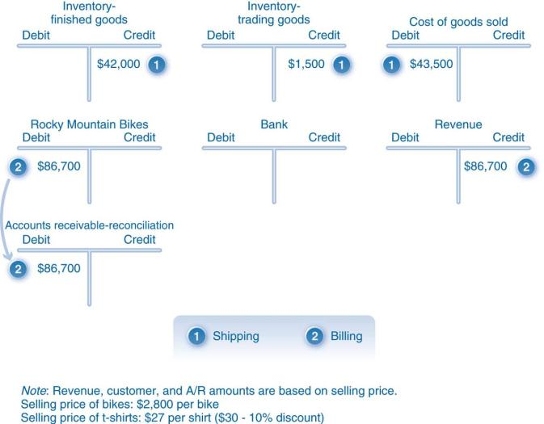
Process: Billing

Slide 40
Process: Customer Payment

Slide 41
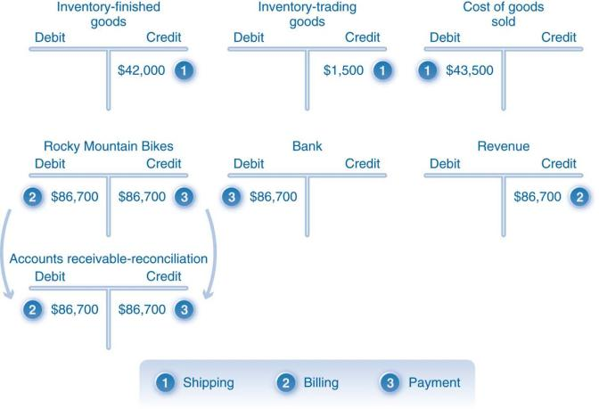
Process: Customer Payment

