Slide 1
Global Bike
Curriculum: Introduction to S/4HANA using Global Bike

Slide 2

4.3 (July 2025)
SAP S/4HANA 2023
Global Bike
No Prerequisites needed

Slide 3
Simha Magal
Stefan Weidner
Jeff Word
Beginner

Slide 4
At the completion of this module, you should be able to:
Describe the story of the Global Bike Group
Draw the organizational structures of the Global Bike Group
Describe the essential characteristics of the products and business partners
of the Global Bike Group.
List the business processes of the Global Bike Group.

Slide 5
Agenda
Global Bike Group
Organizational Structure
Products
Business Partners
Business Processes

Slide 6
Global Bike Group
Background:
  Global concern using full ERP capabilities
  Consists of two companies located in the US and in Germany
History:
  John Davis won numerous mountain bike championships in the US
  In 1990, started his own mountain bike company (Frankenstein Bikes)
  Peter Schwarz grew up on road bikes in the Black Forest, Germany
  As a student, he engineered ultra-light composite frames
  In 1993, started his own bike frame company (Heidelberg Composites)
  Both met in 2000
  In 2001, merged to form Global Bike Inc.

Slide 7
Global Bike Group
Strategy:
  John and Peter are Co-CEOs
  John is responsible for (in terms of reporting)
    Sales, Marketing, Service and Support, IT, Finance, and Human Resources
    sells products and brings in money
  Peter is responsible for
    Research, Design, Procurement, and Manufacturing Groups
    builds products and spends money
  World-class bicycle company serving both the professional and “prosumer” in touring and off-road racing.
  Focus on:
    Quality
    Toughness
    Performance

Slide 8
Agenda
Global Bike Group
Organizational Structure
Products
Business Partners
Business Processes

Slide 9
Organizational Structure (Overview)
Global Bike Group
Concern
Co-CEO John Davis
Co-CEO Peter Schwarz
Global Bike Inc.
Global Bike Germany GmbH
Companies
Dallas
Miami
San Diego
Heidelberg
Hamburg
Locations

Slide 10
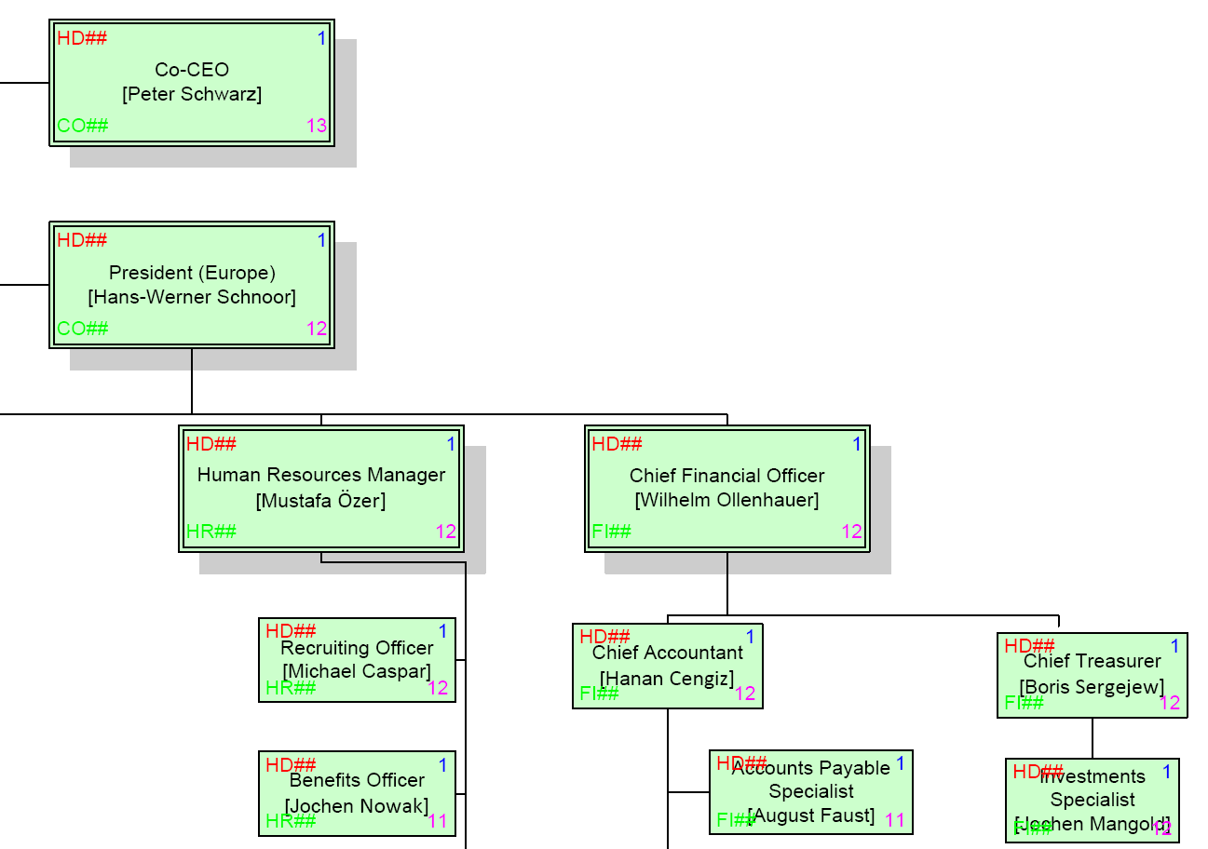
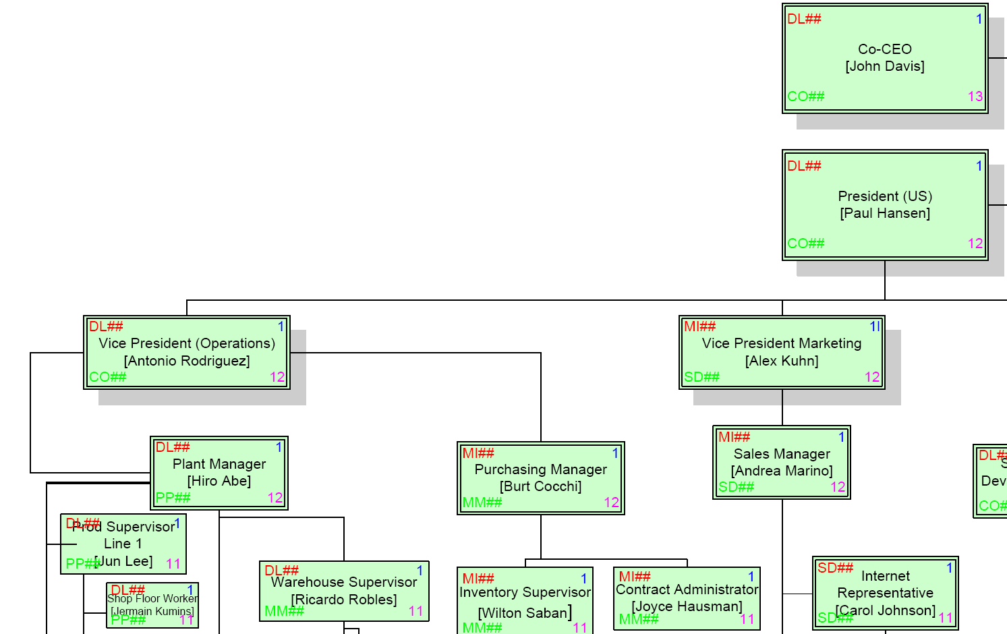
Organizational Structure (Human Resources)
Employees (US and Germany)

Slide 11
Agenda
Global Bike Group
Organizational Structure
Products
Business Partners
Business Processes

Slide 12
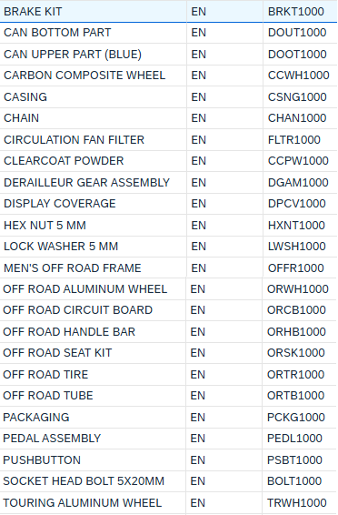
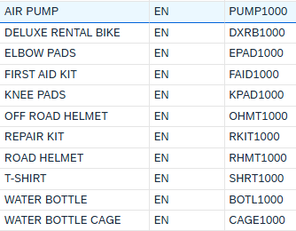
Products
Trading Goods
  Accessories
    Safety Gear
    Other
Raw Materials

Slide 13
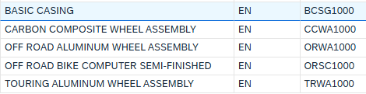
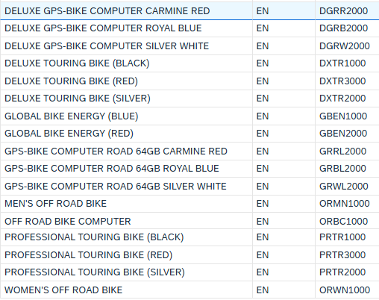
Products
Semi-Finished Goods
Finished Goods
  Touring Bikes (Deluxe, Professional) in three colors
  Off-Road Bikes (Men, Women)
  GPS-Bike Computer

Slide 14
Agenda
Global Bike Group
Organizational Structure
Products
Business Partners
Business Processes

Slide 15
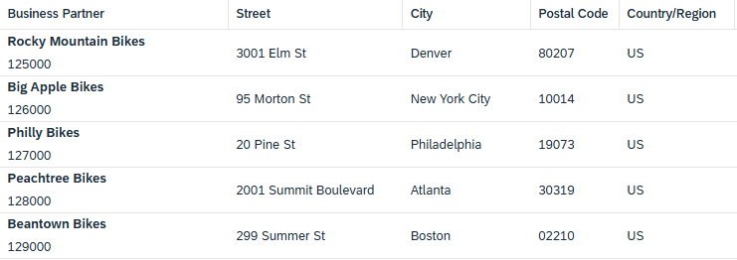
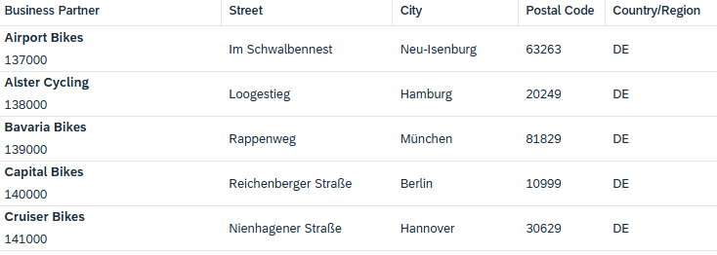
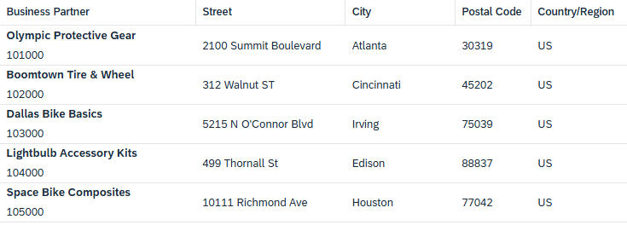
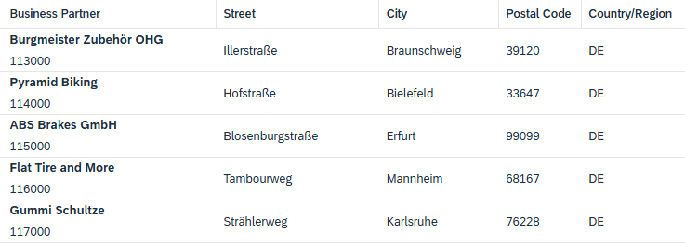
Business Partners
Customers (US and Germany)
Vendors (US and Germany)

Slide 16
Agenda
Global Bike Group
Organizational Structure
Products
Business Partners
Business Processes

Slide 17
Business Processes
Sell – Fulfillment
Buy – Procurement
Make – Production
Track – Financial Accounting
Track – Controlling
People – Human Capital Management
Store – Inventory and Warehouse Management
Maintain – Enterprise Asset Management
Service – Customer Service
Project – Project Management
Environment – Environment, Health and Safety

Slide 18
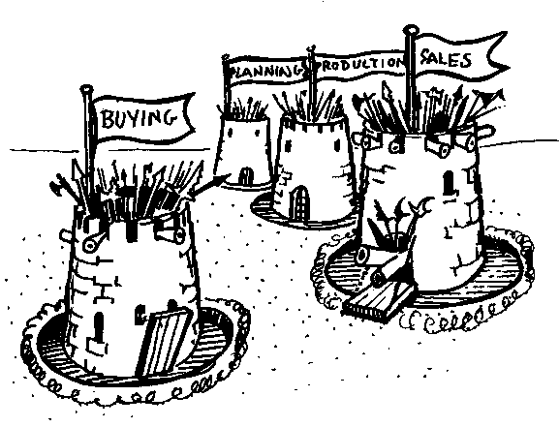
Cross-functional Integration
Notes:
ERP - Enterprise Resource Planning - breaks down the traditional barrier that exist within a corporation. For anyone to benefit from ERP, everyone has to contribute, this is the key to ERP survival.
There has to be a common agenda throughout the business. To get the commitment from everyone, everyone has to believe their needs and objectives are addressed by the plan, learning the tools and techniques to accomplish this is then relatively easy.

Slide 19
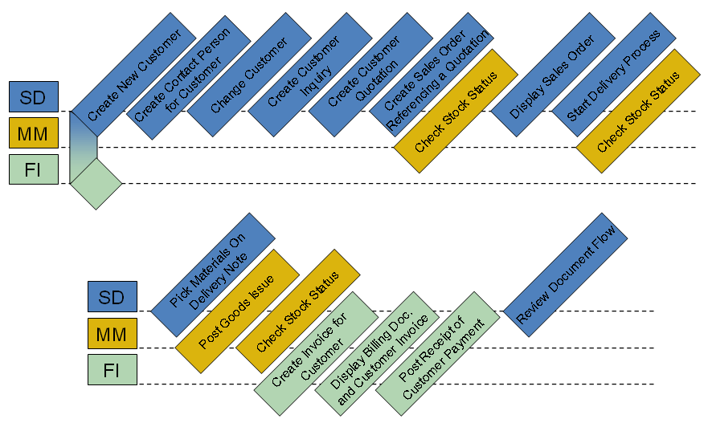
Process Integration (Example)
Order-to-Cash Process
  Sales and Distribution (SD)
  Materials Management (MM)
  Financial Accounting (FI)

Slide 20
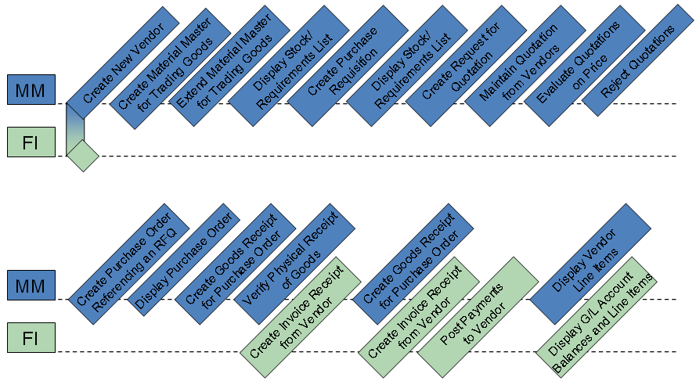
Process Integration (Example)
Procure-to-Cash Process
  Materials Management (MM)
  Financial Accounting (FI)

