Slide 1
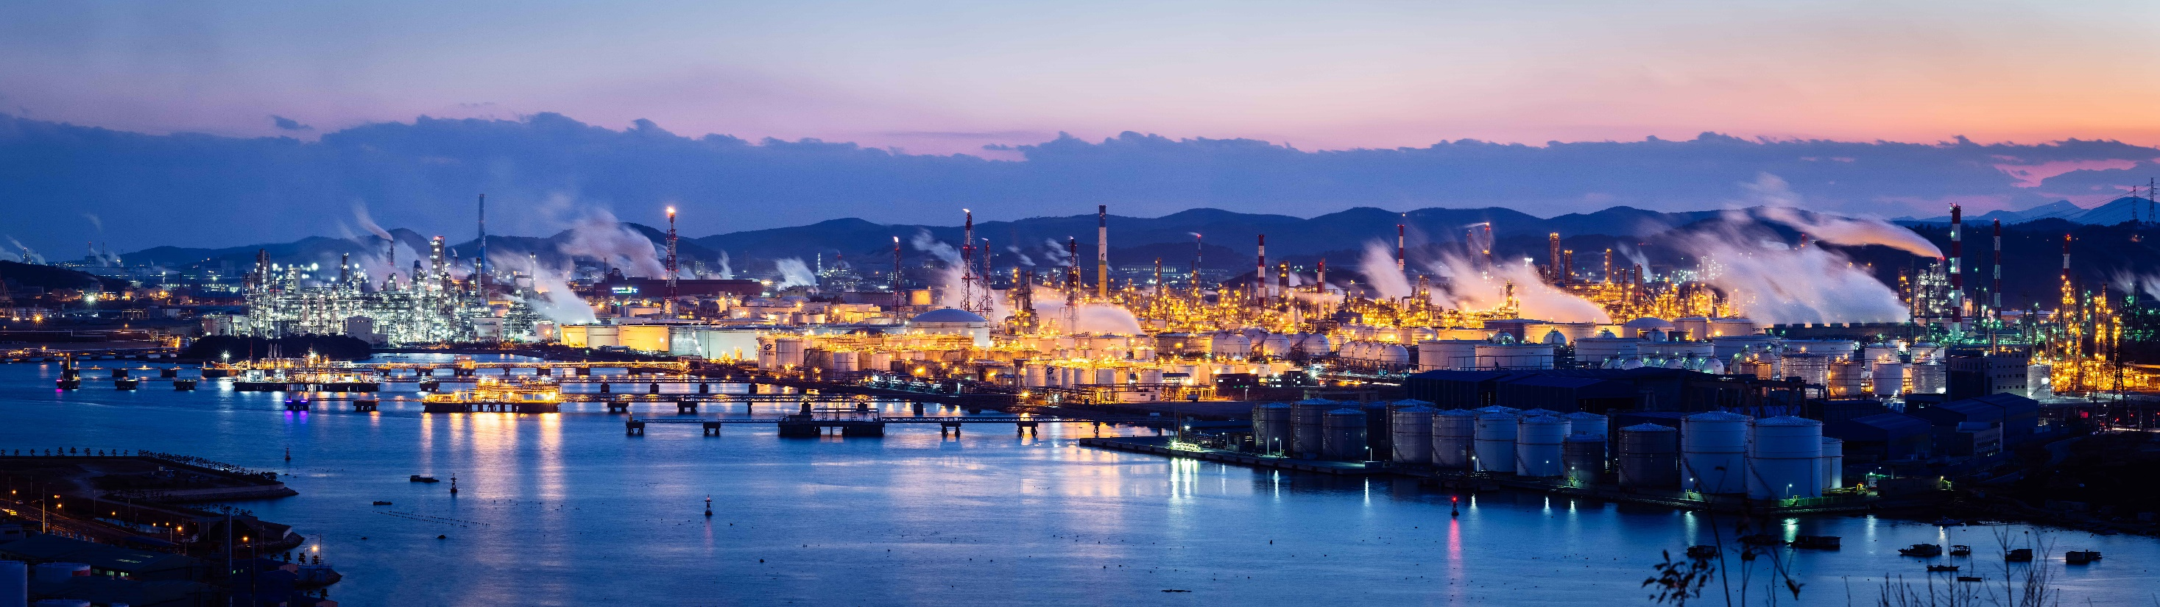
SAP EHS Environment Management
Greenhouse Gas Emissions
Stefan Weidner
SAP UCC Magdeburg

Slide 2
Our offering – SAP Cloud for Sustainable Enterprises
SAP Cloud for Sustainable Enterprises
HOLISTIC STEERING AND REPORTING
Go from averages to actuals and record data on transactional level
Zero Emissions
with Climate Action
Zero Waste
with Circular Economy
Zero Inequality
with Social Responsibility
Decarbonize your entire value chain (scope1-3) based on actual business transactions
Incorporate circularity into your supply chain & create sustainable business models
Understand the impact of your business on people and the society
SAP EHS Environment Management
SAP EHS Environment Management
SAP EHS Workplace Safety
Notes:
Talking points:
First, let’s look at “Holistic Steering and Reporting”
With SAP Control Tower, we help companies record, report and act on actual data vs averages. You can record all your sustainability data in one single source of truth. You can report them along regulatory & voluntary frameworks (such as GRI and TCFD) in an auditable, granular way. You will be enabled to act and operationalize these insights and become more sustainable.
Next, let’s look at Zero Emissions:
We provide solutions that help measure and optimize carbon emissions within their four walls, but also extended outside into their value chains ( Scope 1-3). SAP Product Footprint Management, helps evaluate the carbon footprint of your.
For Zero Waste, we released SAP Responsible Design and Production, a new solution that help companies design and activate circular business processes.
This solution will help businesses keep track of public commitments such as Extended Producer Responsibility (or EPR), and new regulations so they can manage the operational costs associated with downstream processing and gain better visibility and control of their material flows across multi-tiered partners and even communities.
For Zero Inequality, we provide an entire suite of solutions to manage corporate social responsibility.
These include Enhancements to many of our products that are in mainstream use. For example, in Ariba to ensure better integration with ethical and socially responsible partners. Or features in our HXM solutions to gain visibility and transparency into DEI initiatives and the effective management of people.
Important thing to note is that the Cloud for Sustainable Enterprises is built on BTP and integrated with SAP applications for e.g. S/4HANA Fin which puts SAP in a unique position to access data easily.
All together, we address sustainability topics across climate action, circular economy, and social responsibility. Why? Because we see these as interconnected issues which must be addressed in unison. And, solving just one issue alone is necessary, but not sufficient.
All those points are enabled & brought to the next level through our industry specific solutions, the business network and our ecosystem of partners.

Slide 3


SAP EHS Solution Portfolio for Sustainable Operations
SAP Cloud for Sustainable Enterprise
Safe Operations
Analytics
Enterprise Asset Management
Environment Management
Workplace Safety
HR/SuccessFactors
Workplace Safety
Workplace Safety
Waste Management
Air Emissions Management
GHG Emissions Management
Incident Management
Near Misses
Safety Observations
Water/Wastewater Management
Chemical Approval
Chemical Management
Operational Risk Assessment
Industrial Hygiene and Sampling
Occupational Health*
Management of Change
Regulatory and Permit Compliance Management
Action/Task Management
S/4HANA Enterprise Management
Work Permit Management
Audit Management
*OH licensed separately

Slide 4
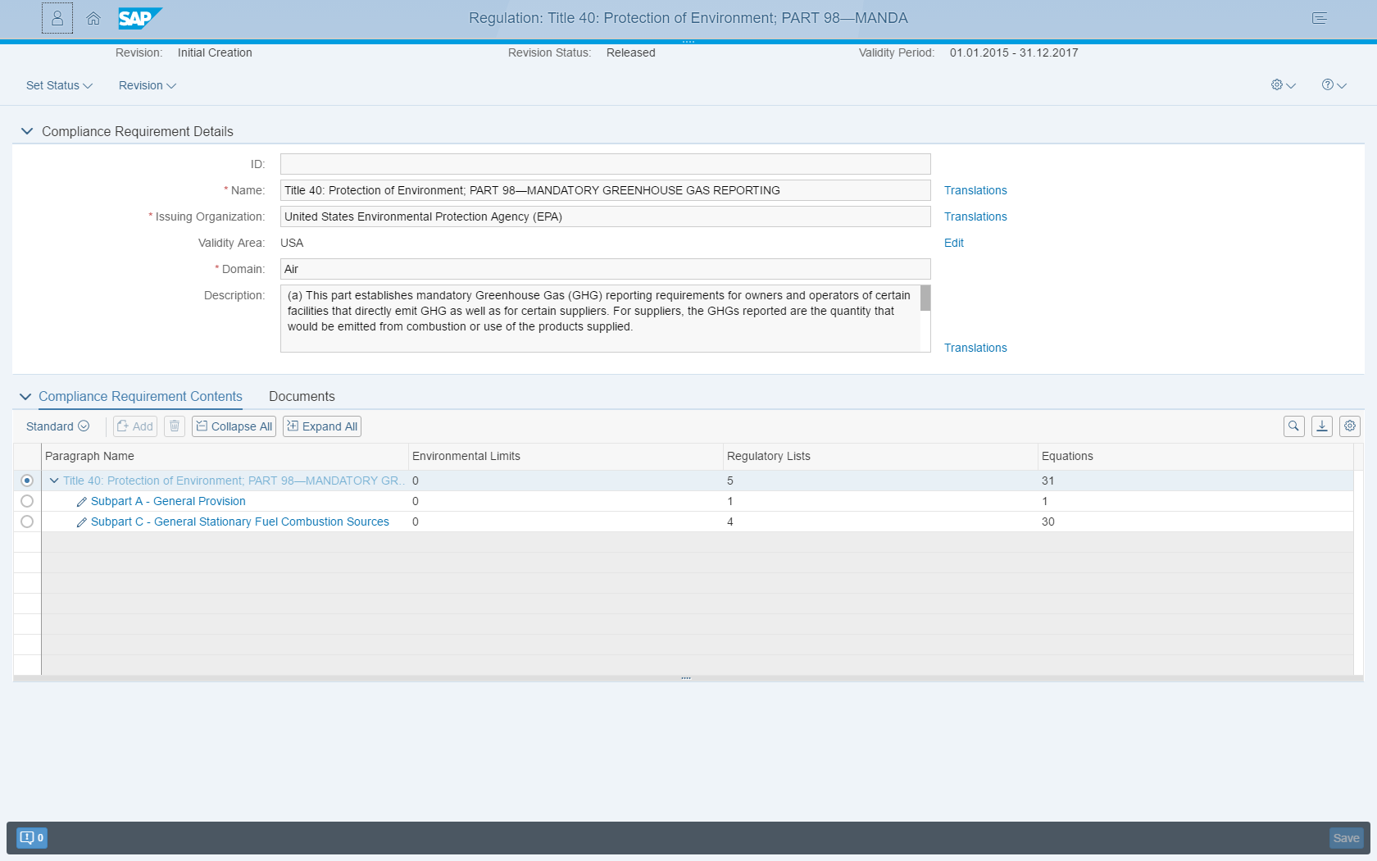
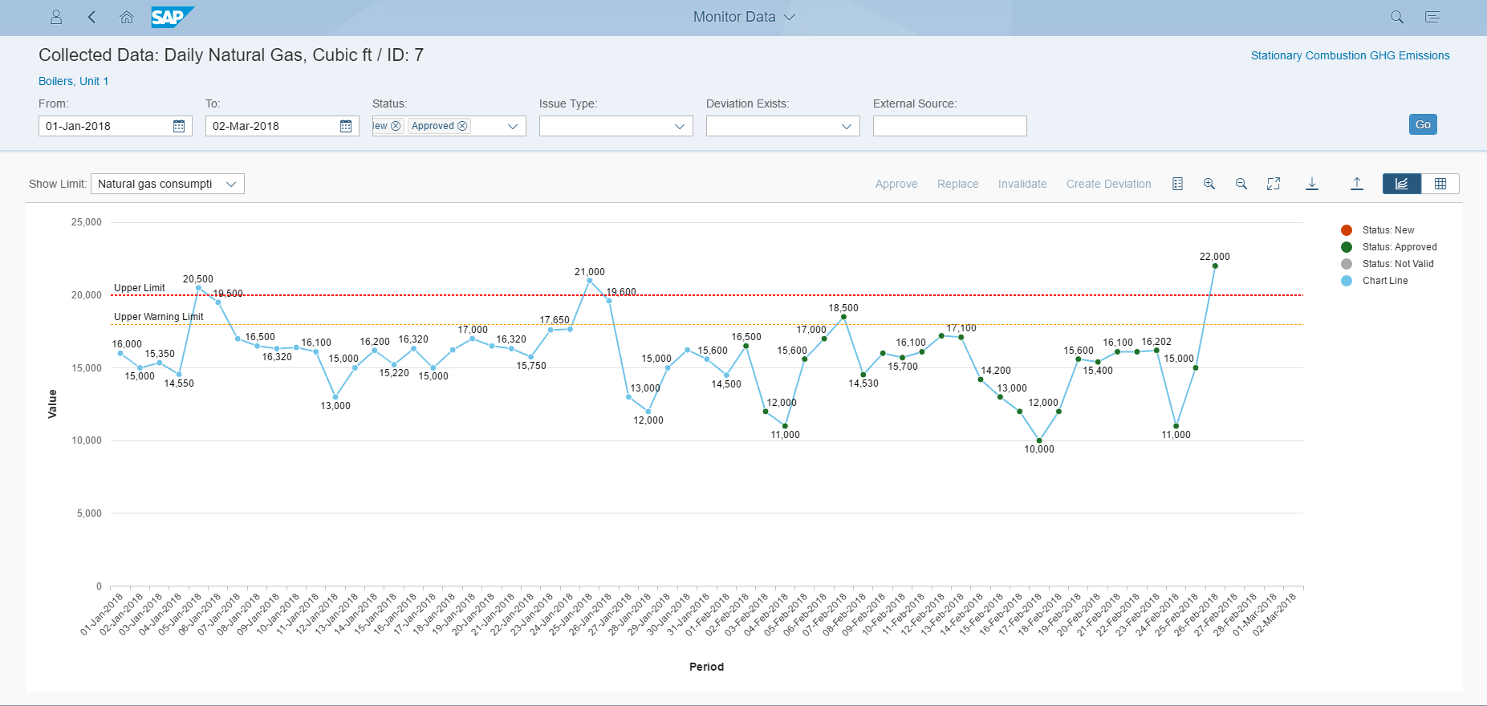
GHG Emissions Management
Objective
Support an end-to-end process for calculating actual greenhouse gas emissions from initial data collection to reporting that is auditable
Capabilities
Multiple options for data collection and interfacing to sources of information
Calculation of greenhouse gas inventories to comply with voluntary and corporate reporting requirements
Equations, regulations, and emission factor content built-in for Scope 1 and 2 GHG Protocol emission outputs
Calculate and aggregate emissions while fostering data transparency
Multiple options for validation of collected data and also emissions results
Emissions forecasting
Benefit
Closely monitor performance and environmental impact
Improved accuracy and consistency
Reduced effort and cost for data collection and calculations
Real-time visibility into the enterprise for better insight into reducing energy usage and carbon emissions

Slide 5
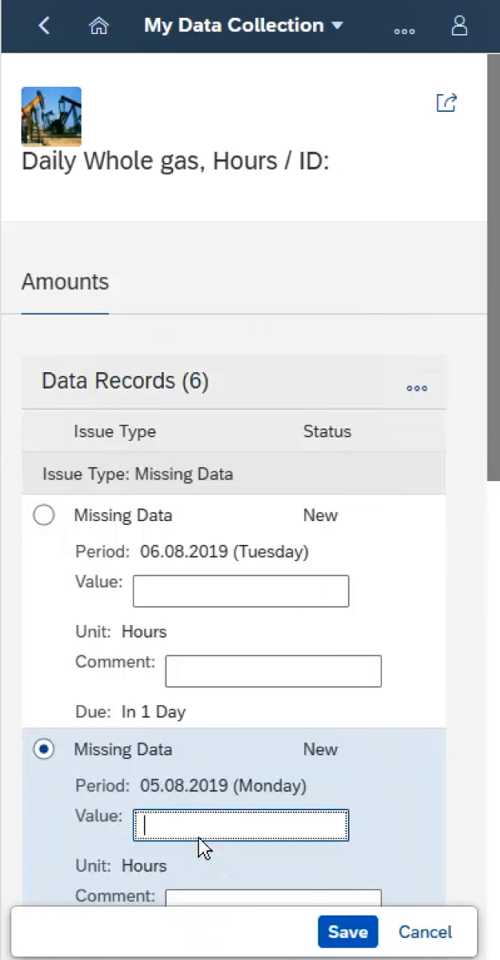
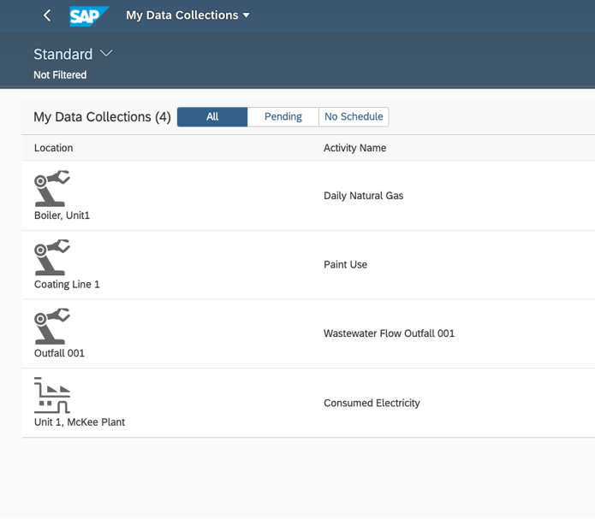
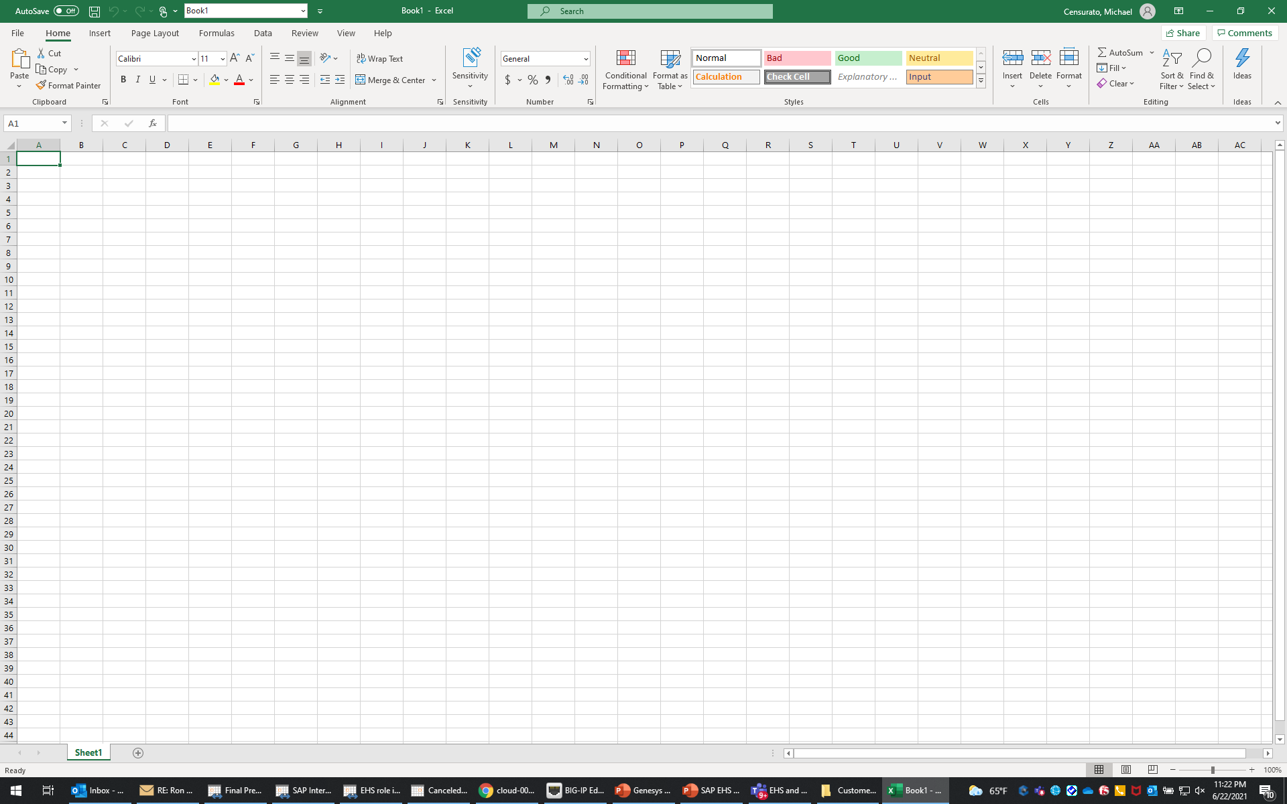
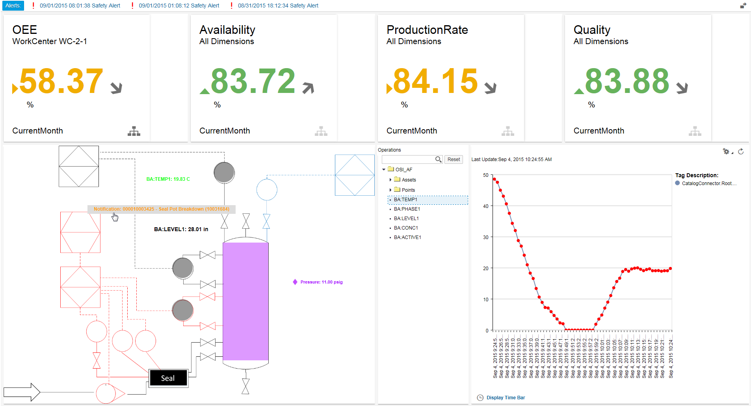
GHG Emissions Management
Business Process
Utilize Emissions Data for reporting and disclosure
Manual Data Collection
Identify Compliance Requirements
Convert and Aggregate Data
Parameter Data
Utilize Emissions Data for Carbon Footprint Calcs
Emissions Planning
Bulk data import
Leverage Appropriate Equations
Calculate GHG Emissions
Validate Emission Results
Scope 1,2,3 Activity Data
SAP MII, IOT, API
Validate Collected Data
Monitor Calculated Results
Utilize Emissions Data for Forecasting

Slide 6
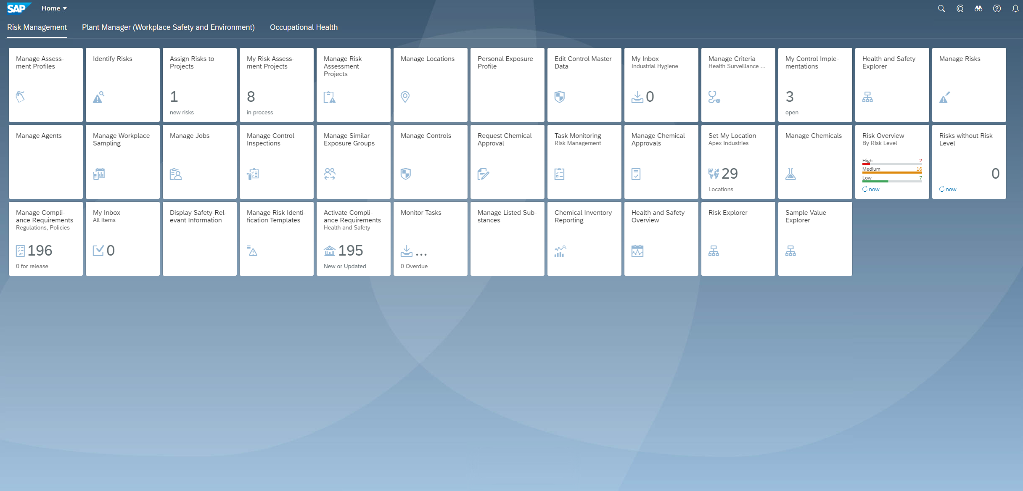
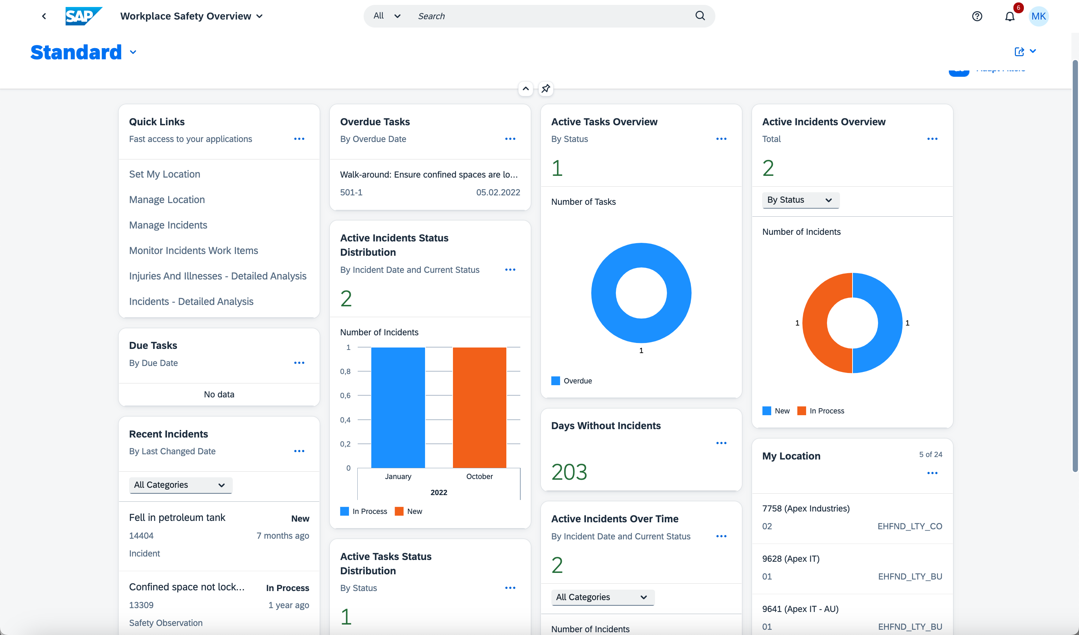
GHG Emissions – Role-based Entry Screen
Use new Horizon white theme

Slide 7
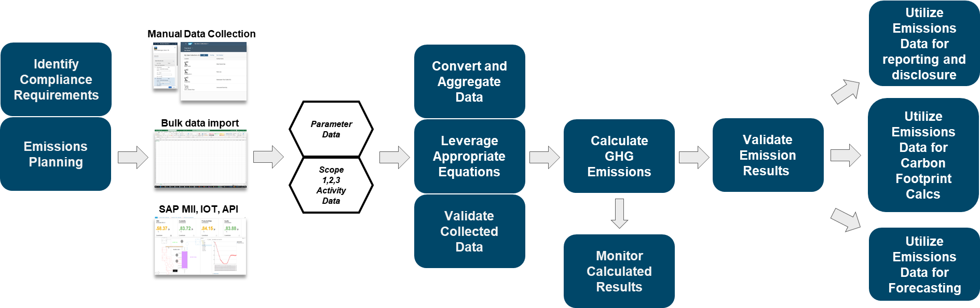
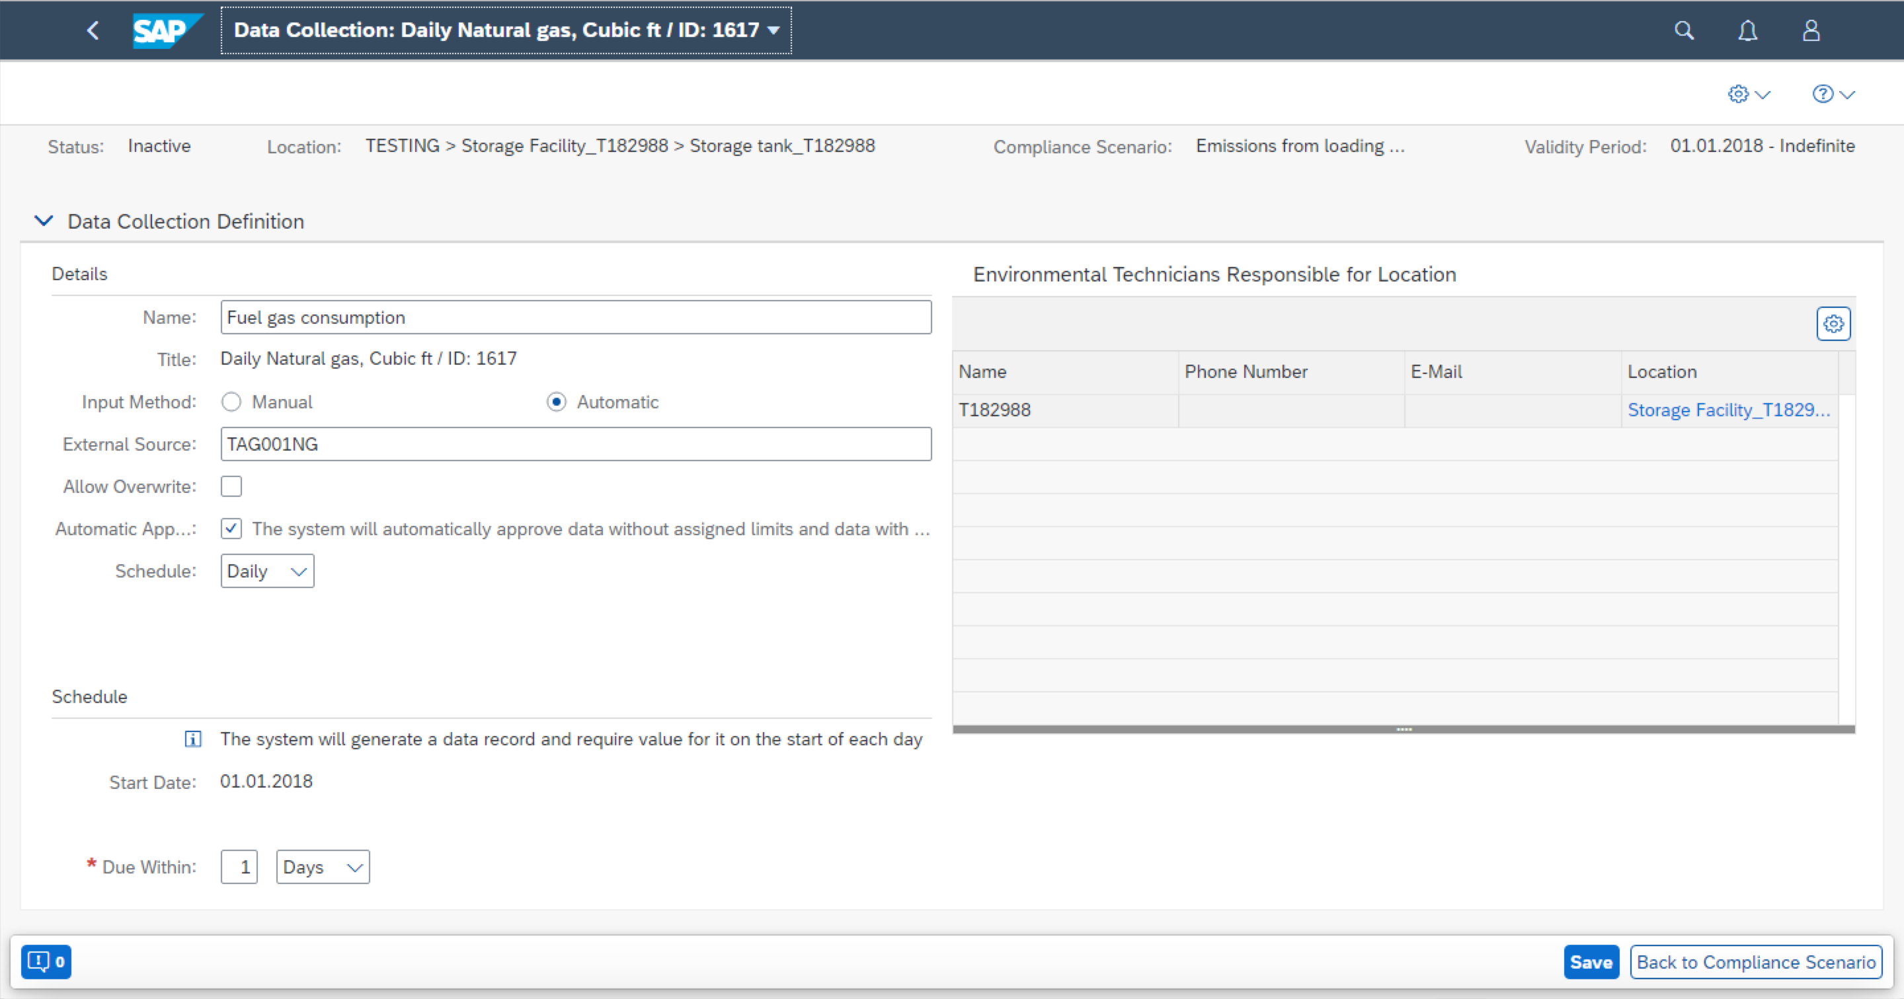
Emissions Planning
Record and track all relevant requirements for calculating emissions, whether they are based on regulations, permits, company policy, corporate goals, etc.
After that, use the compliance scenario to link up the appropriate equations, factors, locations, and other information to structure how the emissions will be calculated and managed.

Slide 8
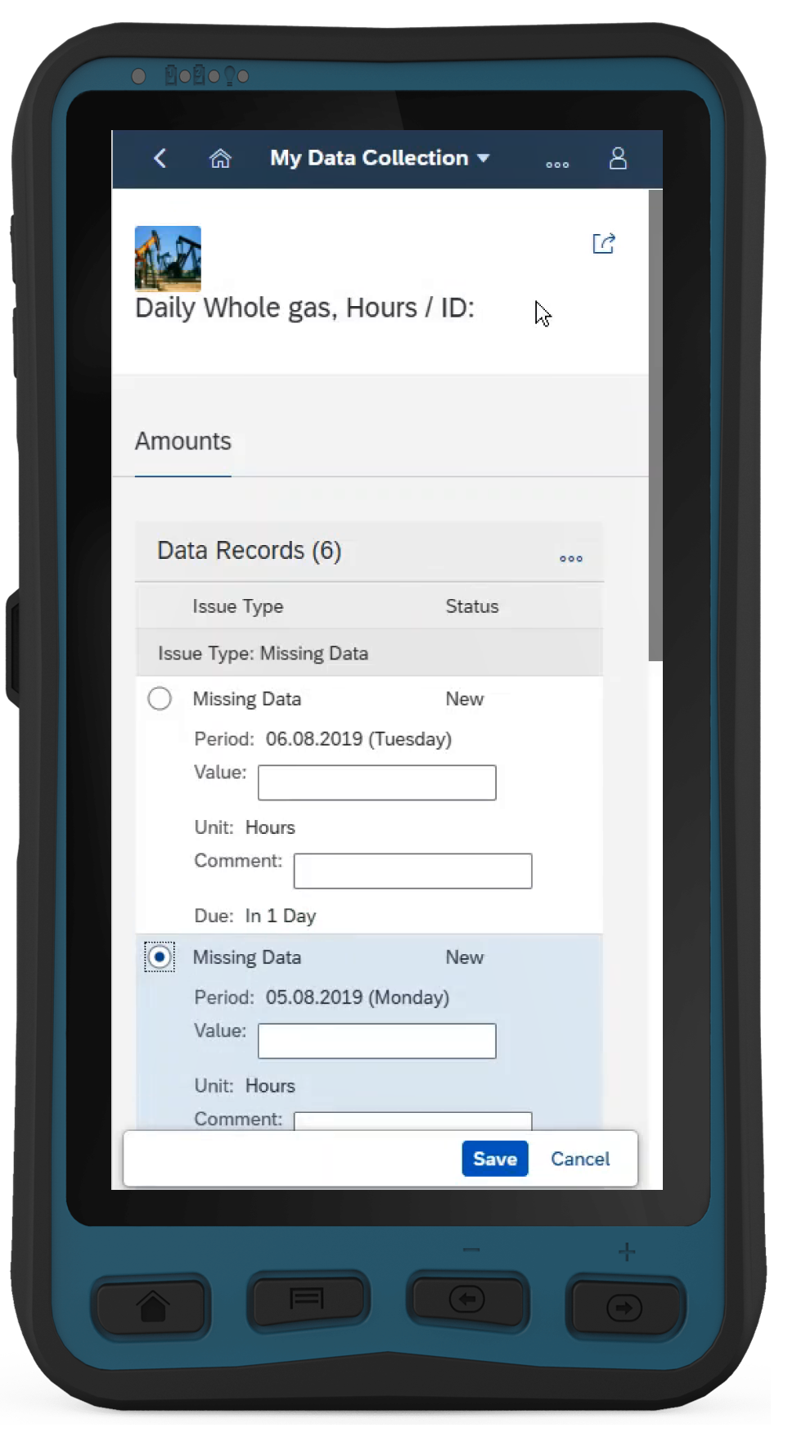
Data Collection – Manual Process
With the My Data Collections app the system provides the production operator a mobile, optimized and more efficient way of collecting the required data related to a compliance scenario. ​
​
​The extended features in the My Data Collections app improve the process of collecting data in the field with:​​
Fiori app with mobile support​​
Ad-Hoc collection of event data ​​
Approval control and ability to correct the collected data​​
Import/export data from spreadsheet

Slide 9
Data Collection – Automated
The Data Collection activity is defined by assigning Environmental Limits and responsible Persons to perform the measurement.
Additionally, the schedule of the data collection can be maintained as well as manual versus automated collection setting.

Slide 10
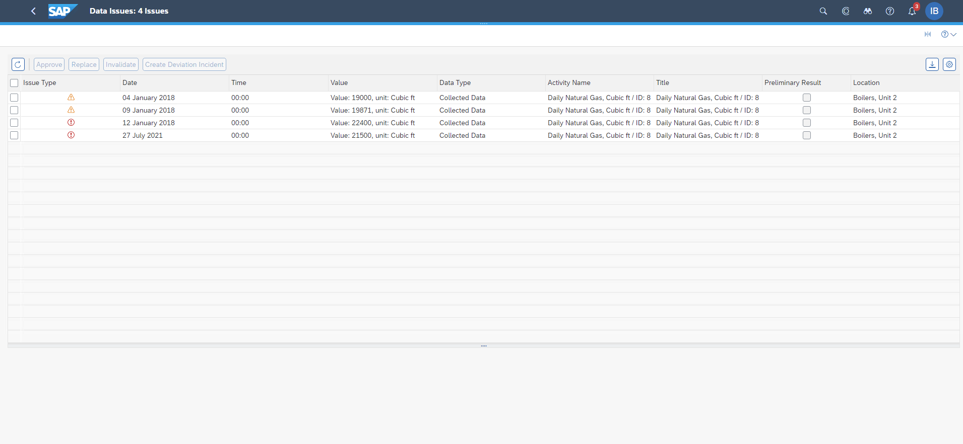
Data Validation
Collected and Calculated data is automatically compared to associated limits and flagged if exceeded.
Limit warnings and exceedances are displayed in the Data Issues –Exceedances & Warning Tile.

Slide 11
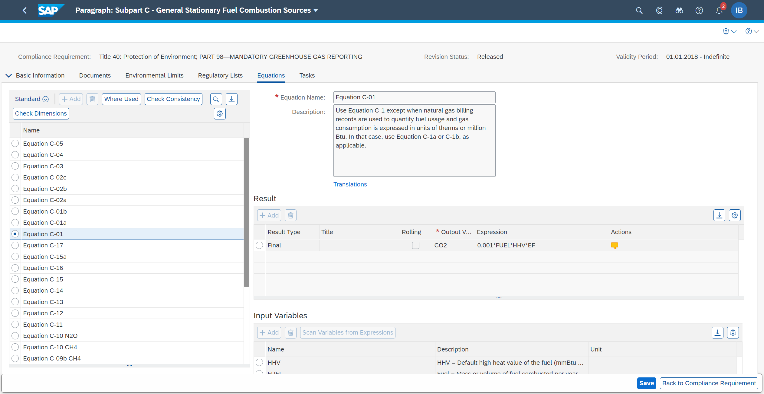
Calculate GHG Emissions
Equations can be defined within the compliance requirement and can be used for calculating emissions for one or more locations.
Predefined equation library for certain country/region are available out of the box.
Regulatory list such as emission factors can be stored and used for emission calculation.

Slide 12
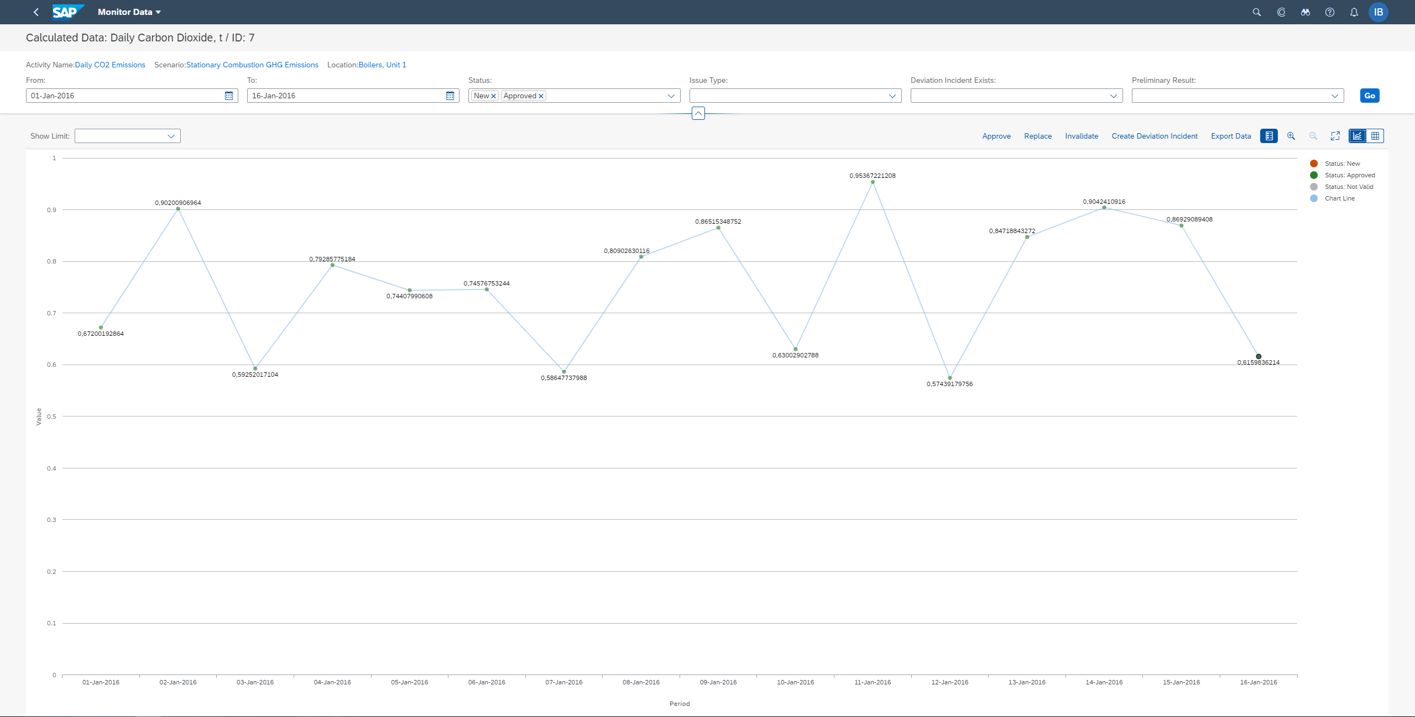
GHG Emissions Monitoring
Collected activity data and calculated emissions data can be monitored with Monitor Data app.
The data can be visually displayed if validation limits are configured.
User can Approve, Replace, Invalidate, Create Deviation for warning/exceeded data.
Data can be imported as well using MS Excel within Monitor Data App

Slide 13
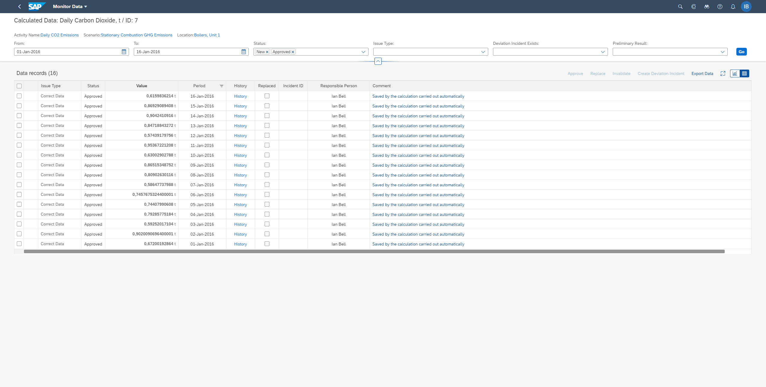
Validate Emissions
There are multiple steps in the emissions process to allow users to validate, correct, and audit emissions results.
There are tabular views of collected and calculated data, data change logs for auditing, and data deviation tracking.

Slide 14
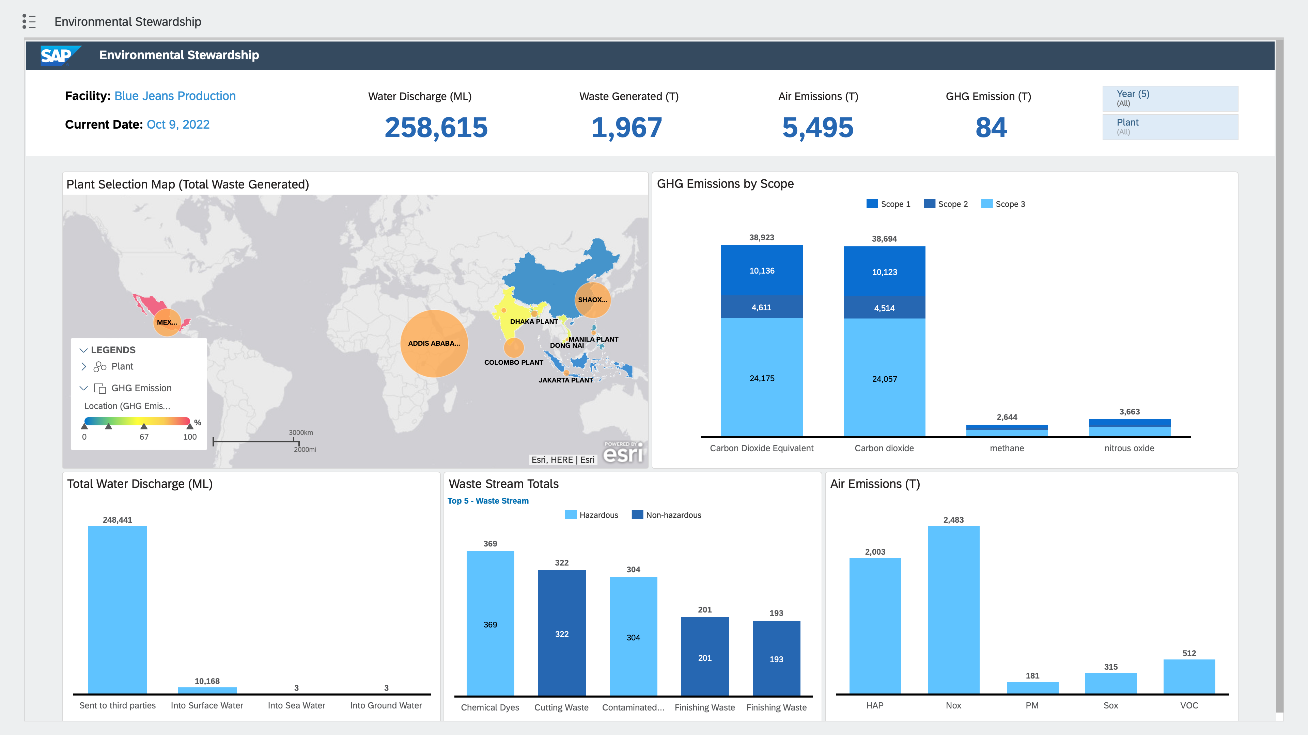
Utilize GHG Emissions results for reporting
Emissions results can be outputted in multiple ways. One is through a set of a dashboards in SAP Analytics Cloud focused on plant operations and the emissions and waste being generated.
Other options include embedded analytics within SAP EHS, exports to MS Excel, Emission Declaration outputs for regulations, and direct data feeds to sustainability reporting tools like SAP Sustainability Control Tower.

Slide 15
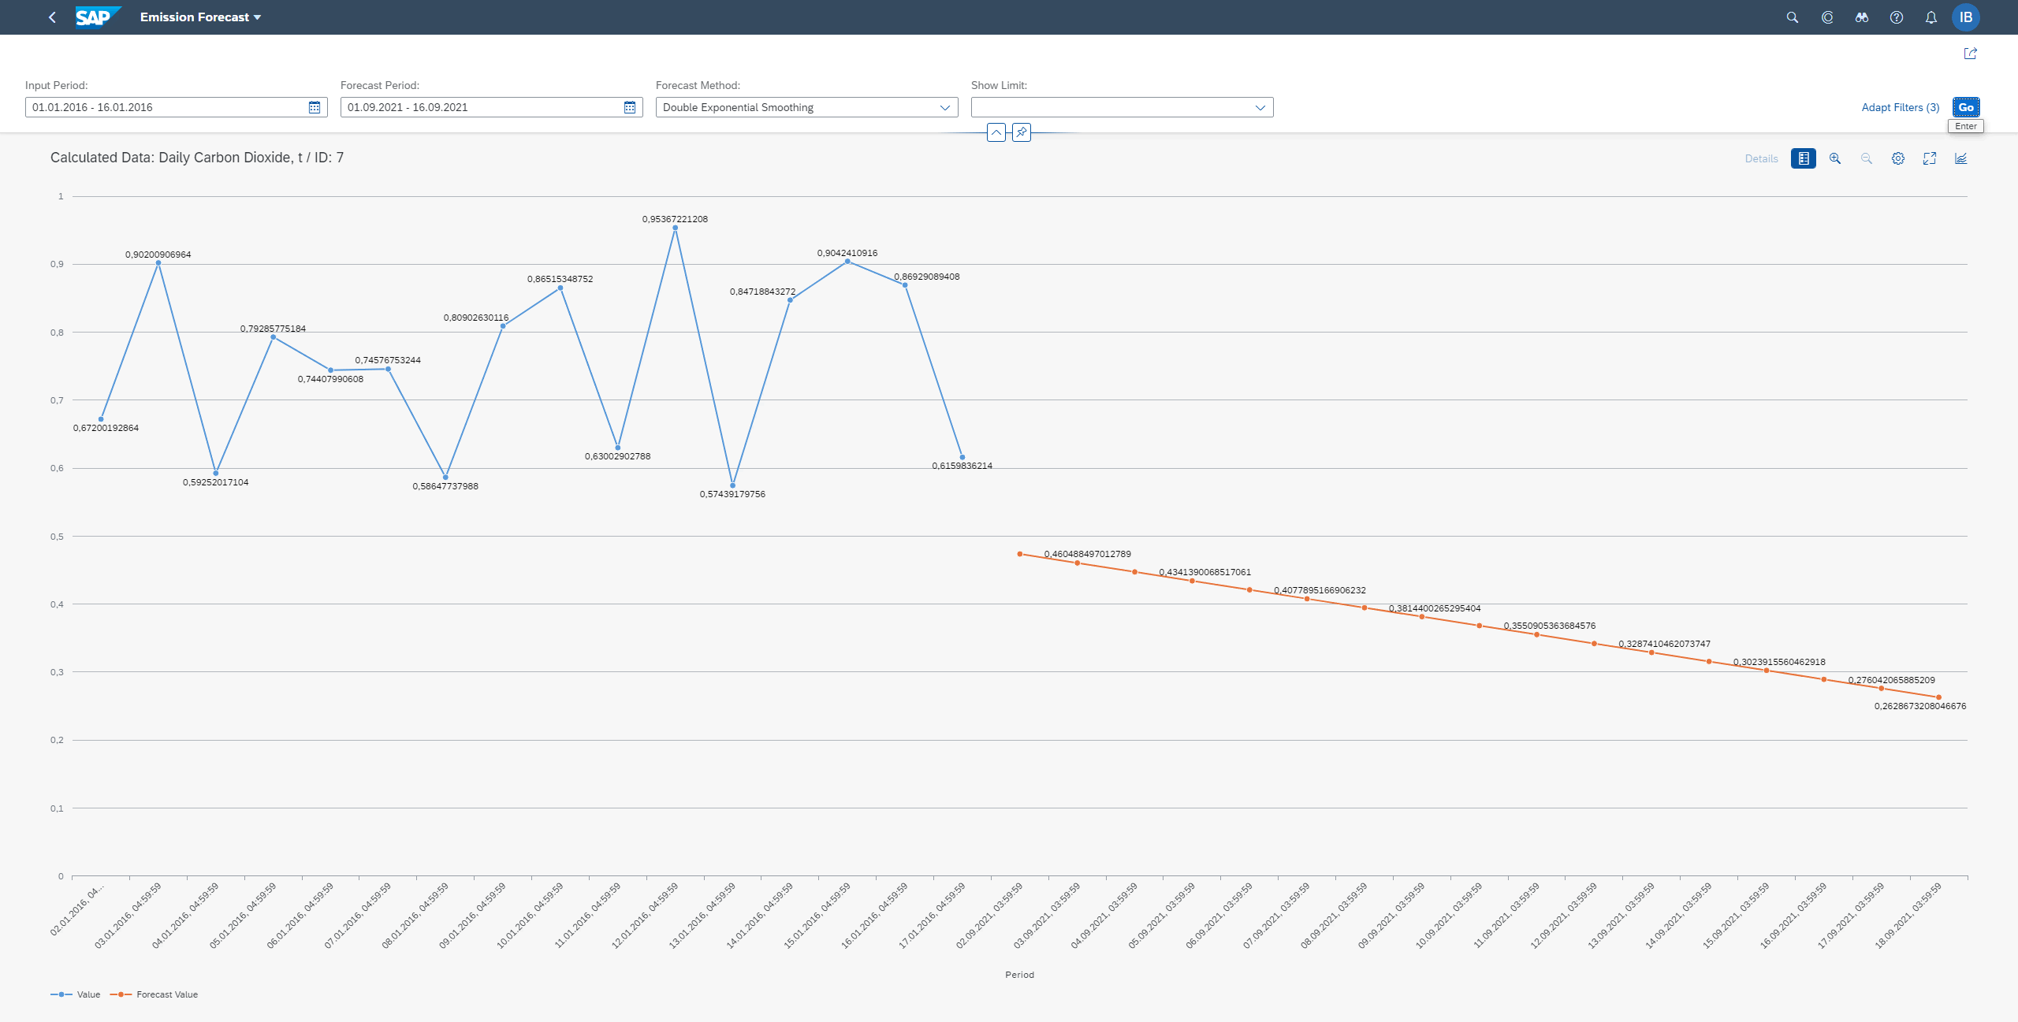
Utilize GHG Emissions data for forecasting
Historical data can be leveraged to predict/forecast future period data.

Slide 16
GHG Emission Management
Functional Components
Emissions Planning
Collect and Calculate Data
Monitor Data
Outputs
Link applicable compliance requirements to locations and equipment
Plan data collection, calculations, sampling and aggregation activities
Equations
Define emission limits
Task-driven data collection
Data based on hourly, daily, monthly and yearly intervals
Automatic data collection from data historians and sensors
Aggregation based on location hierarchy
Equations, factors, and calculations supporting the GHG Protocol and other emission reporting frameworks
Monitoring views for data validation issues and compliance deviations
Deviation investigation and correction
Data analysis with Environment Data Explorer
Audit trail of changes
Emissions Forecasting Tool
Direct data feed to SAP Sustainability Control Tower
Embedded analytical views for GHG emission results
Data Export of results for carbon footprint calculations
Emissions Declarations

Slide 17
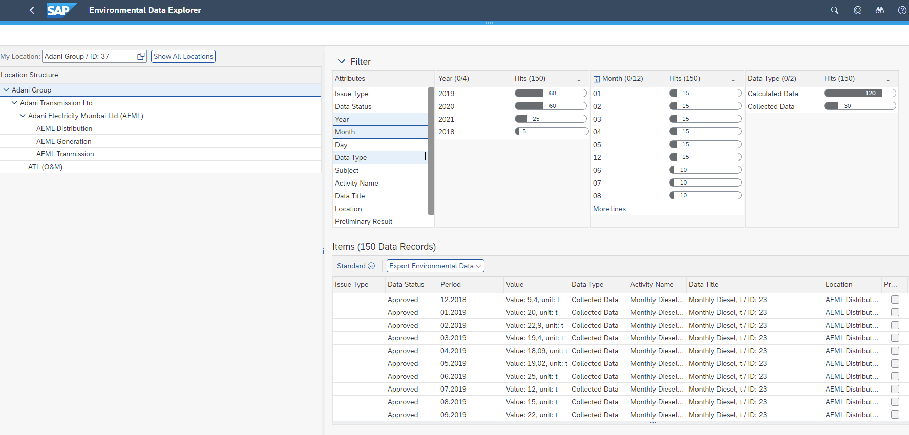
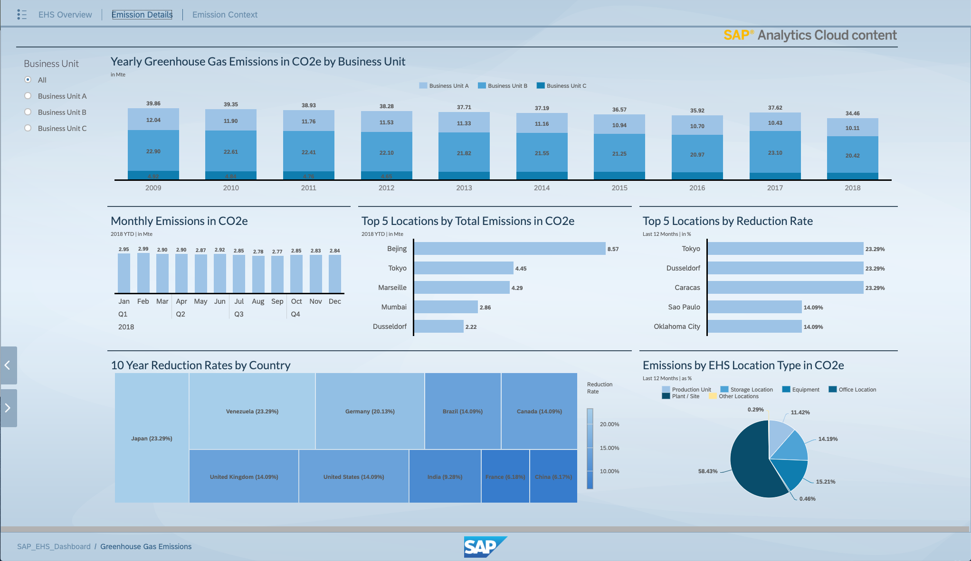
GHG Emissions Management
Outputs
Data Explorers
Trend Monitoring
Analytics

Slide 18
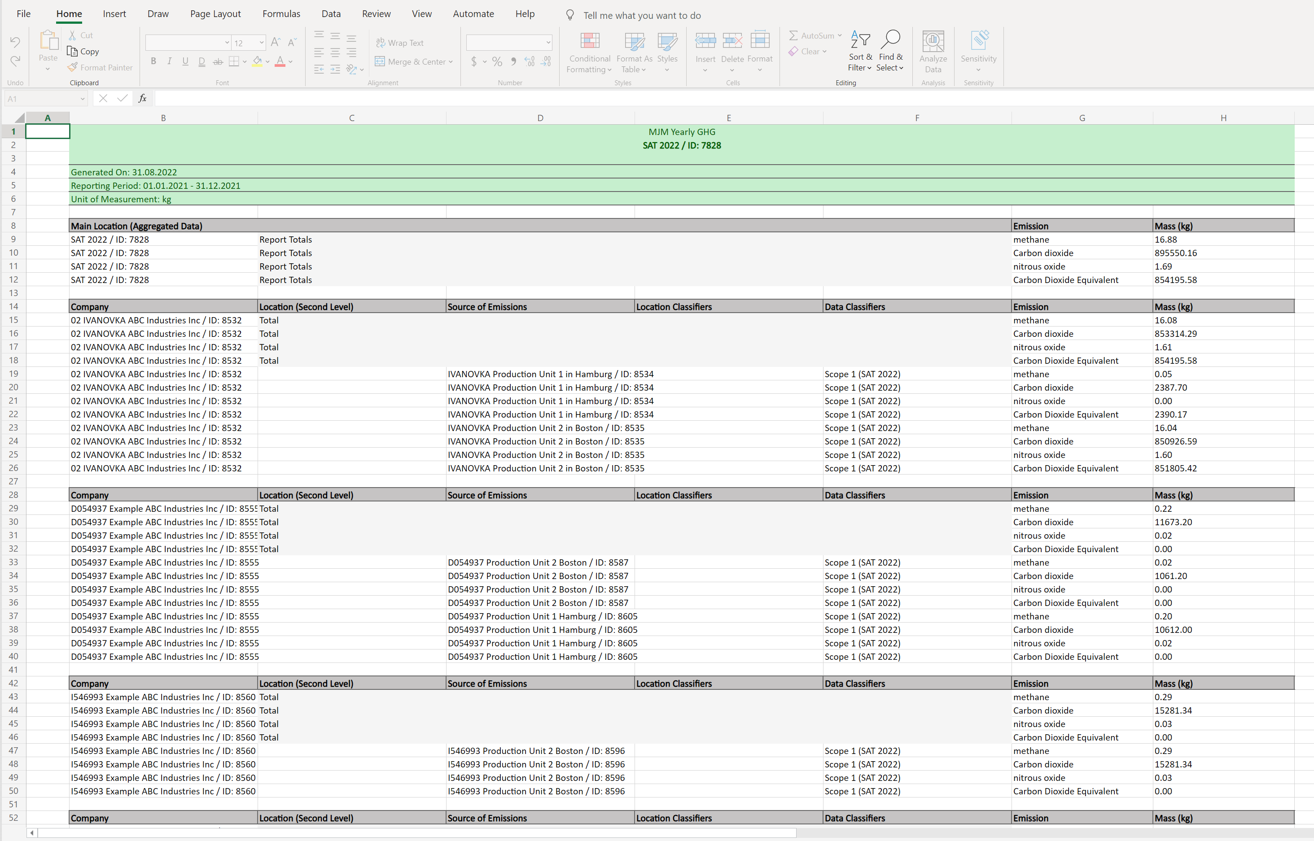
CO2e versus actual GHG Inventory
Greenhouse Gas Inventory (actuals)
Calculation of specific amounts of specific gases (CO2, SF6, N2O, Methane, etc)
Some of the regulations and frameworks calling for actual emission amounts
US EPA 40CFR Part 98
US SEC Disclosure Rule
Australian NGERS
GHG Protocol Scope 1 and 2
Global Reporting Initiative
All covered by functionality and standard content in EHS-EM
GRI wants the final submittal in CO2e, but specific emission amounts of CO2, CH4, N2O, HFCs, PFCs, SF6, NF3 are needed for Scope 1 and 2 emission (305-1 and 305-2 respectively) and intensity ratios (305-4) disclosures.
CO2e
Used to measure and compare emissions from greenhouse gases based on how severely they contribute to global warming
EHS-EM is designed to handle actuals due to regulatory compliance focus and can calculate a true GHG inventory along with CO2e.

Slide 19


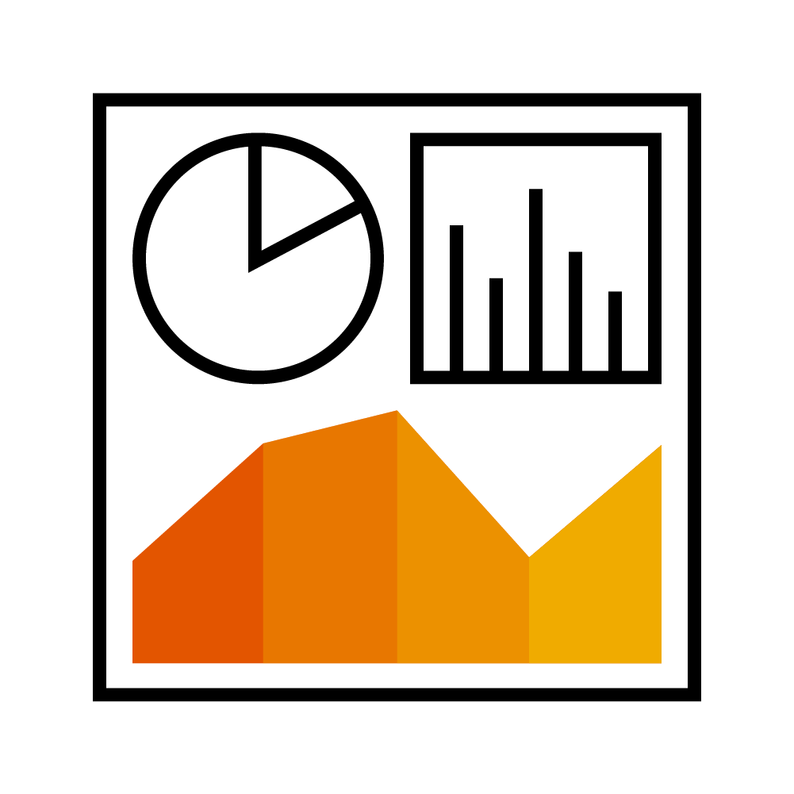
Integration
Process
Data
Reporting
Handoffs and triggers that occur in your real-life business processes can be driven by the system with no drops in communication or responsibility
Process improvement is not only enabled by the system, but the system becomes a source of new ideas and innovation
Provides context not matched by point solutions
Data entry at all levels is quicker and less error-prone
Processes run on a consistent source of truth
EHS department does not need to deal with maintaining enterprise data
Consistent user-interfaces across multiple parts of SAP
No need to maintain separate interfaces to other reporting tools
Leverage central SAP ERP hierarchies as a source of truth like Plant, Functional Locations, Cost Centers, and Org Structure to enable both roll-up and drill-down reporting in real time
Consistent security paradigm between process data and reporting logic
Gain additional insight with ability to pull data from disparate processes within the SAP landscape

Slide 20



Why SAP EHS is best to help you calculate emissions
The combination of the calculation and forecasting engine within SAP EHS Environment Management with analytical outputs from SAP Analytics Cloud provides an end-to-end solution for tracking GHG emissions integrated with business processes across the enterprise.
Corporate
EHS Practitioner
Operations
Real-time visibility into the enterprise for better insight into reducing energy usage and carbon emissions
Reduced risk of non-compliance
Primary source of emissions data that can be provided for overall corporate sustainability reporting and carbon credit accounting
Real time analytical reporting across all processes
Direct integration to sources of truth for equipment, locations, people, and chemicals
Flexible calculations engine to model and forecast plant-specific processes and resulting emissions
Empowerment to drive reductions in carbon emissions and improve sustainability performance

Slide 21




Making Global Bike an
Intelligent and Sustainable Enterprise
SAP Sustainability Curriculum
SAP EHS Product Management, SAP UCC Magdeburg
Wolfgang Bock, Mariya Krasteva, Alexander Diener, Stefan Weidner, Robert Häusler, Nils Voigtländer

Slide 22









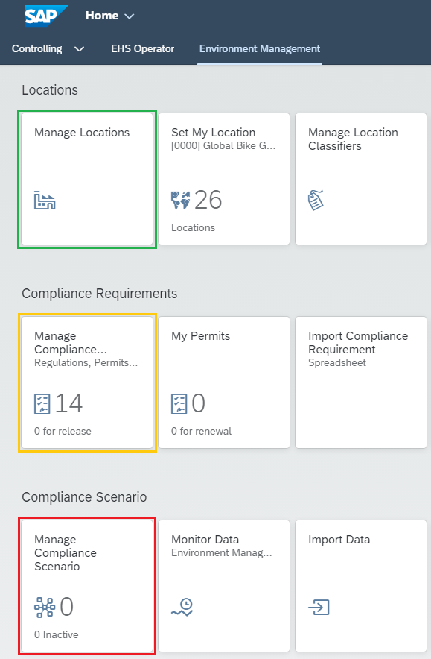
Global Evaluation Project 2023
SAP S/4HANA Environment Management
  10 pilot universities from around the globe
Step 1: Define locations and location hierarchy
Step 2: Define Compliance Requirements
Step 3: Define Compliance Scenarios with
  Data collections
  Samplings
  Calculations
  Aggregations
  Tasks

Slide 23
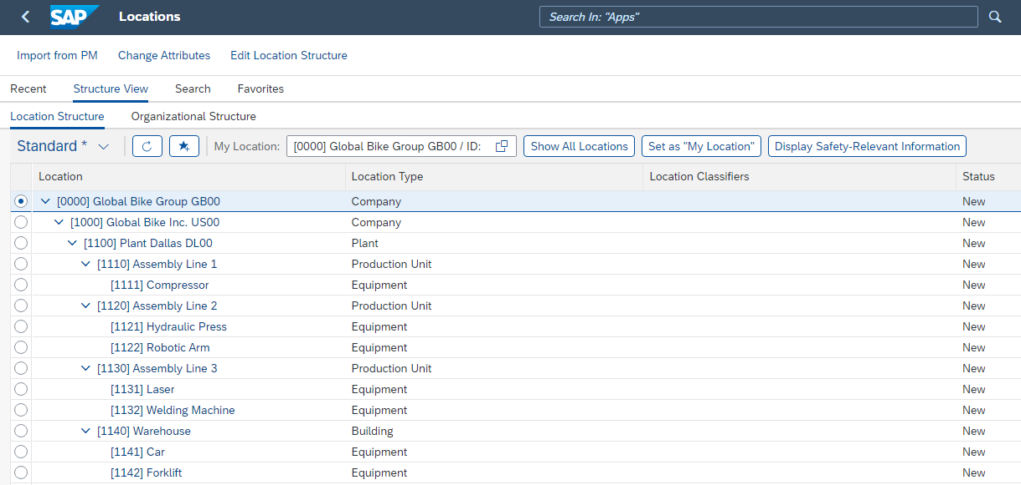
Demo – Location Structure

Slide 24
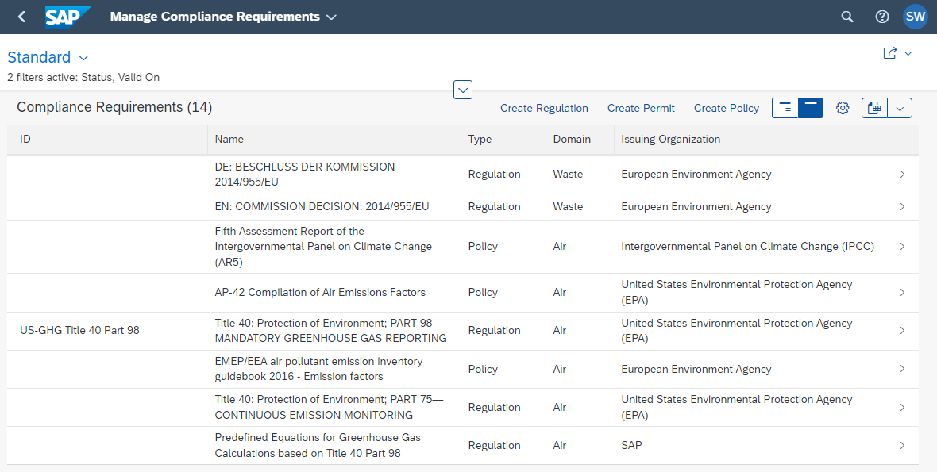
Demo – Compliance Requirements

Slide 25
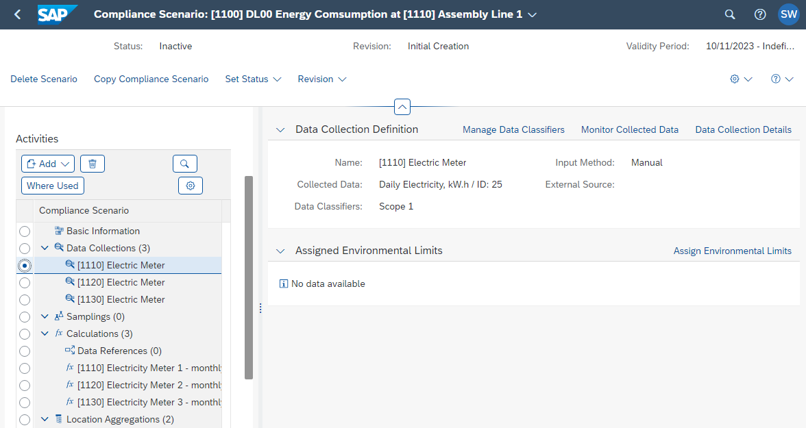
Demo – Compliance Scenario

Slide 26
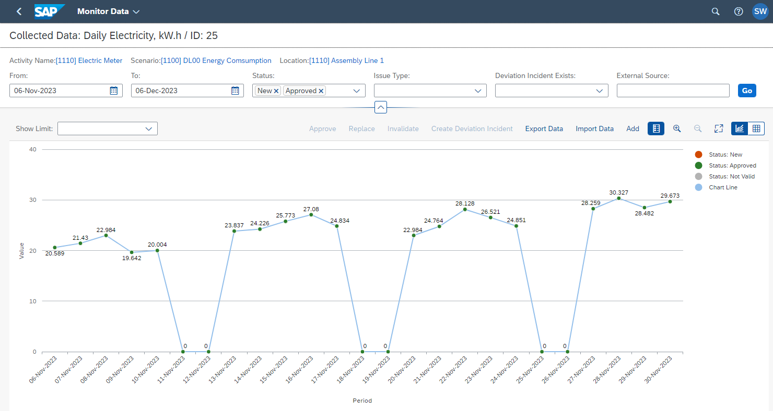
Demo – Data Collection

Slide 27
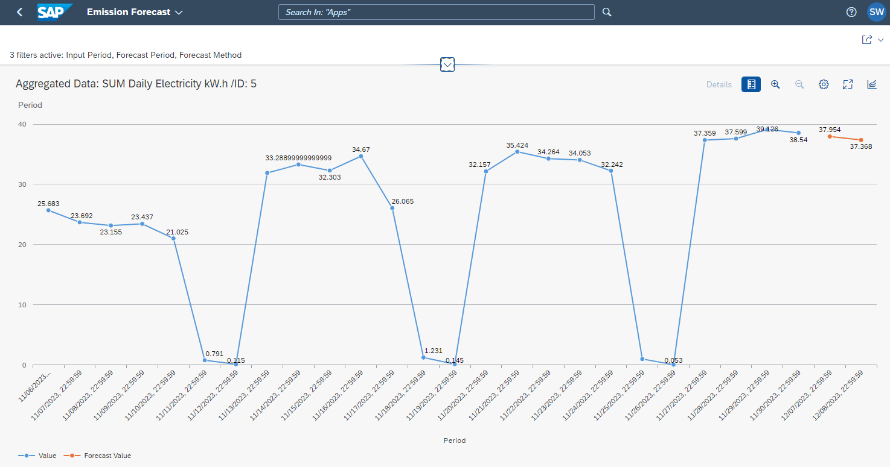
Demo – Emission Forecast

Slide 28
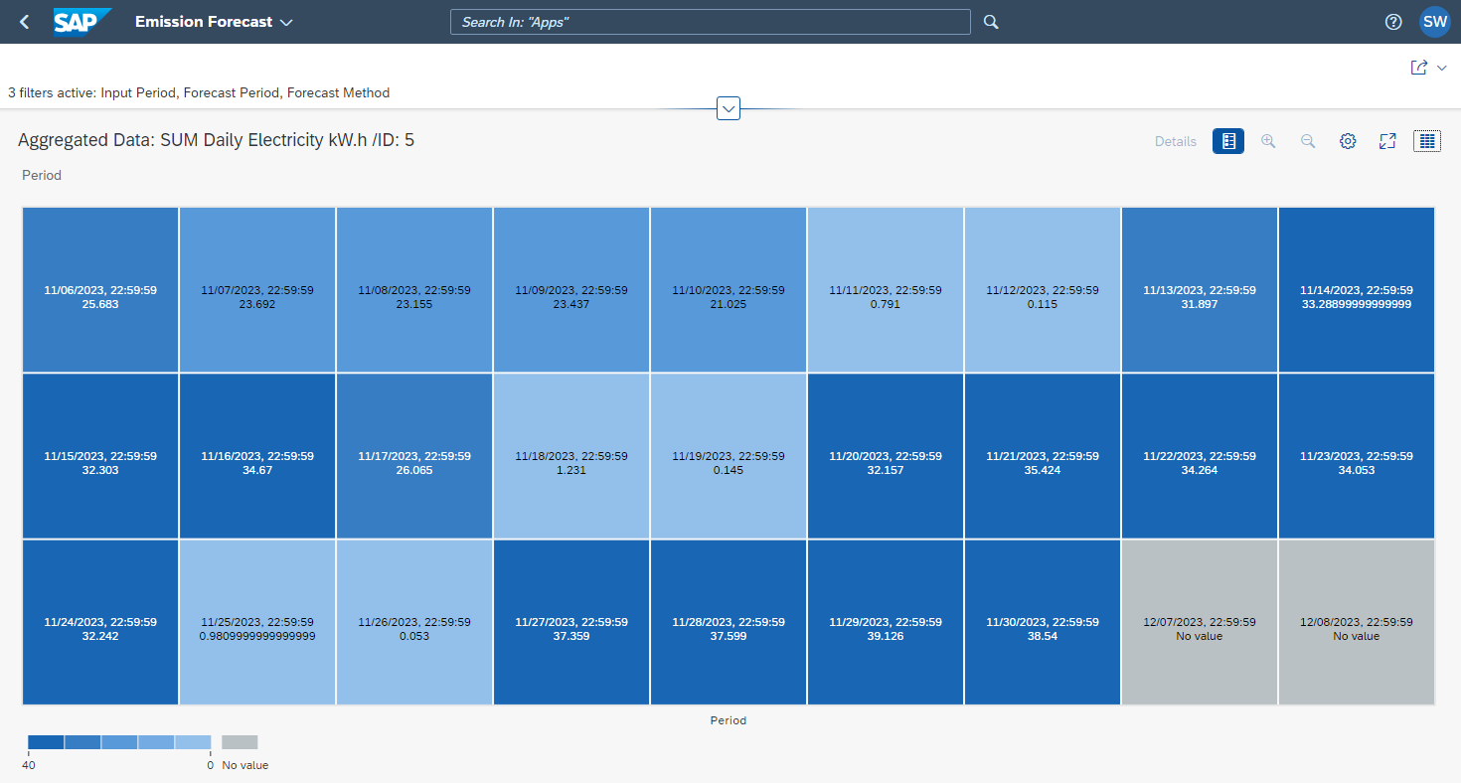
Demo – Sustainability Analytics

Slide 29
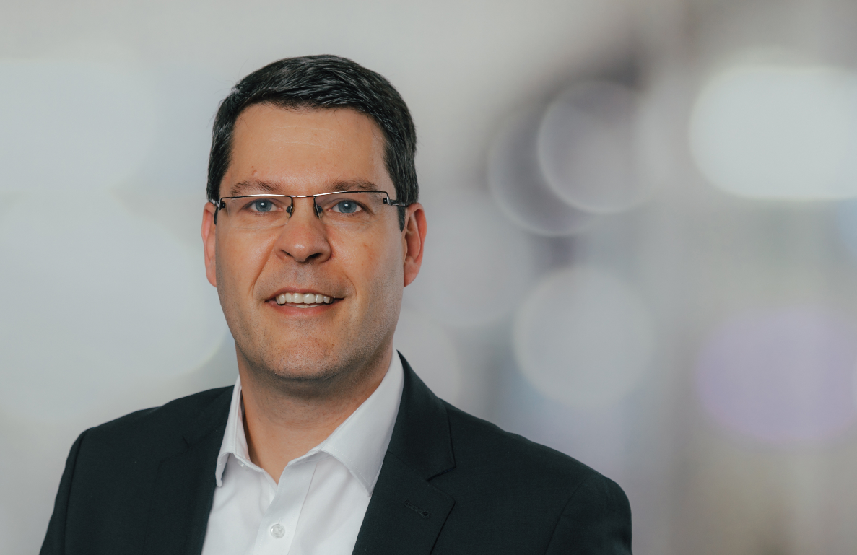
Stefan Weidner
Executive Director
SAP UCC Magdeburg
Otto von Guericke University Magdeburg
stefan.weidner@ucc.ovgu.de
https://portal.ucc.ovgu.de
+49 391 67 54871

