Slide 1
Sales and Distribution (SD)
Curriculum: Introduction to S/4HANA using Global Bike

Slide 2
Innovations in SAP S/4HANA
Focus Sales and Distribution in GBI
Business Partner (BP) is the Single Point of Entry for master data such as customer, vendor, contact person
Transaction BP replaces FD01, FD02, FD03, FD05, FD06, FD0 FK01, FK02, FK03, FK05, FK06, FK08 MAP1, MAP2, MAP3 MK01, MK02, MK03, MK05, MK06, MK12, MK18, MK19, V-03, V-04, V-05, V-06, V-07, V-08, V-09, V-11, V+21, V+22, V+23, VAP1, VAP2, VAP3 VD01, VD02, VD03, VD05, VD06 XD01, XD02, XD03, XD05, XD06, XD07 XK01, XK02, XK03, XK05, XK06, XK07
2) Credit Management has to be initialized in S/4HANA to perform processes in distribution
Simplification in SD Analytics
No aggregates are formed via data for analytical processes. S/4HANA analyzes are based on ODATA and Open CDS (Core Data Services). These data are stored directly on the database and they grow there over time.

Slide 3
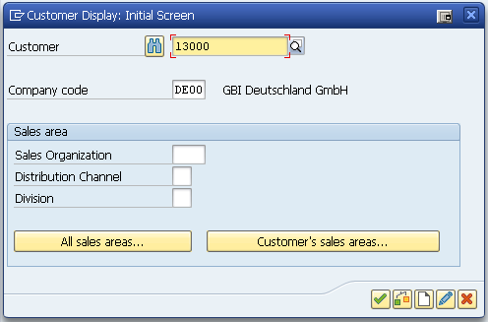
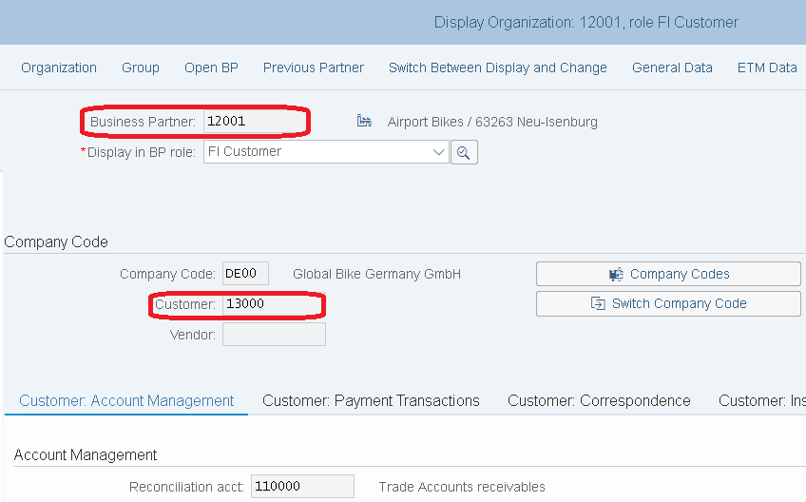
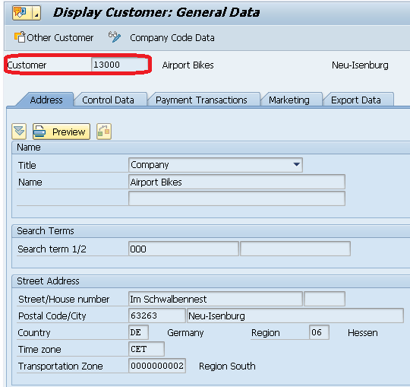
Innovations in SAP S/4HANA
Business Partner
The core function of SAP S/4HANA is the simplification of data structures
various transactions, such as the management of customers or creditor, are summarized
It is (so far) still possible to navigate through the well-known tree paths
A unique business partner number is assigned to customer 13000. This business partner number is assigned to various roles such as the customer, creditor or contact person.
Relationship: n:m

Slide 4
Innovations in SAP S/4HANA
Business Partner
There are redundant object models in the traditional ERP system where the vendor master and customer master is used.
  The (mandatory) target in SAP S/4HANA is the Business Partner approach.
Business partners can be categorized as a person, group, or organization as follows:
  An organization represents units such as a company (for example, a legal person), parts of a legal entity (for example, a department), or an association. Organization is an umbrella term to map every kind of situation in the day-to-day business activities.
  A group represents a shared living arrangement, a married couple, or an executive board.

Slide 5

Innovations in SAP S/4HANA
Credit Management
In contrast to ERP, the component Credit Management (FI-AR-CR) is not available as part of S/4HANA.
Equivalent: SAP Credit Management (FIN-FSCM-CR)
  In ERP there was the possibility to not use the function FI-AR-CR, but FIN-FSCM-CR has to be initialized.
  It helps companies to identify the risk of loss of receivables against their business partners at an early stage, and to make credit decisions efficiently and partially automated.
Recommended for:
  Companies with a high number of business partners
  Companies that want to merge internal and external data of a business partner into an own credit assessment or evaluation.
  Companies that have an extremely distributed system landscape often have
  problems with the consolidation of information on the purpose of credit decisions

Slide 6

Innovations in SAP S/4HANA
Simplification in SD Analytics
Analyzes are based on ODATA and Open CDS (Core Data Services)
stored directly on the database Data grow there over time
SD specific business objects such as Sales Order, Customer Invoice, Outbound Delivery and many others in the data base tables VBAK, LIKP and VBRK are represented by CDS views that regulate uniform access to analytical views
  Is achieved by semantic field names to connect business objects such as customers, materials, etc
  Predefined analytical view of the CDS queries allows the report to be executed directly on the database, without preformed aggregates
  Groupings and filters on the fly

Slide 7
Warehouse Management (WM)
Curriculum: Introduction to S/4HANA using Global Bike

Slide 8
Innovations in S/4HANA
Extended Warehouse Management (EWM)
Long-term the central warehouse management system from SAP
Part of the Supply Chain Execution (SCE) from SAP in contrast to the WM standard
Significant difference: WM system concentrates on internal functions
  Little functionality that provides link to external processes (i.e. contract packaging or transportation)
In addition to the classical properties for structuring and warehouse control → EWM contains Instruments for strategic placement of the warehouse within the supply chain
Detailed picture of the complete warehouse complex → improves the overview of the total quantity of the product in the warehouse
Holdings from several plants can be stored together

Slide 9
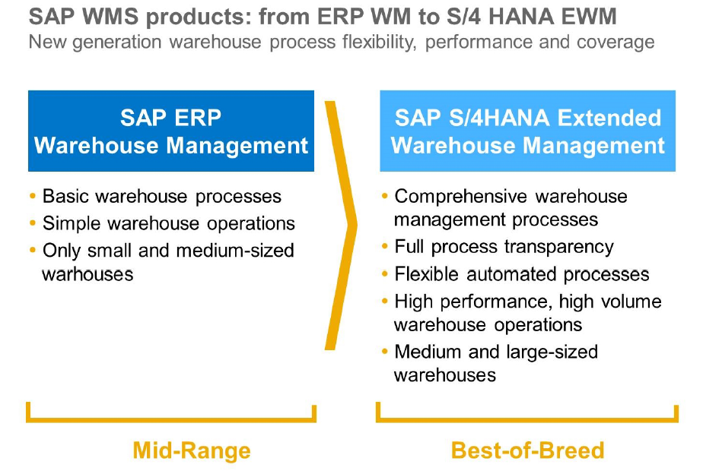
Innovations in S/4HANA
Extended Warehouse Management (EWM)

Slide 10
Innovations in S/4HANA
Extended Warehouse Management (EWM)
Scenarios with ECC 6.0
Scenarios with S/4HANA
SAP ERP
ECC 6.0
SAP decentralized EWM
(Advanced)
SAP S/4HANA
SAP decentralized EWM
(Advanced)
Interface
Interface
WM
WM
Embedded EWM
(Basic/Advanced)
Classic illustration with an ERP ECC system
License costs for EWM (decentralized EWM)
WM can be used indefinitely for new launches (as long as ECC 6.0 is still in use)
No SAP support for ERP WM from 2025 onwards
Illustration based on S/4HANA
No EWM license costs for the „Basic Version“ of the integrated EWM
WM usage rights in S/4HANA ends 2025
A change from ECC 6.0 to S/4HANA requires a change to EWM from this point onwards

Slide 11

Innovations in S/4HANA
Extended Warehouse Management (EWM)
Extended Warehouse Management
  Optimization of inventory management (e.g., slotting)
  Inbound process optimization (e.g., deconsolidation)
  Outbound process optimization (e.g., wave management)
  Material Flow Control (MFC)
  Yard management (e.g., TU processing, DAS)
  Laboratory management
  Logistic additional services (VAS, for example, Kitting processing)
  Cross docking
  Inventory process cost accounting
Basic Warehouse Management
  Inventory management
  Inbound processing
  Outbound processing
  Internal stock movements
  inventory procedures
  Reporting
SAP S/4HANA SUPPLY CHAIN
Suite
Optimization of warehousing processes
Extended Warehouse Management
Products
Basic Warehouse Management
Digital Core
Stock security and transparency
S/4 HANA

Slide 12
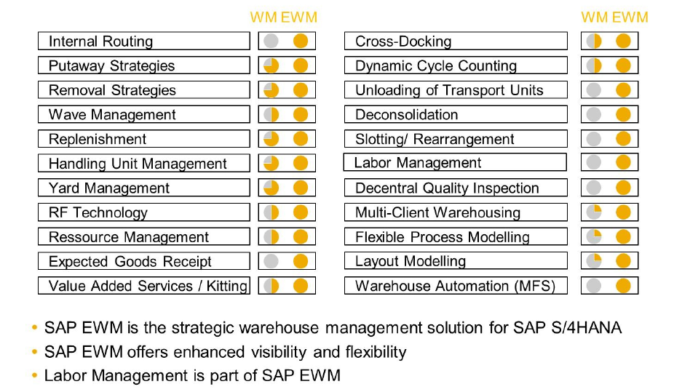
Innovations in S/4HANA
Extended Warehouse Management - Scope of functions

Slide 13
Innovations in S/4HANA
Extended Warehouse Management - Scope of functions
Optimized warehouse space management
  Different storage facilities (automatic bearings,…) can be arranged in different storage types according to their own requirements
  Stock movements can be better understood as each storage location is mapped in the system
  In addition, each product will receive an optimal storage location according to its size and access frequency
Goods movements
  EWM is used to process all goods movements that affect the warehouse
  Storage capacity and material flows are optimized using put away and removal strategies
  Optimizing takes place individually as required or by using handling units

Slide 14
Innovations in S/4HANA
Extended Warehouse Management - Scope of functions
Stocktaking
  Product related or storage related
  Different monitor with adjustable tolerance groups, over which maximum values can be configured for the calculation of differences
  Additional extras: automatic close out after time limits, inventory procedures according to different priorities, zero check, low stock control
  Radio frequency functionality is integrated in for example Cycle Counting
Planning and monitoring
  Forward-looking load analysis and early intervention in case of faulty warehouse processes
  Extensive monitor functions project a up-to-date picture of all activities in the warehouse
  Actual work in the warehouse can be controlled this way

Slide 15
Innovations in S/4HANA
Extended Warehouse Management - Scope of functions
Wireless data connection
  Controlling the work steps via mobile radio terminals → clear and economical
  The radio frequency connection (RF connection) for mobile data acquisition ensures a fast data transmission
  RF devices receive data from the SAP system and transmit data back, e.g. through barcodes
Warehouse control
  EWM has interfaces to external systems (storage controllers)
  e.g. automated storage and retrieval systems can be integrated for all storage movements

Slide 16
Innovations in S/4HANA
Reasons to Switch to EWM
Reduce costs through better warehouse efficiency, increased labor productivity, and better space utilzation
Increase transparency in stock and processes
Increase flexibility in warehouse process modeling
Implement customer specific put-away and retrieval strategies
Quickly onboard new customers
Better manage value added distribution processes
Strong integration with other SAP solutions
Integrated Material Flow System (MFS) for automated storage and retrieval

Slide 17
Production Planning and Execution (PP)
Curriculum: Introduction to S/4HANA using Global Bike

Slide 18
Innovations in S/4HANA
The Functional relationship between Bill of Material (BOM), Routing and Production Version has been changed to streamline future release/revision process .
The ERP Engineering Workbench is not the future target architecture. It will not be updated, but will still work at a functional level in the system.
MRP has been optimized for the SAP HANA real time database and is called MRP LIve. All MRP relevant data is read directly from the system instead of being stored in a separate table in ERP.
Sales & Operations Planning (SOP) is replaced by Integrated Business Planning (IBP).
Material Number Field length is extended from 18 characters to 40 characters. This will appeal to many different customers

Slide 19
Innovations in S/4HANA
Innovations in S/4HANA compared to ERP in Production Planning
  Customizing for date validity is no longer considered for BOM explosion → Instead, only BOMs with valid production version are considered during BOM explosion.
    For old BOMs you can perform a report
    For new BOM there are a standard value in the customizing
  Maintaining product version enables to combine the BOM and Routing entities which helps in streamlining the release/ revision process in future.
Engineering Workbench is not the target architecture anymore and will not receive any further updates
  was used in GBI for BOM and Routings
  required to use alternative UIs, e.g. in Fiori, Web UI or GUI to maintain BOMs and Routings.

Slide 20
Innovations in S/4HANA
  MRP optimized for SAP HANA
    reads material receipts and requirements, calculates shortages, and creates planned orders and purchase requisitions all in one database procedure → minimizes the volume of data that has to be copied from database server to application server and back
    MRP Live reads material receipts and requirements, calculates shortages, and creates planned orders and purchase requisitions all in one database procedure
      minimizes the volume of data that has to be copied from the database server to the application server and back, which considerably improves performance.
    MRP Live always creates purchase requisitions if the material is procured externally.
    Multi-level, make-to-order planning (transaction MD50) and Individual project planning (transaction MD51) is not optimized for HANA

Slide 21
Innovations in S/4HANA
Sales & Operations Planning (SOP) replaced by Integrated Business Planning IBP
  Sales & Operations Planning (SOP) is a forecasting and planning tool for setting targets for sales and production based on historical, current, or estimated data used for long-term strategic planning, not short-term tactical planning
  SOP is often performed on aggregated levels such as product groups and work-center hierarchies.
  IBP supports all SOP features plus
    advanced statistical forecasting,
    multi-level supply planning,
    Collaboration and optimizing tools,
    an Excel-based UI, and Web-based Uis
The key capabilities of SAP IBP for Sales & Operations are as follows:
  Future production analytics will be based on SAP HANA, core data services (CDS) views aggregating transactional data dynamically, and powerful analytical UIs for multi-dimensional reporting. With this, it will be possible to replace the current logistics information system (LIS).

Slide 22
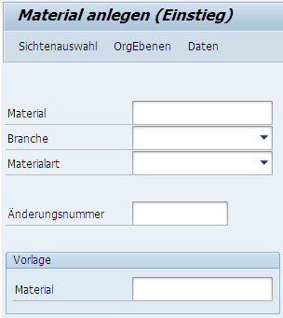
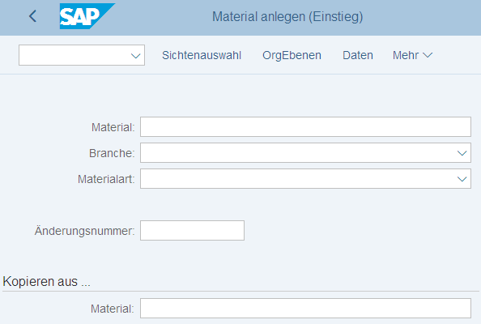
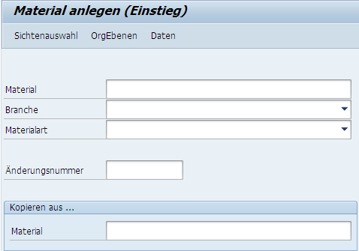
Innovations in S/4HANA
Material Number Field Length Extension from 18 to 40 characters

Slide 23
Financial Accounting (FI)
Curriculum: Introduction to S/4HANA using Global Bike

Slide 24
Innovations in S/4HANA
The General Ledger is the Single Point of Truth. All transactions are stored in the Universal Journal table. The table also stores transactions for Controlling thereby removed many of the reconciliation activities in ERP.
Finance incorporates a re-designed General Ledger and and new asset accounting functionalities.
Using the real time SAP HANA database means that reporting from many different finance areas is unified into a single repository.

Slide 25
Innovations in S/4HANA
General Ledger
General Ledger in S/4HANA is based in the Universal Journal
Line items are stored in the new database table ACDOCA -> optimized to SAP HANA
  no need for CO real-time integration for transfer of secondary CO postings to New GL or the Reconciliation Ledger of Classic GL
  Cost elements are created and managed together with G / L accounts in S / 4HANA. A more detailed description can be found in the CO slides
CO internal postings are now visible in General Ledger as well
The new journal entry consists of a header (table BKPF) and the respective items (table ACDOCA).
The ACDOCA table contains all fields needed for G/L, CO, AA, ML, PA, providing one single source of truth for all these modules. For CO, the universal journal also contains all cost elements, including secondary cost elements, which are also in SAP S/4HANA G/L accounts.
Notes:
https://help.sap.com/doc/554b6154b6718c4ce10000000a4450e5/2.6/en-US/276e8854d45da064e10000000a423f68.html

Slide 26
Innovations in S/4HANA
General Ledger
General Ledger Accounting
Profitability Analysis
Ledger
Company
Account1
Account2
Account3…
Profit Center
Operating Concern
Segment
Universal Journal (New Table in S/4 HANA sFIN: ACDOCA)
Ledger
Company
Cost Elements
Profit Center
Account1
Account2
……
Asset
Material
Controlling
Asset Accounting
Material Ledger
Controlling Area
Cost Elements
Account1
Account2…
Company
Assets
Company
Materials
Various accounting applications merge in the new structure of Universal Journal (ACDOCA)
The new comprehensive data table ACDOCA contains all of the line item documents from FI, FI-AA and CO

Slide 27
Innovations in S/4HANA
Data Model is made very simple
All the Aggregate and Index tables are removed and are calculated on the fly
Before
S/4 HANA
BKPF
BSEG
BSIS
BSIK
BSET
SAP ERP
Financials with Aggregates and Indices
LFC1
GLTO
COBK
COEP
COSP
After
S/4 HANA
S/4 HANA Financials
BKPF
BSEG

Slide 28
Innovations in S/4HANA
Financial Reporting and Analytics Simplified
Before
Traditional
Financial
Reporting
Financial Reporting
Management Reporting
FI
CO
CO-PA
SAP ERP
Financials
OR
OR
After
Unified Reporting
Financial Reporting
Management Reporting
FI
CO
CO-PA
SAP S/4 HANA Financials
+/AND
+/AND
Key Figures
Measures
Dimensions
Comprehensive Reporting Including CO and CO-PA detail
Reporting is not limited by application boundaries
Run one report (e.g. P&L) and drill-down to any dimension available in the financial documents

Slide 29
Innovations in S/4HANA
Currencies in Universal Journal
Situation in ECC | Situation in S/4H
In the Business Suite (ECC) there used to be up to 3 parallel currencies in FI (table T001A / tx OB22) and 2 parallel currencies in CO (TKA01 / tx OKKP): CO area currency and object currency | With the universal journal and the common line item table ACDOCA for FI and CO, there is also a central currency configuration for the universal journal. As the currency configuration depends on the universal journal ledgers, there is a combined view cluster for ledgers and currencies, tx FINSC_LEDGER
The currencies of non leading ledgers in New GL (T882G) were a subset of the currencies in the leading ledger (T001A) | Table BSEG is not extended and still contains only 3 parallel currencies
One of the CO currencies needed to be the local currency (CT 10), but it was not necessary that the other currency in CO was also configured in FI | SAP´s goal is to implement full process integration of all currencies fields in all processes in accounting
 | all journal entry items are converted in the accounting interface for all configured currencies, regardless of the source where the business transaction originates from

Slide 30
Controlling (CO)
Curriculum: Introduction to S/4HANA using Global Bike

Slide 31
Innovations in S/4HANA
No separate cost element master data maintenance anymore
Universal Journal combines account assignment of Controlling
Technical changes in material ledger

Slide 32
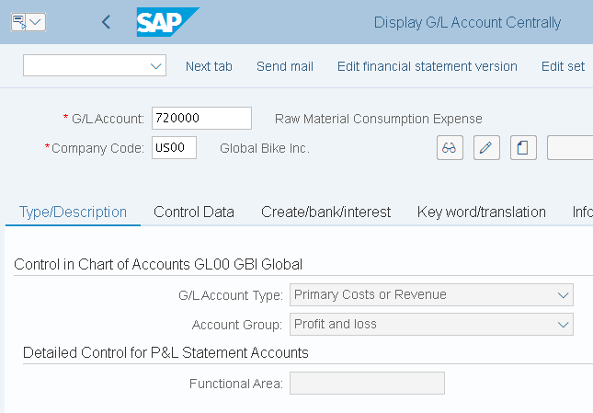
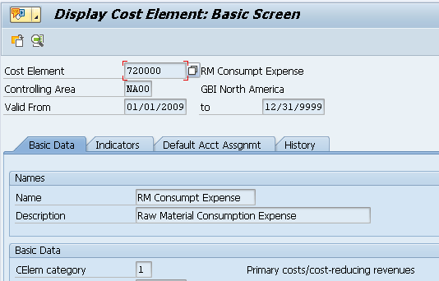
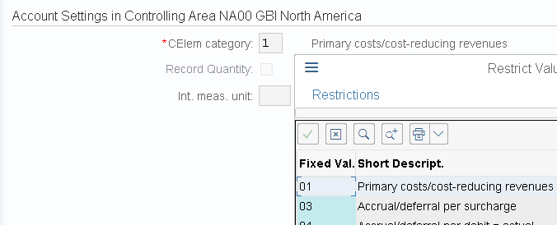
Innovations in S/4HANA
1) Cost element master data maintenance
No separate cost element master data maintenance anymore
  Part of chart of accounts, are managed in GL account master data
  Transactions not available anymore: KA01,KA02,KA03,KA06
  Default account assignments (cost center, order) will be transferred from cost element masters to table TKA3A (view using transaction OKB9)
  The GL account master record includes a new
  mandatory field for cost element category for
  classification of GL accounts
  Previously in KA01

Slide 33
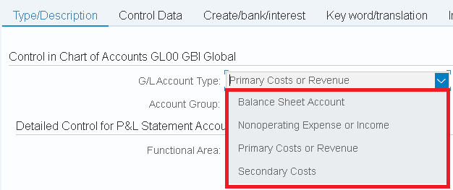
Innovations in S/4HANA
1) Cost element master data maintenance
GL accounts have now attributed on three levels:
1. Chat of accounts area
2. Company-code-specific area
3. Controlling-area-specific area
New account types for primary costs/revenues and secondary costs
Journal entries are recorded under GL accounts (secondary and primary costs)

Slide 34
Innovations in S/4HANA
2) Universal Journal
Universal Journal combines account assignment of Controlling (cost center, WBS element..), Profitability Analysis (products, customers..) and Enterprise Controlling (profit center)
  In previous architecture, many reconciliation work was necessary because the components for P & L representations were structured differently and stored in different tables
  More flexibility: reporting on following dimensions: profit center, functional area, cost center, internal order, project and market segment
SAP Accounting versus SAP ERP
SAP ERP
stability
flexibility
Advantages:
Harmonized external and internal reporting
Increased flexibility in reporting and analysis
No need for coordination
Significantly reduced memory requirements
Compatibility Views for the sum / index tables
Reporting continues to work
totals & indices
External accounting
processing
Logistics
receipt
FI
receipt
CO
receipt
Predefined aggregates
totals & indices
Internal accounting
analytics
SAP Accounting
stability
flexibility
Logistics
receipt
Universal Journal Entry
processing
Aggregation on the fly
through HANA views
analytics
One place of administration-> across applications

Slide 35
Innovations in S/4HANA
2) General Ledger
General Ledger in S/4HANA is based in the Universal Journal
Line items are stored in the new database table ACDOCA -> optimized to SAP HANA
  no need for CO real-time integration for transfer of secondary CO postings to New GL or the Reconciliation Ledger of Classic GL
CO internal postings are now visible in General Ledger as well
The new journal entry consists of a header (table BKPF) and the respective items (table ACDOCA).
The ACDOCA table contains all fields needed for G/L, CO, AA, ML, PA, providing one single source of truth for all these modules. For CO, the universal journal also contains all cost elements, including secondary cost elements, which are also in SAP S/4HANA G/L accounts.
Notes:
https://help.sap.com/doc/554b6154b6718c4ce10000000a4450e5/2.6/en-US/276e8854d45da064e10000000a423f68.html

Slide 36
Innovations in S/4HANA
2) Universal Journal
Advantages:
  No need for coordination
  Significantly reduced memory requirements
  External and internal accounting are harmonized
  Flexible, multi-dimensional real-time analyses can be executed directly from the Universal Journal - without replication of the data into the BI.
There are apps for:
  reporting on cost centers, internal orders, projects, sales, items and reporting on market segments based on the account-based approach
There aren’t yet apps for:
  reporting on commitments for any of the CO account assignments, reporting on target costs, variance categories, intercompany eliminations, reporting on budget, allotted costs, work in process or results analysis, reporting on cost estimates

Slide 37
Innovations in S/4HANA
3) Technical Changes in Material Ledger
The use of Material Ledger (ML) is now obligatory and automatically active in all SAP S/4HANA systems
  fulfills two basic objectives:
  the ability to manage material prices in multiple currencies/valuations: Material inventory values are normally managed by the system in only one currency (company code currency). The material ledger enables the system to manage inventory values in additional currencies/valuations. This is achieved by updating all goods movements in the material ledger. Currency amounts are translated into foreign currencies at historical exchange rates directly at the time of posting.
  and actual costing: with the purpose of determining actual costs for externally procured materials and materials produced in-house
    In addition, actual costing uses actual costs to valuate inventories of raw materials, semi finished products, and finished products
    Actual costing calculates an actual price (periodic unit price) for each material, into which all actual costs for the particular period flow.

Slide 38
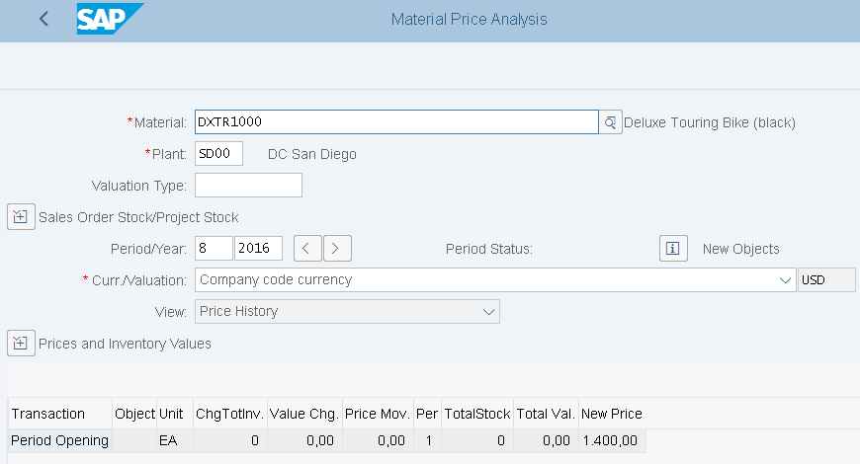
Innovations in S/4HANA
3) Technical Changes in Material Ledger
It is no longer allowed to use an ML type that references currency settings defined in FI or CO
Transaction CKM3PH (Price Determination Structure)
replaces CKM3 / CKM3N
  provides an improved view of materials in plants with
  active Actual Costing
  All views offered by CKM3/CKM3N are no longer
  available, except CKM3 Price History view
  (via CKM3PH for all materials)

Slide 39
Human Capital Management (HCM)
Curriculum: Introduction to S/4HANA using Global Bike

Slide 40
Innovations in S/4HANA
SuccessFactors: the next generation HCM suite in the public Cloud
  the go-forward HCM solution for cloud and on premise
connects S/4HANA with productized integration based on HCI content (HANA Cloud Integration)
  out-of-the-box connectivity options between cloud and on premise applikations
  e.g. OnPremise2Onpremise, Cloud2Cloud or Cloud2OnPremise
SAP S/4HANA customers may also using SAP ERP HCM on-premise

Slide 41
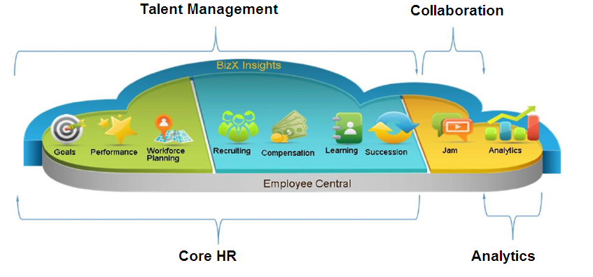
Innovations in S/4HANA
SAP SuccessFactors is the new HR Management in S/4HANA and is supposed to replace the ERP HCM as a cloud solution in the future
The functions are organized in combinable modules:

Slide 42
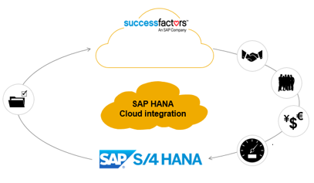
Innovations in S/4HANA
Productized Integrations between SuccessFactors and S/4HANA
Employee Central
Employee Central Payroll
Employee Data
Organizational/Cost Center Assignments
Cost Center Data
Payroll Postings
Employee Availability Information

Slide 43


Innovations in S/4HANA
SuccessFactors is public cloud only | SAP ERP HCM is on-premise only
Deploy together with S/4 HANA cloud edition (productized integration available today) | Deploy as single instance, co-deployed with S/4 HANA on-premise edition
Deploy together with S/4 HANA on-premise edition (productized integration planned 2H2015) | Deploy as separate instance connected with S/4 HANA on-premise edition, productized integration based on ALE
Productized Integration via HCI | Productized integration to deploy with S/4HANA cloud edition is under consideration

Slide 44
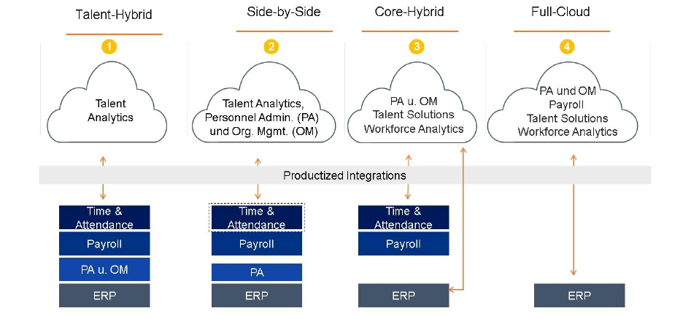
Innovations in S/4HANA
There are various integration options with the existing SAP systems
Based on the business requirements, a suitable solution can be selected
The SAP ERP HCM processes can be executed completely in the cloud, on-premise or with a combination of both variants in a hybrid implementation

Slide 45
Innovations in S/4HANA
only the Software components SAP-HR and EA-HR are still available in SAP S/4HANA, when using the Compatibility mode
It´s not planned to provide application simplifications based on the traditional SAP HCM functionalities, such as Fiori-based user interfaces
Conversion of employees to Business Partners
  The new data model in S/4HANA is based on Business Partners (BP)
  A BP must be assigned to each employee

Slide 46
Warehouse Management (WM)
Curriculum: Introduction to S/4HANA using Global Bike

Slide 47
Innovations in S/4HANA
Extended Warehouse Management (EWM)
Long-term the central warehouse management system from SAP
Part of the Supply Chain Execution (SCE) from SAP in contrast to the WM standard
Significant difference: WM system concentrates on internal functions
  Little functionality that provides link to external processes (i.e. contract packaging or transportation)
In addition to the classical properties for structuring and warehouse control → EWM contains Instruments for strategic placement of the warehouse within the supply chain
Detailed picture of the complete warehouse complex → improves the overview of the total quantity of the product in the warehouse
Holdings from several plants can be stored together

Slide 48
Innovations in S/4HANA
Extended Warehouse Management (EWM)

Slide 49
Innovations in S/4HANA
Extended Warehouse Management (EWM)
Scenarios with ECC 6.0
Scenarios with S/4HANA
SAP ERP
ECC 6.0
SAP decentralized EWM
(Advanced)
SAP S/4HANA
SAP decentralized EWM
(Advanced)
Interface
Interface
WM
WM
Embedded EWM
(Basic/Advanced)
Classic illustration with an ERP ECC system
License costs for EWM (decentralized EWM)
WM can be used indefinitely for new launches (as long as ECC 6.0 is still in use)
No SAP support for ERP WM from 2025 onwards
Illustration based on S/4HANA
No EWM license costs for the „Basic Version“ of the integrated EWM
WM usage rights in S/4HANA ends 2025
A change from ECC 6.0 to S/4HANA requires a change to EWM from this point onwards

Slide 50
Innovations in S/4HANA
Extended Warehouse Management (EWM)
Extended Warehouse Management
  Optimization of inventory management (e.g., slotting)
  Inbound process optimization (e.g., deconsolidation)
  Outbound process optimization (e.g., wave management)
  Material Flow Control (MFC)
  Yard management (e.g., TU processing, DAS)
  Laboratory management
  Logistic additional services (VAS, for example, Kitting processing)
  Cross docking
  Inventory process cost accounting
Basic Warehouse Management
  Inventory management
  Inbound processing
  Outbound processing
  Internal stock movements
  inventory procedures
  Reporting
SAP S/4HANA SUPPLY CHAIN
Suite
Optimization of warehousing processes
Extended Warehouse Management
Products
Basic Warehouse Management
Digital Core
Stock security and transparency
S/4 HANA

Slide 51
Innovations in S/4HANA
Extended Warehouse Management - Scope of functions

Slide 52
Innovations in S/4HANA
Extended Warehouse Management - Scope of functions
Optimized warehouse space management
  Different storage facilities (automatic bearings,…) can be arranged in different storage types according to their own requirements
  Stock movements can be better understood as each storage location is mapped in the system
  In addition, each product will receive an optimal storage location according to its size and access frequency
Goods movements
  EWM is used to process all goods movements that affect the warehouse
  Storage capacity and material flows are optimized using put away and removal strategies
  Optimizing takes place individually as required or by using handling units

Slide 53
Innovations in S/4HANA
Extended Warehouse Management - Scope of functions
Stocktaking
  Product related or storage related
  Different monitor with adjustable tolerance groups, over which maximum values can be configured for the calculation of differences
  Additional extras: automatic close out after time limits, inventory procedures according to different priorities, zero check, low stock control
  Radio frequency functionality is integrated in for example Cycle Counting
Planning and monitoring
  Forward-looking load analysis and early intervention in case of faulty warehouse processes
  Extensive monitor functions project a up-to-date picture of all activities in the warehouse
  Actual work in the warehouse can be controlled this way

Slide 54
Innovations in S/4HANA
Extended Warehouse Management - Scope of functions
Wireless data connection
  Controlling the work steps via mobile radio terminals → clear and economical
  The radio frequency connection (RF connection) for mobile data acquisition ensures a fast data transmission
  RF devices receive data from the SAP system and transmit data back, e.g. through barcodes
Warehouse control
  EWM has interfaces to external systems (storage controllers)
  e.g. automated storage and retrieval systems can be integrated for all storage movements

Slide 55
Innovations in S/4HANA
Reasons to Switch to EWM
Reduce costs through better warehouse efficiency, increased labor productivity, and better space utilzation
Increase transparency in stock and processes
Increase flexibility in warehouse process modeling
Implement customer specific put-away and retrieval strategies
Quickly onboard new customers
Better manage value added distribution processes
Strong integration with other SAP solutions
Integrated Material Flow System (MFS) for automated storage and retrieval

Slide 56
Project Management (PS)
Curriculum: Introduction to S/4HANA using Global Bike

Slide 57
Innovations in SAP S/4HANA
All project planning activities will be carried out using the single transaction CJ20N - Project Builder. In the past there were several transactions that were used.
A new graphic user interface will be used to replace Project System Gantt charts, network graphics and hierarchy graphics

Slide 58
Innovations in S/4HANA
Date Planning Transactions
Currently multiple transactions to plan dates
  Project Builder transaction CJ20N for simplification
  But other transactions are still available with S/4HANA 1511/1610, hence not categorized as target architecture
    CN24 and CN24N for cross network scheduling, but not the target architecture as well
    End user need to switch from multiple date planning transactions to single maintenance transaction CJ20N

Slide 59
Innovations in S/4HANA
Project Builder
Target: one single maintenance transaction instead of multiple, partially redundant transactions to maintain projects → Single Point of Entry
  CJ20N Project Builder
Project Builder: Single Point of Entry
  the target for links and references in reports, still classified as relevant for the target architecture, is going to the Project Builder and not longer to other project related transactions
  For reports classified as not strategic anymore the navigation has not been adopted

Slide 60
Innovations in S/4HANA
Graphics
New graphic user interface patterns to replace the following: Project System including Gantt charts, network graphics and hierarchy graphics
Because of this also the following transactions are categorized not as the target architecture:
  CJ27 Project planning board
  CJ2B Change project planning board
  CJ2C Display project planning board
Improved interface patterns might not provide exactly the same functional scope
Existing graphics and corresponding transactions can still be used

Slide 61
Enterprise Asset Management (EAM)
Curriculum: Introduction to S/4HANA using Global Bike

Slide 62
Innovations in S/4HANA in EAM
Companies are moving more and more to proactive maintenance strategies
S/4HANA enables real-time insights of asset performance for timely, relevant decisions
Capabilities of S/4HANA Asset Management:
  Simulate maintenance strategies with respect to cost, risk, and performance
  Analyze data by machines and sensors (OT) to prevent downtime
  Prioritize maintenance activities for scheduling

Slide 63
Innovations in S/4HANA in EAM
Innovations:
  Instant insight into asset system behaviour
  combined view of IT and OT data
    OT: Operational Technology is hardware and software that detects or causes a change by directly monitoring and / or controlling physical devices, processes, and events in the company
  simplified user experience
Goal: Added value through increased return on investment, increased customer satisfaction and lower maintenance costs

Slide 64
Innovations in S/4HANA in EAM
Predictive Maintenance and Service
Powered by SAP HANA in-memory technology
Analyzes large volumes of sensor data (such as temeprature, vibration or rotation speed)
Warning message long before a machine breaks down
Internet of Things (IoT) solution uses real time machine data
  Predict and prevent failures
  Asset manufacturers can improve customer service – operators can maximize equipment uptime
From reactive to proactive maintenance

Slide 65
Innovations in S/4HANA in EAM
EAM – Traditional system
Offline tools and seperate systems
RCM/FMEA
Asset criticality analysis
Asset strategy management
SAP Business Warehouse – business planning and simulation
Reporting and analysis
Planning
SAP ERP
Maintenance plans
Activity-based costing
Maintenance task lists
Planning
Lack of insight due to disparate systems and incomplete reporting capabilites
Analysis based on past performance, not proactively driving asset strategies
No real simulation and forecasting features
Difficult to include OT data into condition-based maintenance plans
Sophisticated analytics only available offline, hence losing transparency of strategy changes

Slide 66
Innovations in S/4HANA in EAM
With SAP S/4HANA
Predictive maintenance and Service
Asset intelligence network*
SAP S/4HANA
Proactive maintenance strategy planning*
Risk and reliability analysis*
Maintenance execution
Risk-based asset lifecycle costing*
*planned
Insight into asset performance, KPIs instantly refreshed
Real-time view into ongoing maintenance activities with the ability to re-plan schedules multiple times a day
Developing maintenance strategies based on reliability centered maintenance (RCM) and failure modes and effects analysis (FMEA) and asset criticality
Planning and budgeting for lifecycle costs (capital expenditure/ operational expenditure) based on risk and performance
Simulation, planning and optimization of maintenance activities
Process integration with predictive maintenance and service and asset intelligence network

Slide 67
Quality Management (QM)
Curriculum: Introduction to S/4HANA using Global Bike

Slide 68
Innovations in S/4HANA in QM
Integrated QM capabilties
Challenge: mass personalization while ensuring consistent quality in every product
Manufacturers require flexible and intergrated QM processes from design to final delivery
With S/4HANA, Quality management becomes fully integrated in the entire quality process
  Improves the Segment of One process
Streamlined and exceptional end user experience together with new functionalities

Slide 69
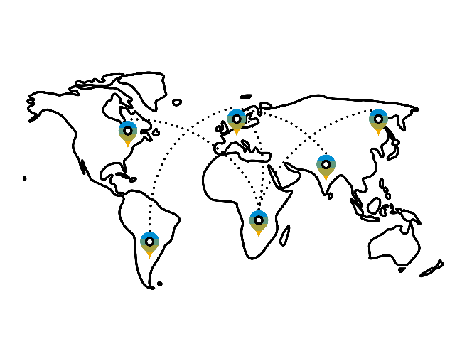




Innovations in S/4HANA in QM
Integrated QM capabilties
SAP S/4 HANA Manufacturing Cloud
Standardization of issue resolution procedures
Simplified inspection planning process
Predictive quality management
Third-party collaboration
Preconfigured QM scenarios
Machine – Learning capabilities
Streamlined test equipment management
Advanced closed loop inspection planning
Comprehensive analysis of quality management
Integrated QM capabilities
IoT connectivity
Digital Core

Slide 70
Innovations in S/4HANA in QM
Preconfigured core processes
Quality Management
Procurement
Quality management in procurement
  Regular quality inspection process at goods receipt
  Quality inspection process with dynamic modification
  Quality inspection process with material-supplier release
Quality management in stock handling
  Post unrestricted or blocked stock to quality inspection stock
  Post quality inspection stock to different storage location
Quality management in discrete manufacturing
  Goods receipt from production
  Within production process
Quality management in sales
  Goods issue only with accepted quality
Inventory Management
Production
Sales

Slide 71
Innovations in S/4HANA in QM
Role-specific Fiori launchpads
Core QM processes supported by new roles
New personalized Fiori launchpads for the following roles:
Typical transactions/ apps are combined in business catalogs and assigned to the different roles
Quality planner
Quality technician
Quality engineer
Creating QM data
Manage plans
Provide basis for inspection
Execute quality inspections
Record the results
Monitoring quality inspections
Analysis of test results
Quality manager
Quality auditor
Calibration technician
Establishing quality standards/ procedures
Set up of controls
Check products based on specific inspection plans
make sure that testing devices are calibrated correctly

Slide 72
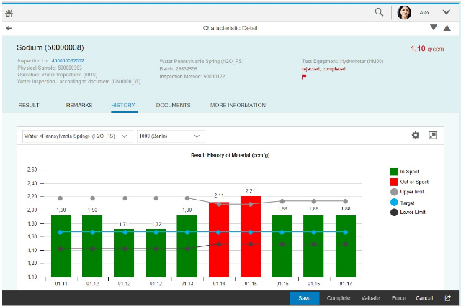
Innovations in S/4HANA in QM
New Fiori apps
New Fiori apps with exceptional end user experience together with new functionalities
  For example: App for recording results of quality inspections
  Quality technicians can record the results of their quality inspection easily and efficiently
In order to achieve this the app provides flexible and state-of-the-art worklists

